Slide 1
Fast 2D Travel Time Fields and Ray Tracing Calculations in Strongly Anisotropic Media
James Ludlam[1]
Supervisors/Collaborators: Katy Tant[1], Victorita Dolean[1], Andrew Curtis[2]
[1] University of Strathclyde, [2] University of Edinburgh

Slide 2
Motivation of this work
Inversion of time of flight data for velocity medium
Many inversion techniques require forward model to be run many times
High computational efficiency is required

Slide 3
Outline
Fast marching method
New anisotropic travel times forward model
New method for anisotropic ray tracing
Future work

Slide 4
Fast marching method

Slide 5
Fast Marching Method (FMM)
The Fast Marching Method (Sethian 1999) calculates the shortest time for a wave to travel from a source to all points on a grid
Similar to Dijkstra’s algorithm (Dijkstra 1959), but uses a finite difference method to solve the Eikonal equation to calculate travel times
$$\left|∇u(x, y)\right|= \frac{1}{V(x, y)}$$
Often used for isotropic media
Sethian, J. A. (1999). Fast Marching Methods. SIAM Review, 41(2), 199–235
Dijkstra, E. W. (1959). A note on two problems in connexion with graphs. Numerische Mathematik, 1(1), 269–271

Slide 6
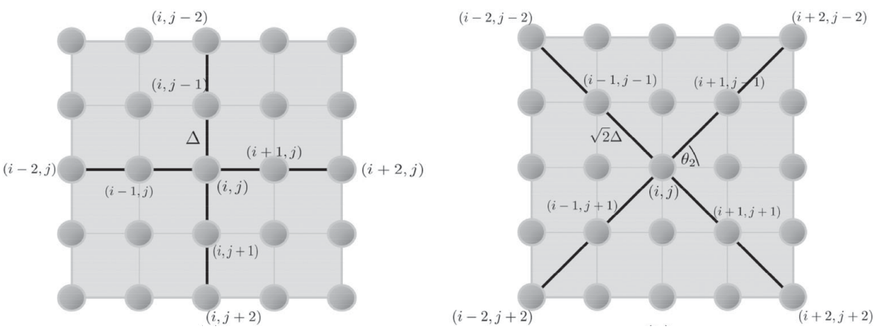
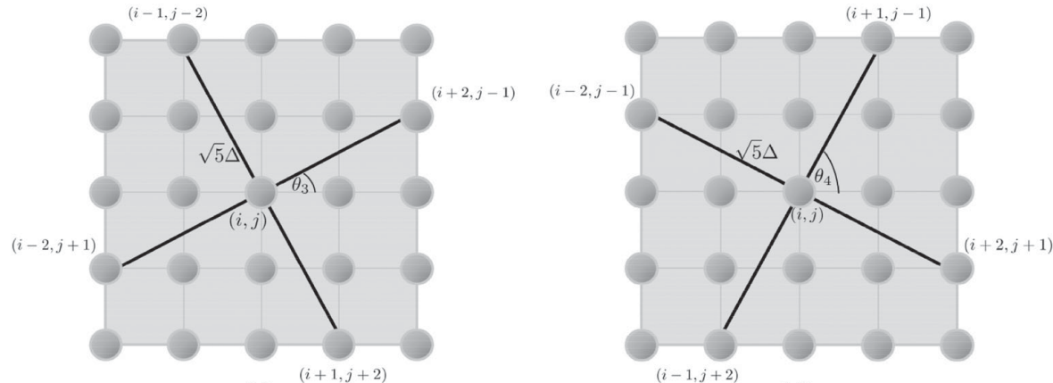
Anisotropic Fast Marching Method
Anisotropic Multi-Stencil Fast Marching Method (AMSFMM) uses a 25 point finite difference scheme with 4 stencils
The velocity used in the finite difference scheme is determined by the orientation of the stencil
Materials must have $90°$ rotational symmetry
Travel time fields have a large bias
K. M. M. Tant, E. Galetti, A. J. Mulholland, A. Curtis, A. Gachagan. Effective grain orientation mapping of complex and locally anisotropic media for improved imaging in ultrasonic non-destructive testing

Slide 7
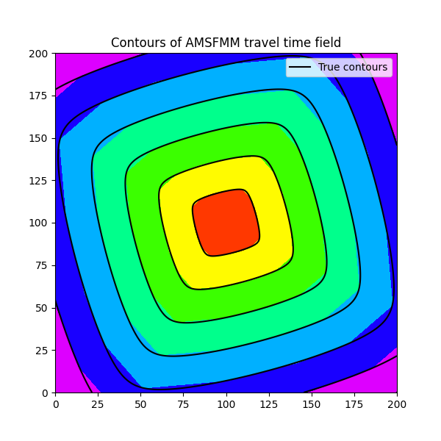
Anisotropic Fast Marching Method
Anisotropic Multi-Stencil Fast Marching Method (AMSFMM) uses a 25 point finite difference scheme with 4 stencils
The velocity used in the finite difference scheme is determined by the orientation of the stencil
Materials must have $90°$ rotational symmetry
Travel time fields have a large bias
$$∆y$$
$$∆x$$

Slide 8
Anisotropic Fast Marching Method
Anisotropic Multi-Stencil Fast Marching Method (AMSFMM) uses a 25 point finite difference scheme with 4 stencils
The velocity used in the finite difference scheme is determined by the orientation of the stencil
Materials must have $90°$ rotational symmetry
Travel time fields have a large bias
$$∆y$$
$$∆x$$

Slide 9
New Anisotropic Travel Times Forward Model

Slide 10
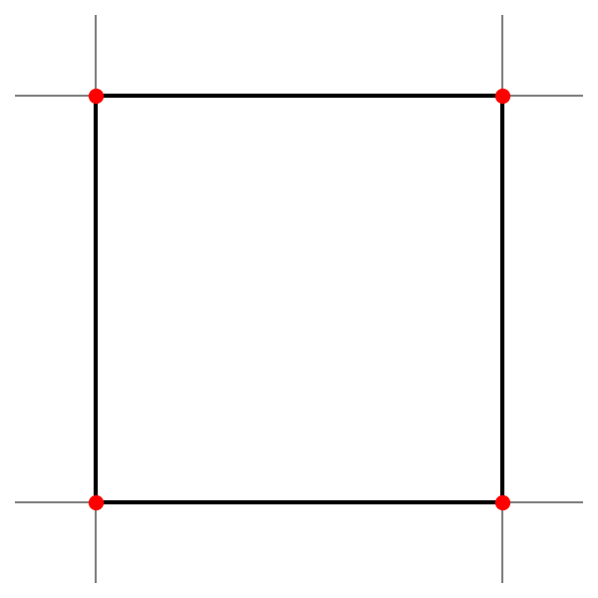
Forward Model
Travel times are calculated in order of travel time
Finite difference method approximates wavefront as local planar
Four points are selected which form a stencil

Slide 11
Forward Model
Unknown travel time
$$C$$
$$D$$
𝑡(𝐴) < 𝑡(𝐵) ≤ 𝑡(𝐶) where 𝑡( ) is the travel time
$$A$$
$$B$$

Slide 12
Forward Model
$$C$$
$$D$$
𝑡(𝐴) < 𝑡(𝐵) ≤ 𝑡(𝐶) where 𝑡( ) is the travel time
Find the point $E$ on line $AC$ where the travel time ($t(E)$) equals $t(B)$ using linear interpolation
$t\left(B\right)=\left(1−a\right)t\left(A\right)+at\left(C\right)$ for some $a ∈[0, 1]$
$a= \frac{t\left(B\right)−t(A)}{t\left(C\right)−t(A)}$
$E = (1−a) A + a C$
$$E$$
$$A$$
$$B$$

Slide 13
Forward Model
$$C$$
$$D$$
Line 𝐸𝐵 is the approximate wavefront
$$E$$
$$A$$
$$B$$

Slide 14
Forward Model
$$C$$
$$D$$
Line 𝐸𝐵 is the approximate wavefront
Length and direction of 𝐹𝐷 → time 𝑡(𝐷)
Estimated using a finite difference approximation to the Eikonal Equation
$$\left|∇u(x, y)\right|= \frac{1}{V(x, y)}$$
$$E$$
$$F$$
Anisotropic phase velocity normal to wavefront
$$A$$
$$B$$

Slide 15
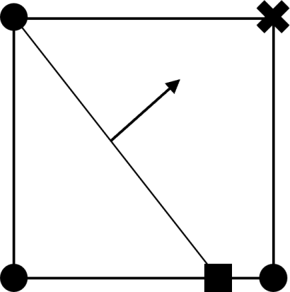
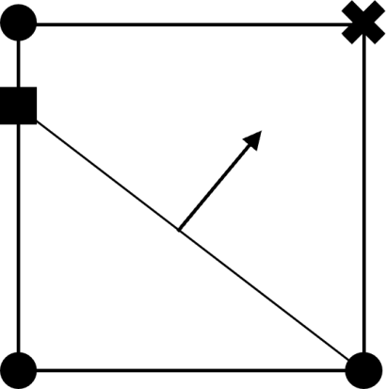
Forward Model
$$B$$
$$D$$
All stencils come in pairs
Use the same points with B and C swapped
Condition that 𝑡(𝐵)≤𝑡(𝐶) holds for one of the pair
𝐸 is always between 𝐴 and 𝐶
$$A$$
$$E$$
$$C$$
$$C$$
$$D$$
$$E$$
$$A$$
$$B$$

Slide 16
Forward Model
$$B$$
$$(i\text{−}1,j\text{+}1)$$
$$C$$
$$(i\text{−}1,j\text{+}1)$$
$$E$$
$$B$$
$$D$$
$$C$$
$$D$$
$$(i\text{−}1,j)$$
$$(i,j)$$
$$(i\text{−}1,j)$$
$$(i,j)$$
$$E$$
$$A$$
$$(i\text{−}2,j)$$
$$D$$
$$(i,j)$$
$$A$$
$$(i\text{−}2,j)$$
$$D$$
$$(i,j)$$
$$A$$
$$(i\text{−}1,j\text{−}1)$$
$$E$$
$$C$$
$$(i,j\text{−}1)$$
$$A$$
$$(i\text{−}1,j\text{−}1)$$
$$B$$
$$(i,j\text{−}1)$$
$$E$$
$$C$$
$$(i\text{−}1,j\text{−}1)$$
$$B$$
$$(i\text{−}1,j\text{−}1)$$
Square stencils used for finite difference method along with 90⁰, 180⁰ and 270⁰ rotations

Slide 17
Forward Model
$$A$$
$$(i,j+2)$$
$$A$$
$$(i,j+2)$$
$$D$$
$$(i,j)$$
$$D$$
$$(i,j)$$
$$E$$
$$E$$
$$C$$
$$B$$
$$B$$
$$C$$
$$C$$
$$(i,j−1)$$
$$B$$
$$B$$
$$(i,j−1)$$
$$C$$
$$(i,j+1)$$
$$(i+1,j+1)$$
$$(i,j+1)$$
$$(i+1,j+1)$$
$$(i+1,j−1)$$
$$(i+1,j−1)$$
$$E$$
$$E$$
$$D$$
$$(i,j)$$
$$D$$
$$(i,j)$$
$$A$$
$$(i,j−2)$$
$$A$$
$$(i,j−2)$$
Triangular stencils used for finite difference method along with 90⁰, 180⁰ and 270⁰ rotations

Slide 18
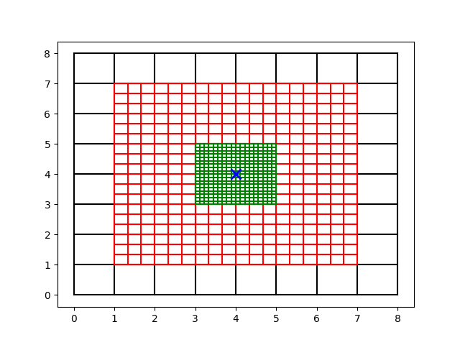
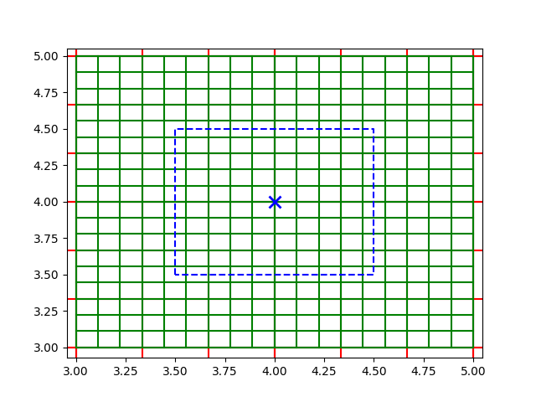
Forward Model
Approximating the wavefront as locally planar is inaccurate around the source
A finer grid is required around the source

Slide 19
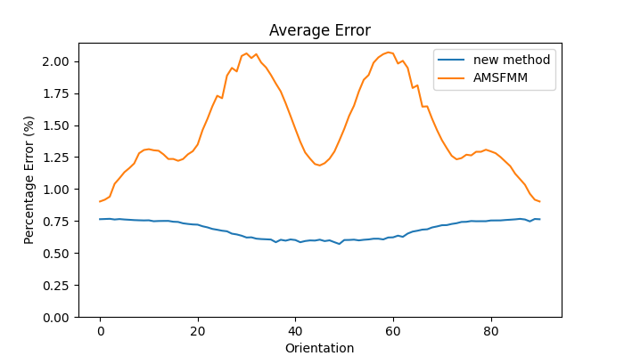
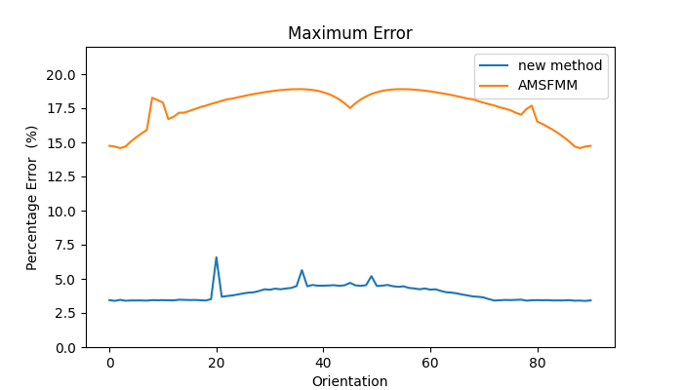
Forward Model
Average Error
Maximum Error
AMSFMM
New Method
Material is an austenitic steel, a cubic material with stiffness tensors $c_{11}=203.6$GPa, $c_{12}=133.5$GPa and $c_{44}=129.8$GPa with density $σ=8774 Kg/m^{3}$

Slide 20
Solving Christoffel Equation at Run Time
Velocities are obtained by solving the Christoffel equation
Constructing a library of velocity curves in advance becomes inefficient when a large variety of materials with different stiffness tensors are used.
Normally velocities are calculated at each integer angle.
Calculating velocities at each point in the grid by solving the Christoffel equation at run time can be more computationally efficient for some models.
Exact group and phase velocities are obtained.

Slide 21
Solving Christoffel Equation at Run Time
Stiffness matrix for orthotropic material in the form
Eigenvector of M gives direction of group angle $φ$
$$c= \left(\begin{matrix}c_{11} & c_{12} & c_{13} & 0 & 0 & 0 \\ c_{12} & c_{22} & c_{23} & 0 & 0 & 0 \\ c_{13} & c_{23} & c_{33} & 0 & 0 & 0 \\ 0 & 0 & 0 & c_{44} & 0 & 0 \\ 0 & 0 & 0 & 0 & c_{55} & 0 \\ 0 & 0 & 0 & 0 & 0 & c_{66}\end{matrix}\right)$$
$$A\left[\begin{matrix}0 \\ \text{cos}(φ) \\ \text{sin}(φ)\end{matrix}\right]$$
Christoffel matrix
for some $A∈ℝ$ (for longitudinal wave).
Group velocity
M$=\left[\begin{matrix}M_{11} & M_{12} & M_{13} \\ M_{21} & M_{22} & M_{23} \\ M_{31} & M_{32} & M_{33}\end{matrix}\right]$
$$V_{g}=\frac{V_{p}}{\text{cos}(θ−φ)}$$
Phase velocity calculated from eigenvalue of M
Polarisation vector for phase angle θ
$$V_{p}= \sqrt{\frac{λ}{σ}}$$
$$\left[\begin{matrix}0 \\ \text{cos}(θ) \\ \text{sin}(θ)\end{matrix}\right]$$
where $σ$ is the density of the material.

Slide 22
Solving Christoffel Equation at Run Time
$$M= \left(\begin{matrix}{{\text{cos}}^{2}(θ)c}_{66}+{\text{sin}}^{2}(θ)c_{55} & 0 & 0 \\ 0 & {\text{cos}}^{2}(θ)c_{22}+ {\text{sin}}^{2}(θ)c_{44} & \cos{(θ)\sin{(θ)(c_{23}+c_{44})}} \\ 0 & \cos{(θ)\sin{(θ)(c_{23}+c_{44})}} & {\text{cos}}^{2}(θ)c_{44}+ {\text{sin}}^{2}(θ)c_{33}\end{matrix}\right)$$
Let$A={\text{cos}}^{2}(θ)c_{22}+ {\text{sin}}^{2}(θ)c_{44}$ , $B= \cos{(θ)\sin{(θ)(c_{23}+c_{44})}}$ and $C= {\text{cos}}^{2}(θ)c_{44} +{\text{sin}}^{2}(θ)c_{33}$
Eigenvalues are:
$$λ={{\text{cos}}^{2}(θ)c}_{66}+{\text{sin}}^{2}(θ)c_{55} \text{a}nd λ= \frac{\left(A+C\right)±\sqrt{{(A−C)}^{2}+4B^{2}}}{2}$$
Since longitudinal velocity is fastest, +ve square
root is longitudinal and –ve is for shear wave.
Shear wave
$$V_{p}=\sqrt{\frac{λ}{σ}}=\sqrt{\frac{\left(A+C\right)+\sqrt{{(A−C)}^{2}+4B^{2}}}{2 σ}}$$

Slide 23
Solving Christoffel Equation at Run Time
$$θ= \left\{\begin{aligned}{\text{tan}}^{−1}\left(\frac{−B −\sqrt{B^{2}+A^{2}−C^{2}}}{C−A}\right)\text{mod} 180 \text{if} 0<φ<90 \\ { \text{tan}}^{−1}\left(\frac{−B+\sqrt{B^{2}+A^{2}−C^{2}}}{C−A}\right)\text{mod} 180 \text{if} 90<φ<180 \\ & φ \text{if} φ \text{mod} 90= 0 \end{aligned}\right.$$
where $A= c_{22}+c_{33} −2c_{44}$, $B=\left(c_{23}+c_{44}\right) \left(\text{tan}\left(φ\right)−\frac{1}{\text{tan}(φ)}\right)$ and $C= c_{22}−c_{33}$
$$λ = \left\{\begin{matrix}\begin{aligned}0.5 \left[\text{cos}\left(2θ\right)\left(c_{22}−c_{44}\right)+\text{sin}\left(2θ\right)\left(c_{23}+c_{44}\right)\text{tan}\left(φ\right)+\left(c_{22}+c_{44}\right)\right] \\ \end{aligned} \\ c_{22} \\ c_{33}\end{matrix}\right.$$
$$\text{if} 0<φ<180$$
$$\text{if} φ \text{mod} 180=0$$
$$\text{if} φ \text{mod} 180=90$$
$$c= \left(\begin{matrix}c_{11} & c_{12} & c_{13} & 0 & 0 & 0 \\ c_{12} & c_{22} & c_{23} & 0 & 0 & 0 \\ c_{13} & c_{23} & c_{33} & 0 & 0 & 0 \\ 0 & 0 & 0 & c_{44} & 0 & 0 \\ 0 & 0 & 0 & 0 & c_{55} & 0 \\ 0 & 0 & 0 & 0 & 0 & c_{66}\end{matrix}\right)$$

Slide 24
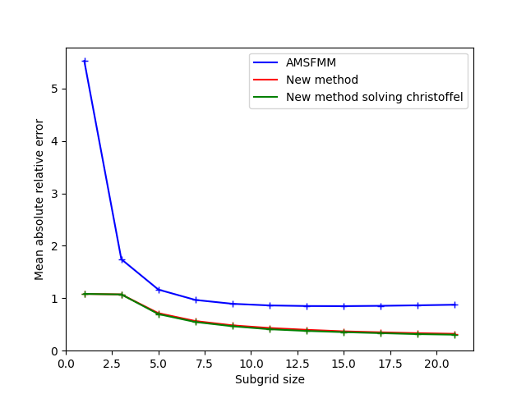
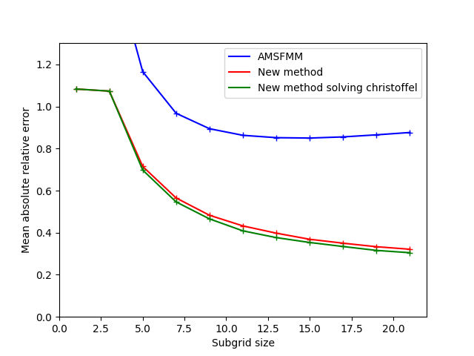
Comparison with the AMSFMM
Error in travel time fields for finer grids with anisotropic orientation of $0°$

Slide 25
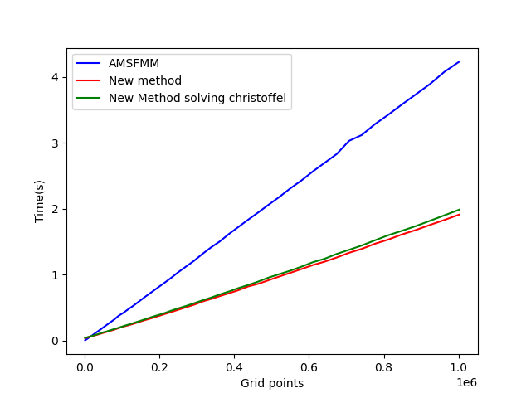
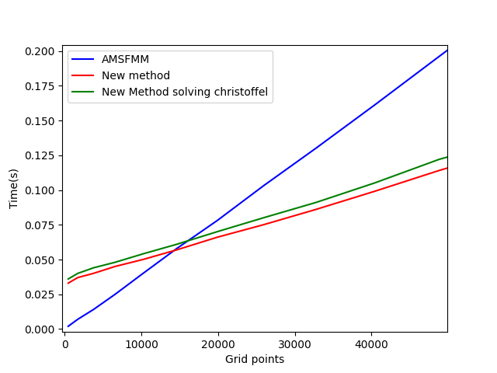
Comparison with the AMSFMM
Compute time of different methods

Slide 26
Anisotropic Ray Tracing

Slide 27
Ray Tracing in Anisotropic Media
Ray used to efficiently calculate gradients of the data w.r.t velocity model parameters for use in gradient based inversion methods.
Methods used for isotropic media can not be applied to anisotropic media
We developed a novel approach to ray tracing in anisotropic media from travel time fields

Slide 28
Ray Tracing in Anisotropic Media

Slide 29
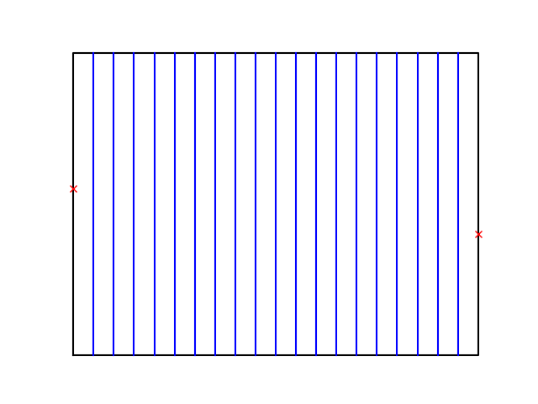
Ray Tracing in Anisotropic Media

Slide 30
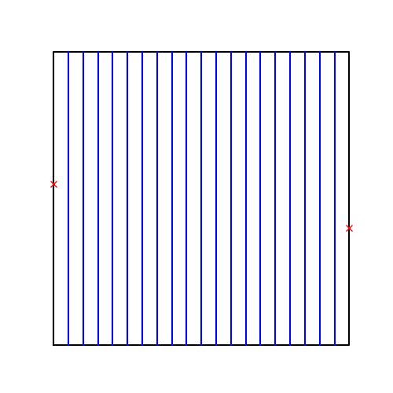
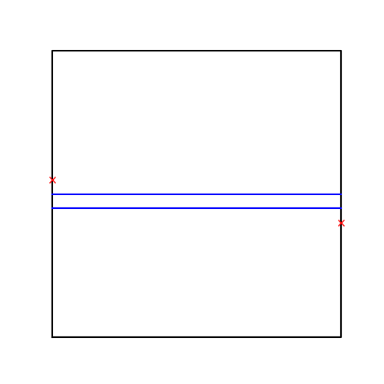
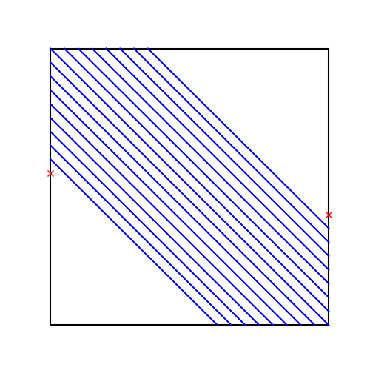
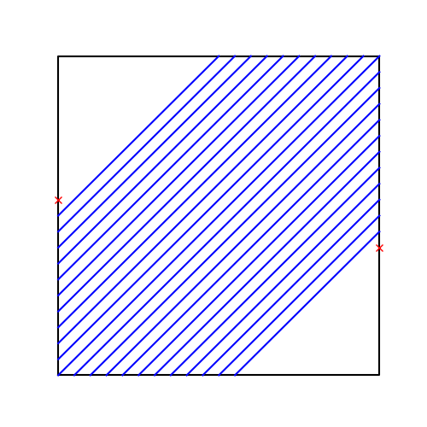
Ray Tracing in Anisotropic Media

Slide 31
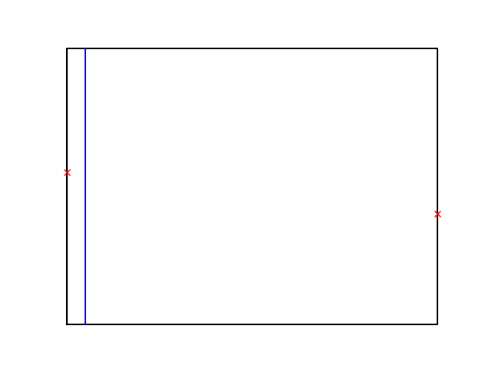
Ray Tracing in Anisotropic Media

Slide 32
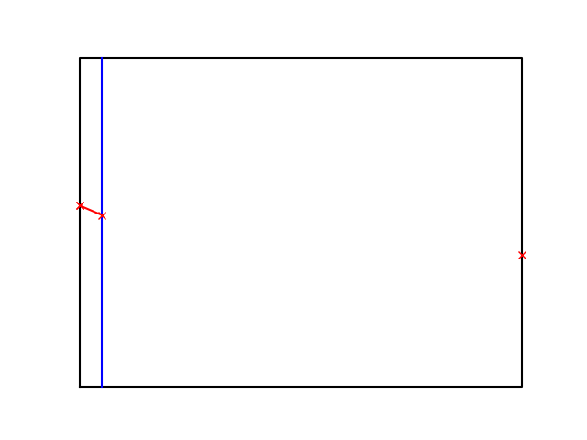
Ray Tracing in Anisotropic Media

Slide 33
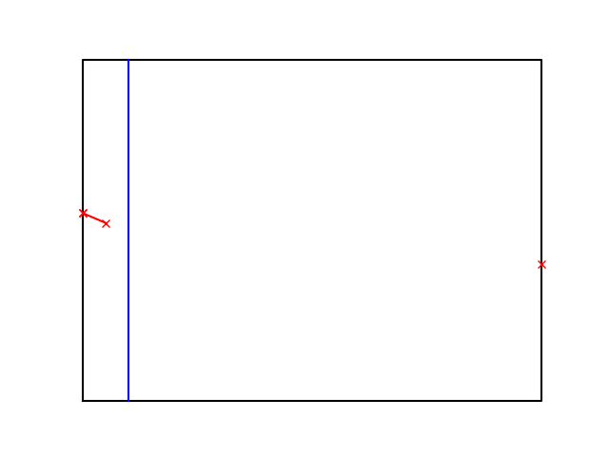
Ray Tracing in Anisotropic Media

Slide 34
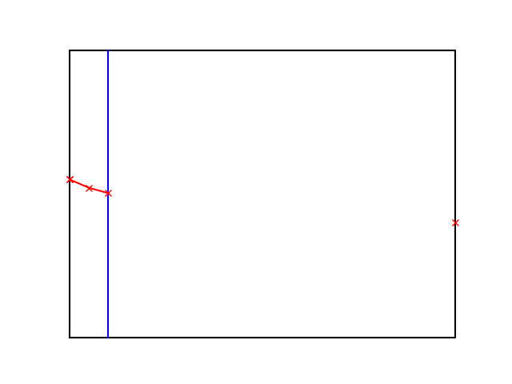
Ray Tracing in Anisotropic Media

Slide 35
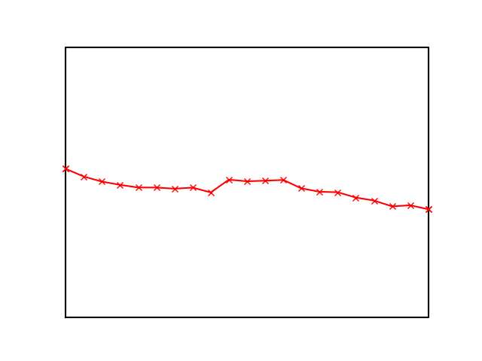
Ray Tracing in Anisotropic Media

Slide 36
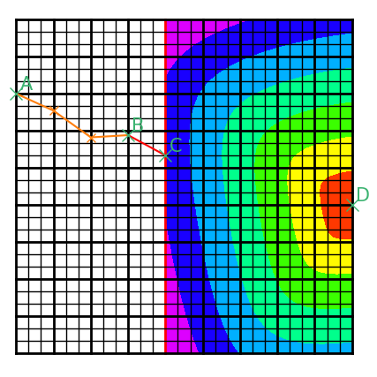
Ray Tracing in Anisotropic Media
Points in the ray path are determined by finding the fastest travel time from the last point in the ray path to the receiver through points on the plane
Travel times are determined using travel time fields and straight rays
Global minimum is estimated by fitting quadratic curves to all local minimum

Slide 37
Ray Tracing in Anisotropic Media
Ray’s calculated using AMSFMM are biased due to bias in travel time fields
Travel time obtained by integrating along the ray path are often more accurate than those obtained from the travel time field

Slide 38
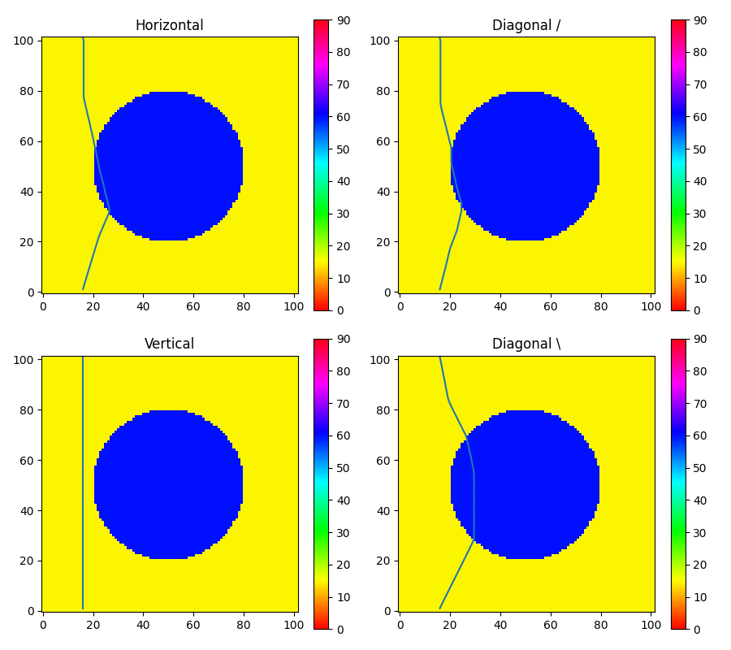
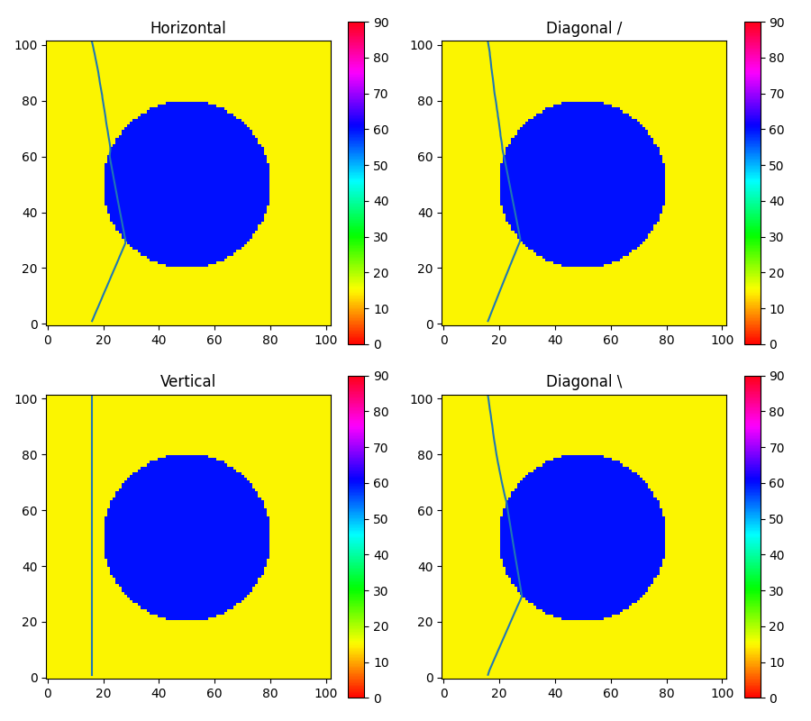
Ray Tracing in Anisotropic Media
t = 1.84106e-05
t = 1.84758e-05
t = 1.82817e-05
t = 1.83111e-05
t = 1.91270e-05
t = 1.85832e-05
t = 1.91270e-05
t = 1.82674e-05
Using AMSFMM
Using new model
travel time from travel time field , t =1.88346e-05
travel time from travel time field , t =1.82975e-05

Slide 39
Ray Tracing in Anisotropic Media
By dynamically switching plane directions more complex ray tracing can be performed
Only one path is calculated making it more efficient than calculating ray path for all plane directions
$$∆y$$
$$∆x$$

Slide 40
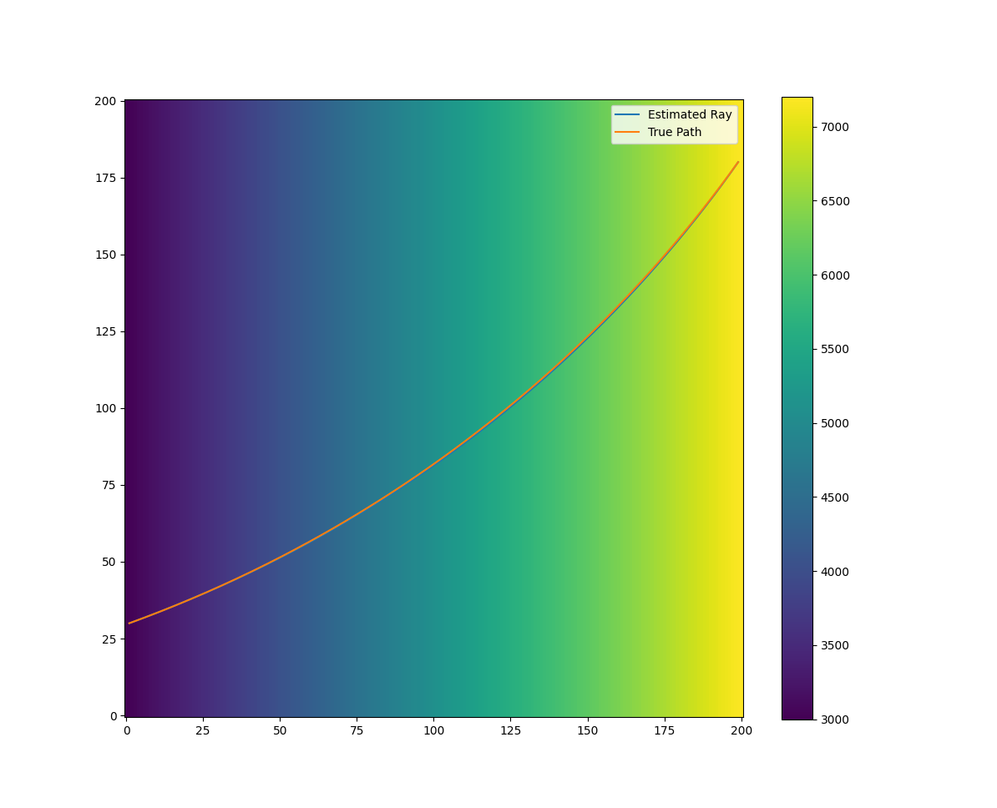
Ray Tracing in Anisotropic Media
$$∆y$$
Velocity (m/s)
$$∆x$$

Slide 41
Summary and Current / Future Work
Summary:
Developed model for travel time propagation with heterogenous anisotropic media
Developed ray tracing algorithm for heterogenous anisotropic media
Current / Future Work:
Non Destructive Testing: Reconstruction of an anisotropic orientation map for an anisotropic weld from time of flight data using Variational Bayesian Inversion (VBI)
Geology: Tomography of anisotropic Earth

