Slide 1
Slowness vector and ray velocity
magnitude from ray direction
in TTI media
Igor Ravve and Zvi Koren, Emerson

Slide 2
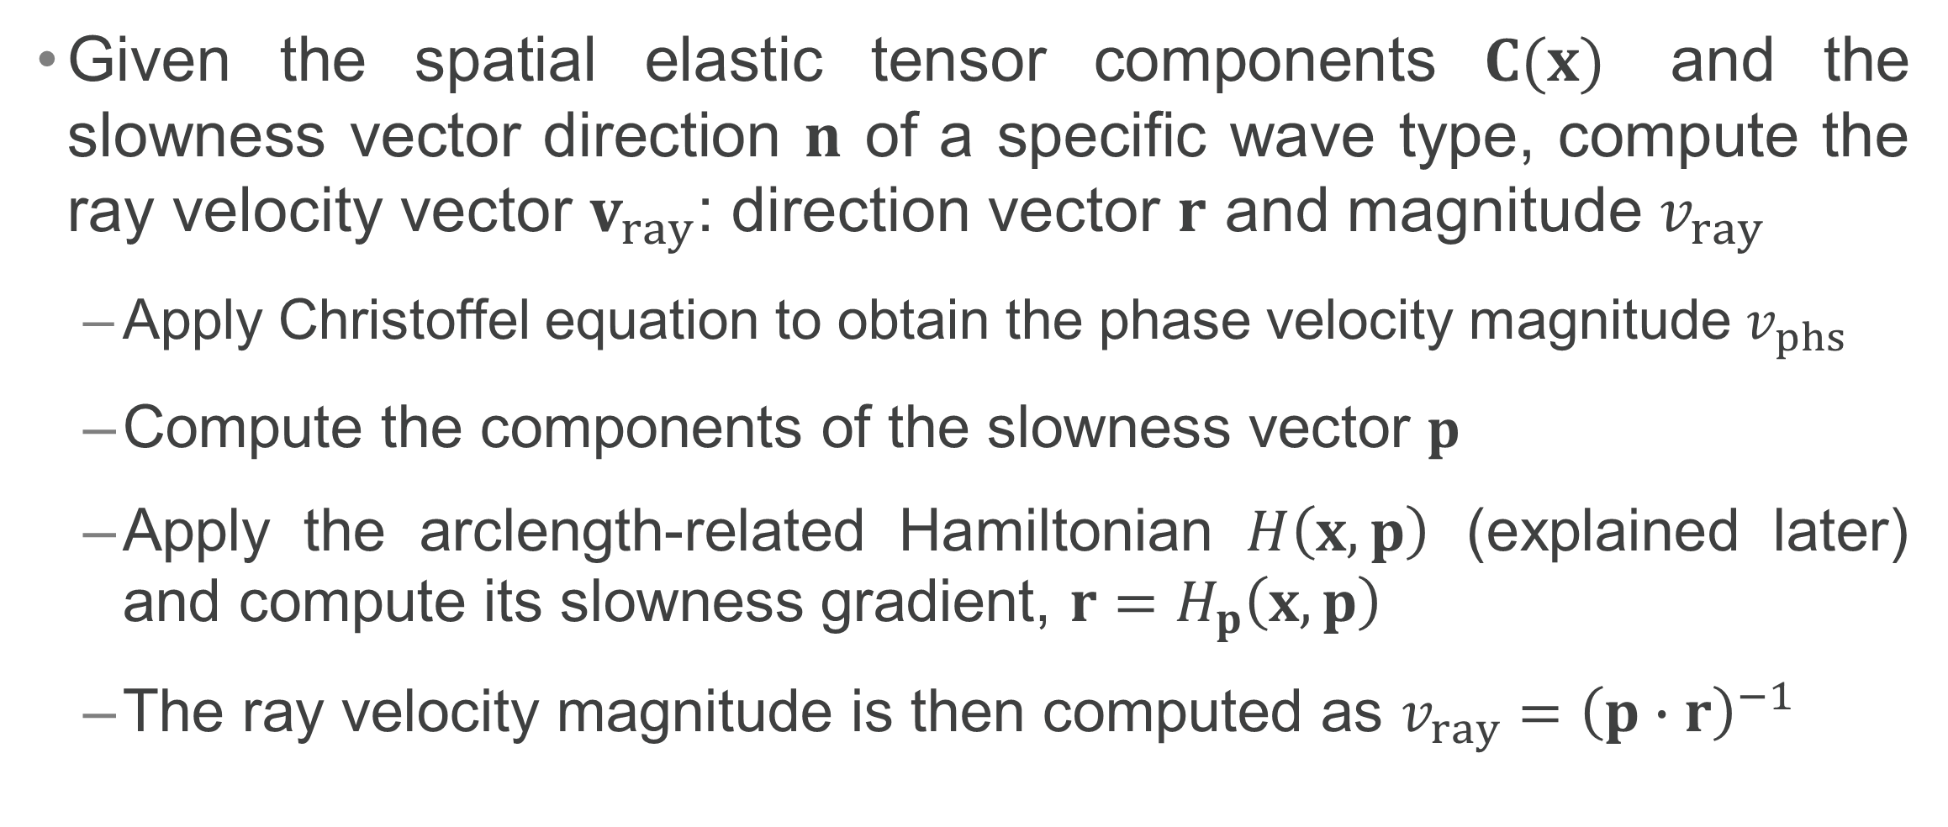
Forward Problem
Given the spatial elastic tensor components $C(x)$ and the slowness vector direction $n$ of a specific wave type, compute the ray velocity vector $v_{ray}$: direction vector $r$ and magnitude $v_{ray}$
  Apply Christoffel equation to obtain the phase velocity magnitude $v_{phs}$
  Compute the components of the slowness vector $p$
  Apply the arclength-related Hamiltonian $H\left(x,p\right)$ (explained later) and compute its slowness gradient, $r=H_{p}\left(x,p\right)$
  The ray velocity magnitude is then computed as $v_{ray}={\left(p∙r\right)}^{−1}$

Slide 3
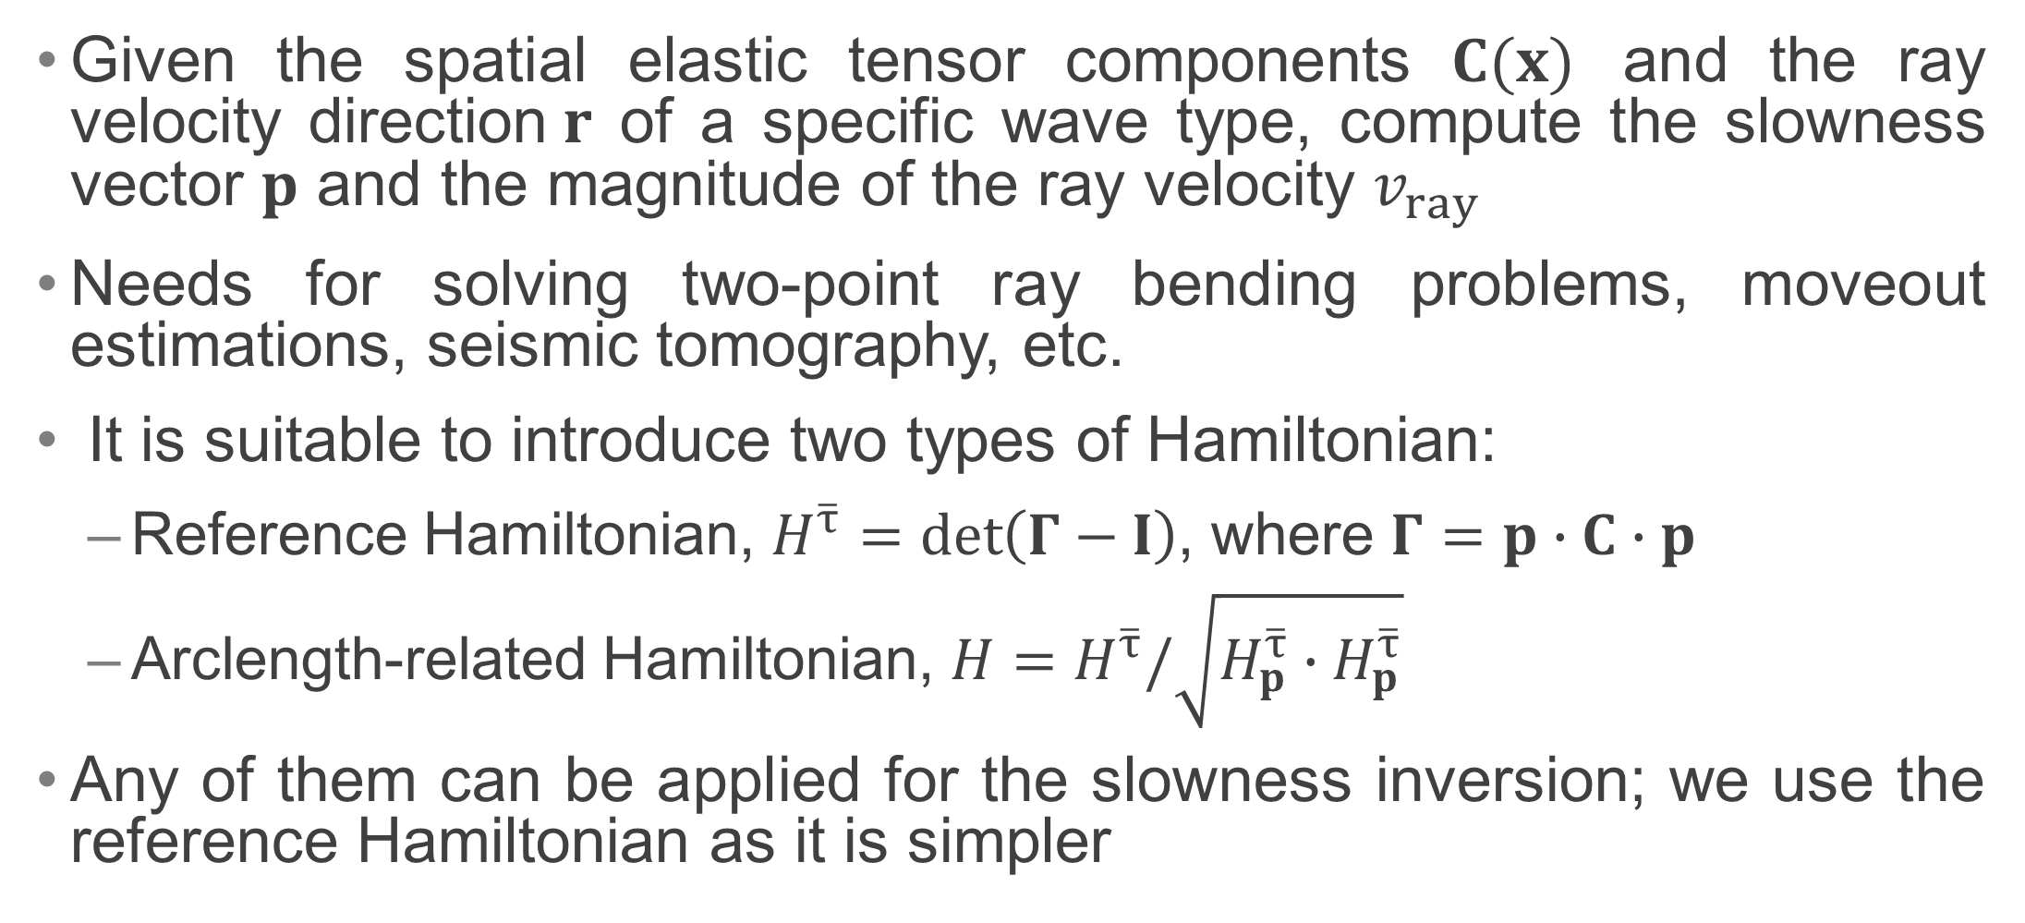
Slowness Inversion
Given the spatial elastic tensor components $C(x)$ and the ray velocity direction$r$ of a specific wave type, compute the slowness vector $p$ and the magnitude of the ray velocity $v_{ray}$
Needs for solving two-point ray bending problems, moveout estimations, seismic tomography, etc.
It is suitable to introduce two types of Hamiltonian:
  Reference Hamiltonian, $H^{\overline{τ}}=\det\left(Γ−I\right)$, where $Γ=p∙C∙p$
  Arclength-related Hamiltonian, $H=H^{\overline{τ}}/\sqrt{H_{p}^{\overline{τ}}∙H_{p}^{\overline{τ}}}$
Any of them can be applied for the slowness inversion; we use the reference Hamiltonian as it is simpler

Slide 4
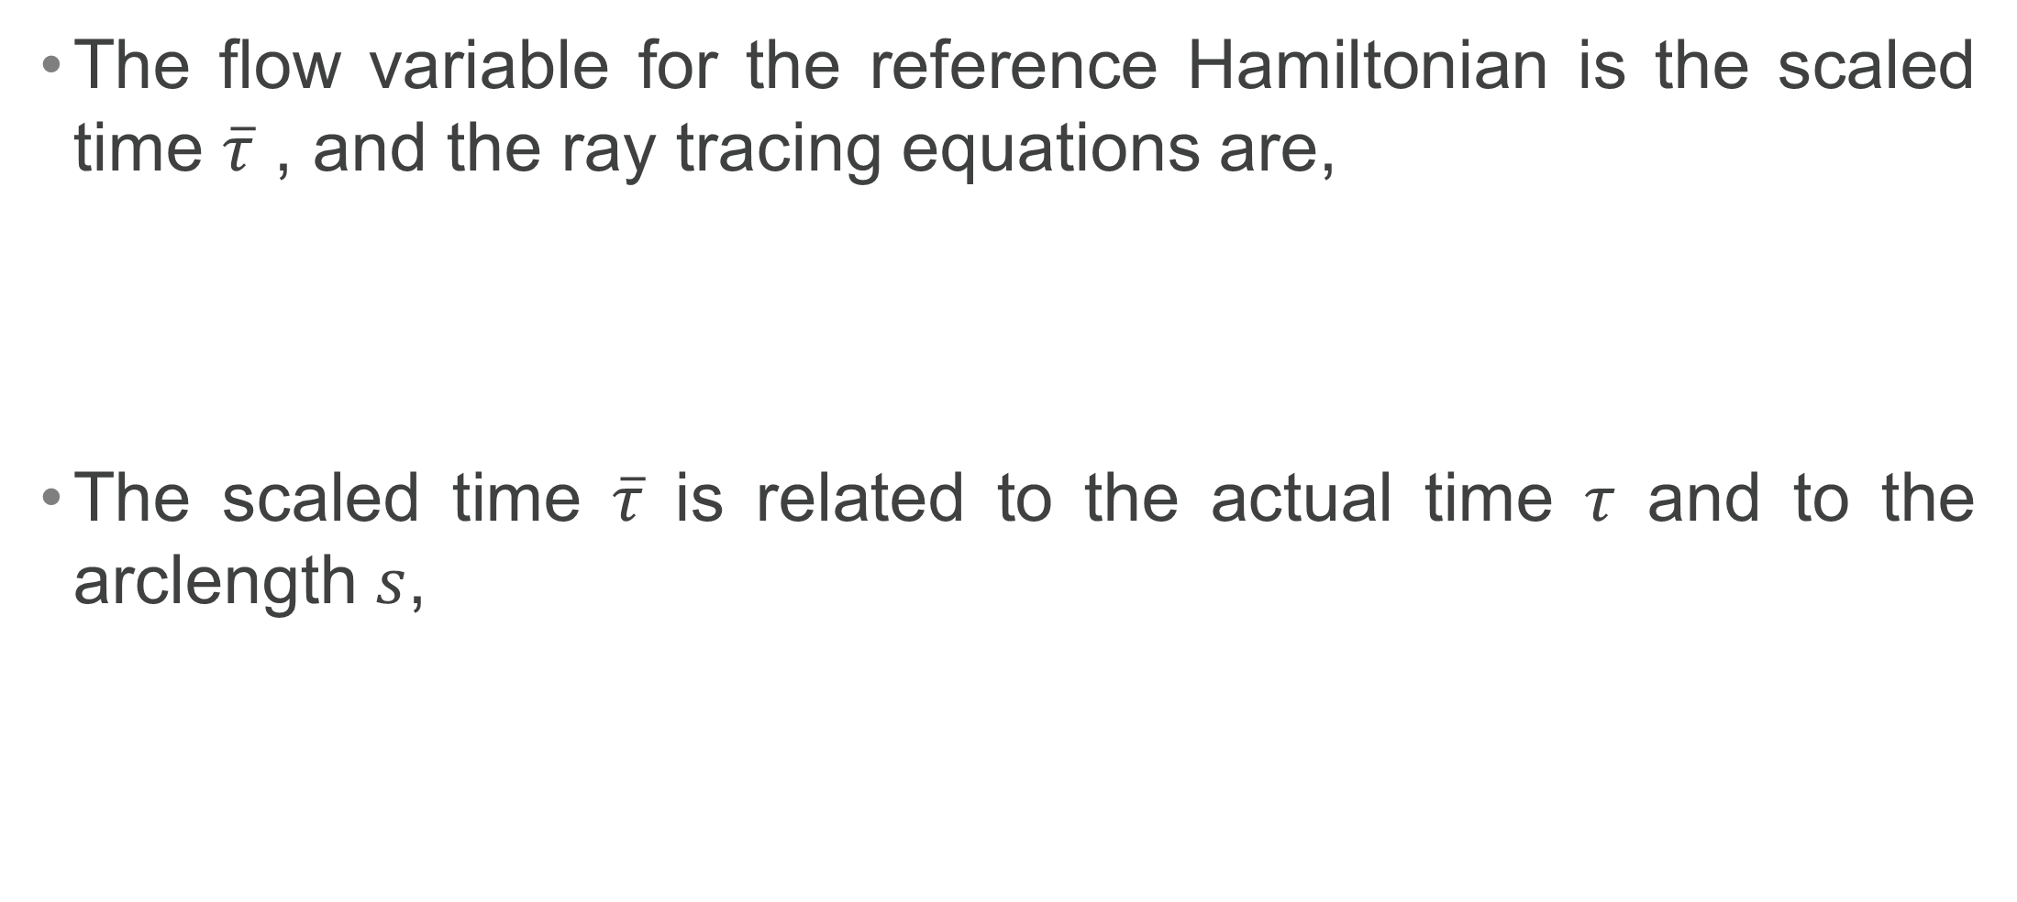
The Reference Hamiltonian
The flow variable for the reference Hamiltonian is the scaled time $\overline{τ}$ , and the ray tracing equations are,
The scaled time $\overline{τ}$ is related to the actual time $τ$ and to the arclength $s$,

Slide 5
The Arclength-Related Hamiltonian
The flow variable in the ray tracing equations is the arclength
Although this Hamiltonian is not applied for the slowness inversion, it is a useful tool for computing the spatial, directional, and mixed first and second derivatives of the ray velocity magnitude
These derivatives, in turn, are needed for the search of the stationary ray path and traveltime, based on the ray-bending approach, and for the subsequent dynamic analysis (primarily, the relative geometric spreading)

Slide 6
Slowness Inversion for General Anisotropy
The resolving equation set for this problem (Musgrave, 1954a, 1954b, 1970; Fedorov, 1968; Helbig, 1994; Grechka, 2017; Koren & Ravve, 2021) can be formulated in our notations as,
The vector equation with the cross-product represents three scalar equations, but they are linearly dependent, so we pick two of them. The third equation is the vanishing Hamiltonian
The unknown values are the three slowness components p_{i}

Slide 7
Algebraic Complexity of Slowness Inversion
The Hamiltonian is a sixth-degree polynomial of the slowness components, and its derivatives are fifth-degree polynomials. A set of two fifth-degree and a sixth-degree polynomials can have at most 5x5x6=150 solutions.
The algebraic degree of the ray (group) velocity surface was studied by Grechka (2017). It was shown that for the case of a general anisotropy, the maximum number of solutions, where the angle between the phase and ray directions is acute, does not exceed 19: a single solution for quasi compressional wave and up to 18 solutions for quasi shear waves

Slide 8
Slowness Inversion for Polar Anisotropy
For polar anisotropy (Transverse Isotropy with tilted axis of symmetry; TTI) the algebraic complexity reduces due to the decoupling of the solution to (1) SH wave, polarized in the isotropic plane, and (2) qP and qSV waves
Analytic solution exists for the SH wave; in this presentation , we concentrate on the two other wave types, whose Hamiltonian is a fourth-degree polynomial

Slide 9
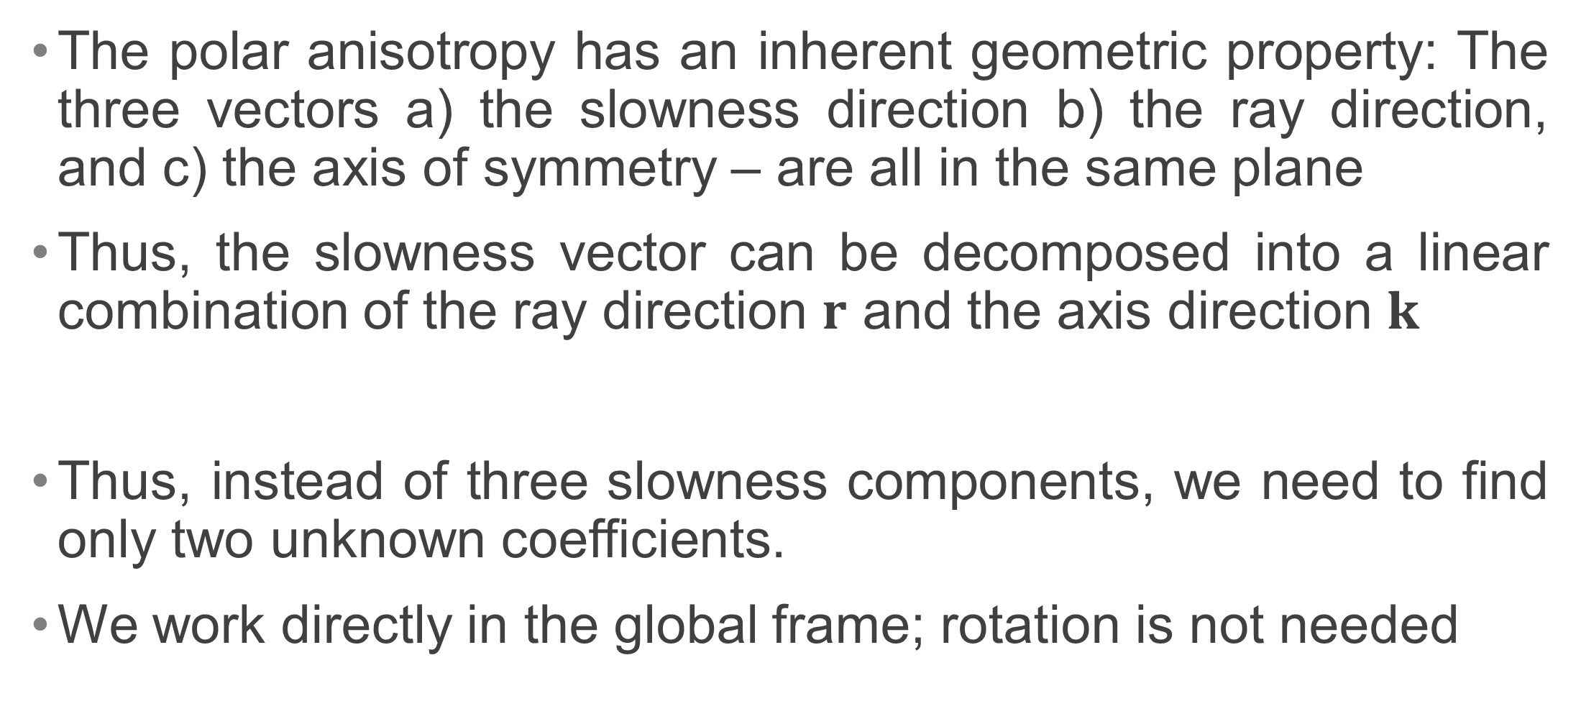
Coplanar Vectors of Polar Anisotropy
The polar anisotropy has an inherent geometric property: The three vectors a) the slowness direction b) the ray direction, and c) the axis of symmetry – are all in the same plane
Thus, the slowness vector can be decomposed into a linear combination of the ray direction $r$ and the axis direction $k$
Thus, instead of three slowness components, we need to find only two unknown coefficients.
We work directly in the global frame; rotation is not needed

Slide 10
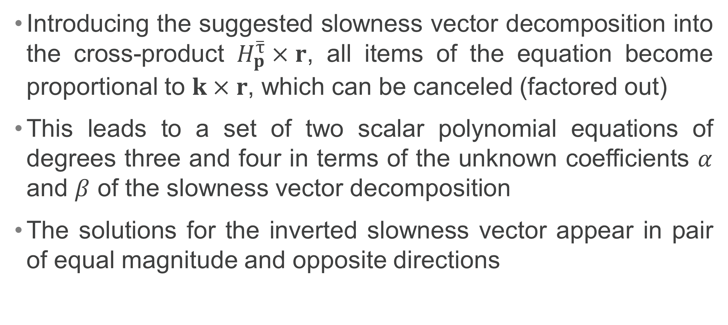
Inversion Equation Set for Polar Anisotropy
Introducing the suggested slowness vector decomposition into the cross-product $H_{p}^{\overline{τ}}×r$, all items of the equation become proportional to $k×r$, which can be canceled (factored out)
This leads to a set of two scalar polynomial equations of degrees three and four in terms of the unknown coefficients $α$ and $β$ of the slowness vector decomposition
The solutions for the inverted slowness vector appear in pair of equal magnitude and opposite directions

Slide 11
Inversion Equation Set (continued)
This set may have up to 3x4=12 solutions, but taking into account the commonly used “acute angle condition”, we remove the six irrelevant solutions and keep the six relevant

Slide 12
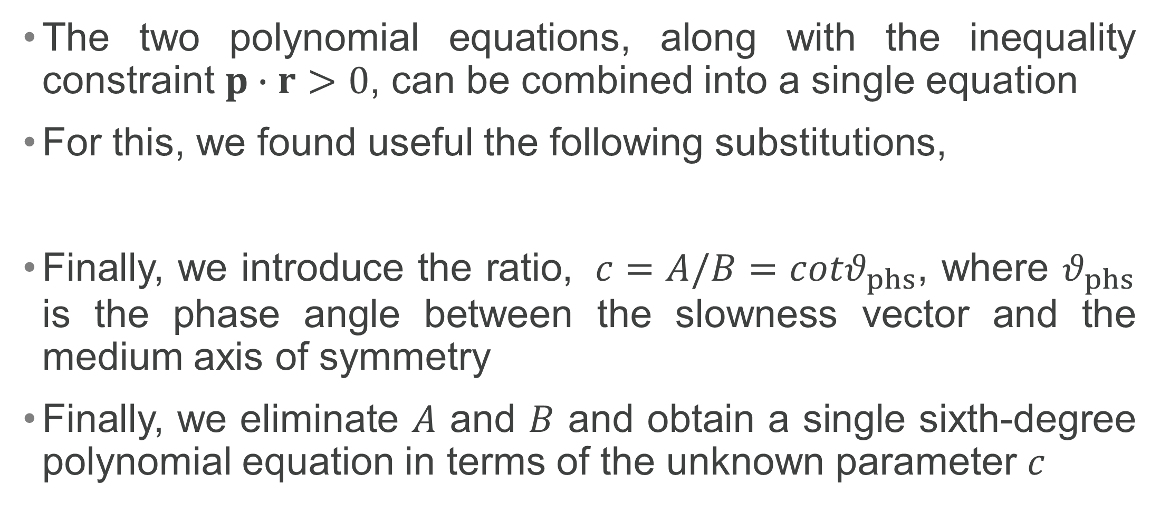
Useful Substitutions
The two polynomial equations, along with the inequality constraint $p∙r>0$, can be combined into a single equation
For this, we found useful the following substitutions,
Finally, we introduce the ratio, ${c=A/B=cotθ}_{phs}$, where $θ_{phs}$ is the phase angle between the slowness vector and the medium axis of symmetry
Finally, we eliminate $A$ and $B$ and obtain a single sixth-degree polynomial equation in terms of the unknown parameter $c$

Slide 13
Resulting Univariate Equation & its Coefficients

Slide 14
Computing Polynomial Roots
The roots of the polynomial are eigenvalues of the so-called companion matrix (e.g., Johnson & Riess, 1982; Edelman & Murakami, 1995; Press et at., 2002); the software for the eigenvalues is widely available

Slide 15
Number of Real Roots
For any values of the medium properties and a ray angle (between the axis of symmetry and the ray direction), the sixth-degree polynomial equation has at least two real roots, for qP and qSV waves
The equation may have four real roots: one for qP wave and three for triplicated qSV wave
There is always at least one pair of complex-conjugate roots, due to the “cuspoid” nature of the ray velocity surface, and there are two pairs of complex-conjugate roots in the absence of a shear-wave triplication (Grechka, 2013; Zhang and Zhou, 2018)

Slide 16
Number of Real Roots (continued)
The number of real roots can be established without solving the sixth-degree polynomial; for this we compute the discriminant of this polynomial
  The positive discriminant means two real roots (no triplication)
  The negative discriminant means four real roots (triplication)
Triplication is likely to occur in the case of essential negative anellipticity

Slide 17
Discriminant of Sixth-Order Polynomial

Slide 18
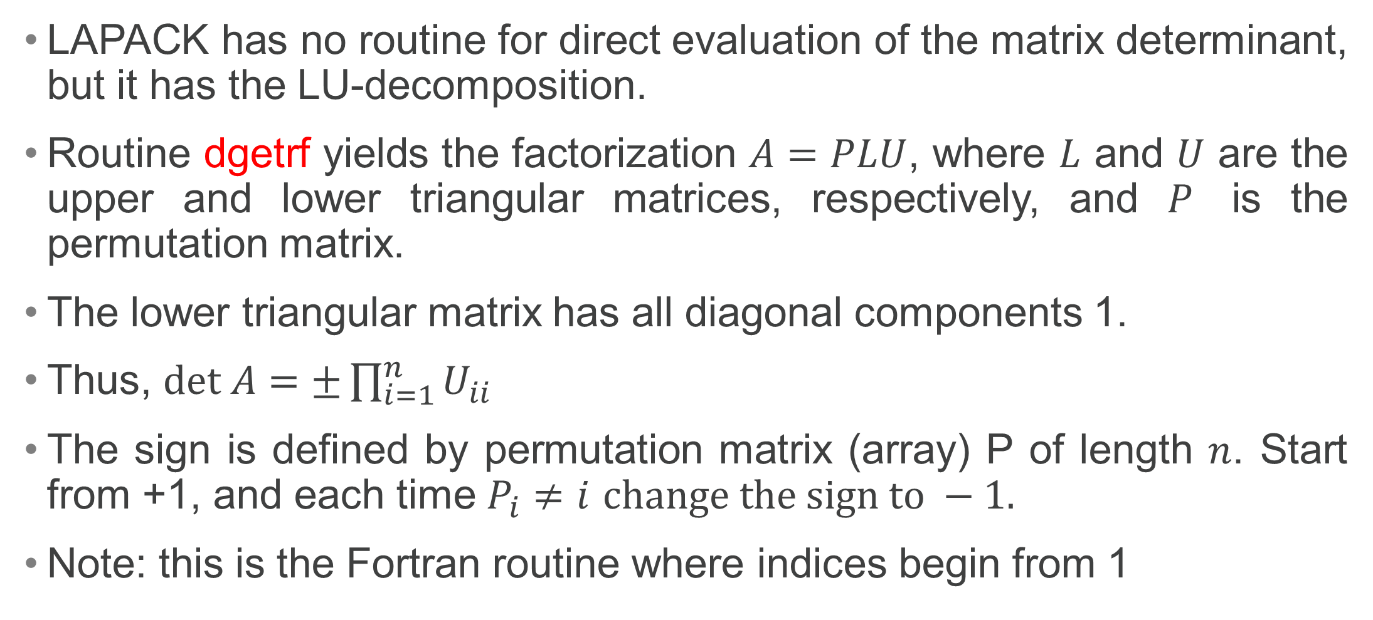
Computing Determinant with LAPACK
LAPACK has no routine for direct evaluation of the matrix determinant, but it has the LU-decomposition.
Routine dgetrf yields the factorization $A=PLU$, where $L$ and $U$ are the upper and lower triangular matrices, respectively, and $P$ is the permutation matrix.
The lower triangular matrix has all diagonal components 1.
Thus, $det A=±\prod_{i=1}^{n}{U_{ii}}$
The sign is defined by permutation matrix (array) P of length $n$. Start from +1, and each time $P_{i}≠i$ $change the sign to −1.$
Note: this is the Fortran routine where indices begin from 1

Slide 19

Particular Case: Acoustic Approximation
In the case of acoustic approximation, $f=1,$the equation reduces to a fourth-degree polynomial

Slide 20

Slowness Direction
After the phase angle is established, one can compute the slowness direction $n$ from the geometric relationship,

Slide 21
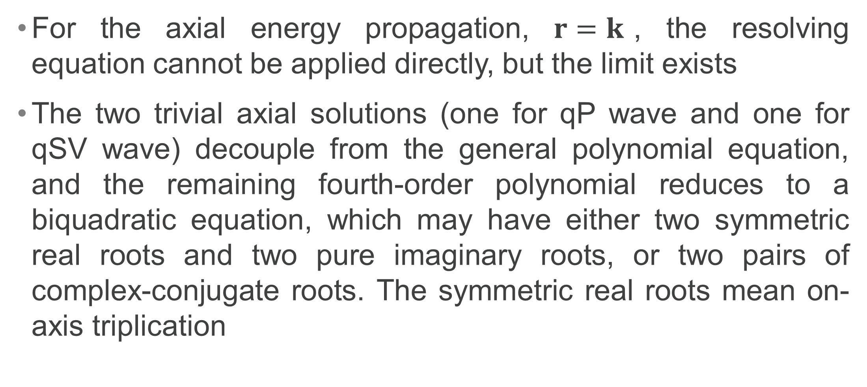
Axial Propagation
For the axial energy propagation, $r=k$, the resolving equation cannot be applied directly, but the limit exists
The two trivial axial solutions (one for qP wave and one for qSV wave) decouple from the general polynomial equation, and the remaining fourth-order polynomial reduces to a biquadratic equation, which may have either two symmetric real roots and two pure imaginary roots, or two pairs of complex-conjugate roots. The symmetric real roots mean on-axis triplication

Slide 22

Analytic Solution for SH Wave
The slowness vector reads,
The phase and ray velocity magnitudes are,
where $v_{P}$ is the axial compressional velocity

Slide 23
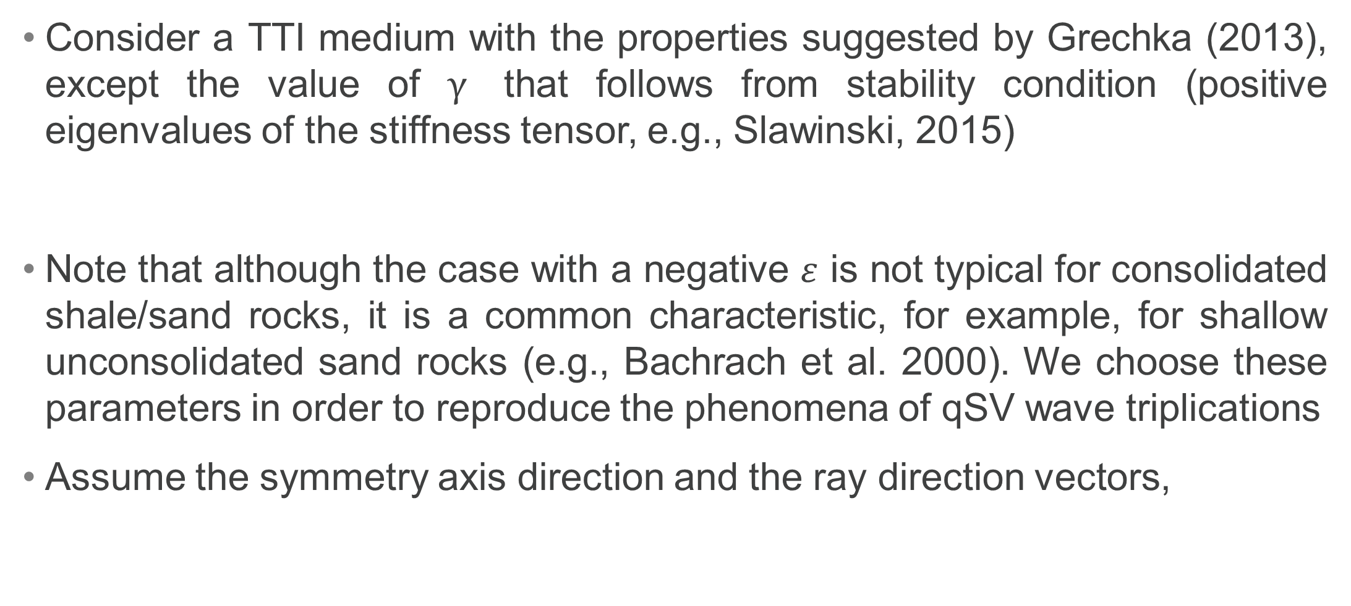
Example with Triplication
Consider a TTI medium with the properties suggested by Grechka (2013), except the value of $γ$ that follows from stability condition (positive eigenvalues of the stiffness tensor, e.g., Slawinski, 2015)
Note that although the case with a negative $ε$ is not typical for consolidated shale/sand rocks, it is a common characteristic, for example, for shallow unconsolidated sand rocks (e.g., Bachrach et al. 2000). We choose these parameters in order to reproduce the phenomena of qSV wave triplications
Assume the symmetry axis direction and the ray direction vectors,

Slide 24

Resolving Polynomial Roots
Compute the coefficients of the monic polynomial (i.e., with $\tilde{d_{6}}=1$)
Compute the four real roots, and a pair of the complex-conjugate roots

Slide 25
Phase Angles

Slide 26
Phase Direction Vectors

Slide 27
Which Solution Relates to Compressional Wave?
To understand, which of the four solutions is related to a quasi-compressional wave, we compute the ray angles (between the ray velocity and the medium axis of symmetry)
First, we assume that any of the four solutions may be related to both qP and qSV waves, and obtain eight ray angles: four for each wave type
Four of these angles will coincide with the given ray angle, while the other four are irrelevant and should be discarder. Among the four relevant solutions, the qP solution is unique

Slide 28
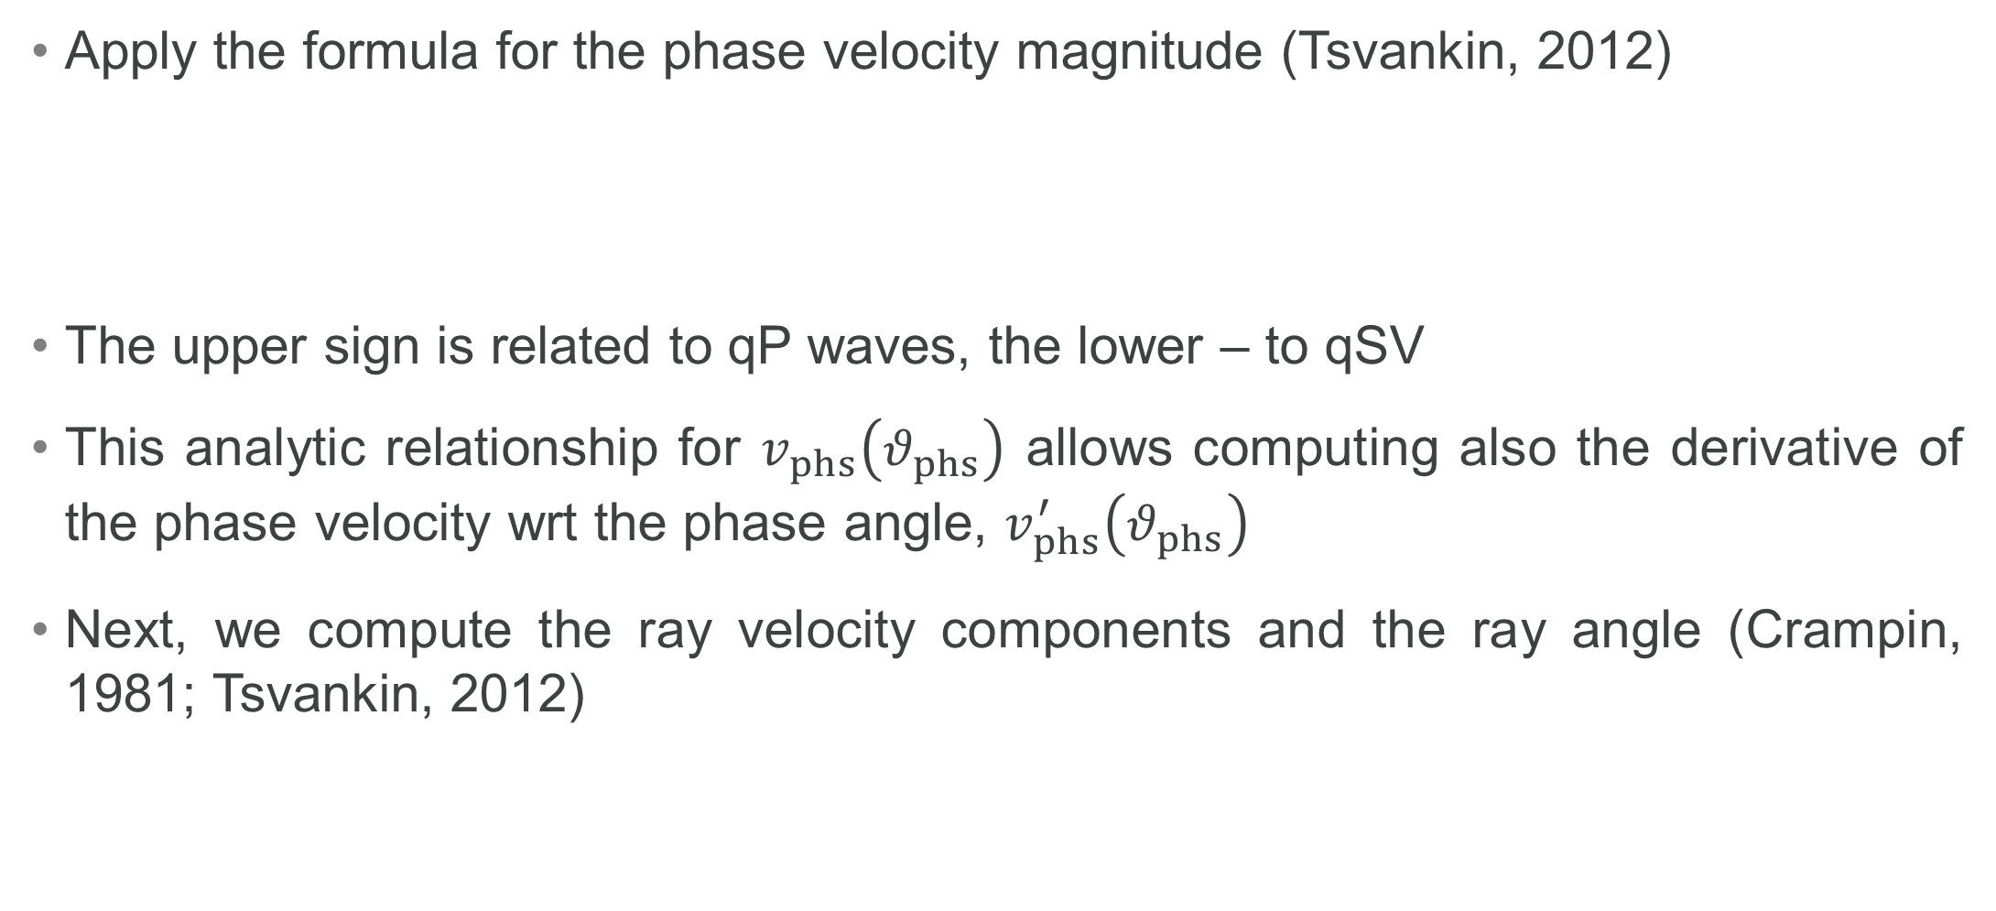
Computing Ray Angles
Apply the formula for the phase velocity magnitude (Tsvankin, 2012)
The upper sign is related to qP waves, the lower – to qSV
This analytic relationship for $v_{phs}\left(θ_{phs}\right)$ allows computing also the derivative of the phase velocity wrt the phase angle, $v_{phs}^{′}\left(θ_{phs}\right)$
Next, we compute the ray velocity components and the ray angle (Crampin, 1981; Tsvankin, 2012)

Slide 29
Computed Ray Angles
The relevant solutions are in blue, the irrelevant – in red
We conclude that the solution with index 1 is related to qP wave, while those with indices 0, 2, 3 are related to qSV waves

Slide 30
Can we Avoid Computing Ray Angles?
In the case when only compressional solution is needed, we apply the formula for the phase velocity with the plus sign only. Then in only one of the solutions, the computed ray angle will match the given ray angle
In the case when the slowness vector inversion is performed many times along the stationary ray path or its approximation, for the points close to each other, there may be no need to compute the ray angles to identify the qP wave and the “branches” of the triplicated qSV. This identification may be done basing on the results for the previous points

Slide 31
Slowness components
Given the formula for the phase velocity, we compute the slowness magnitudes
Next, given the phase directions and the slowness magnitude, we compute the slowness vector components for all solutions, and the corresponding ray velocity magnitudes.

Slide 32
Summary of Results, [V] = km/s , [p] = s/km
Mode | qP_{ac} | qP | qSV₁ | qSV₂ | qSV₃ | SH
c
p₁
p₂
p₃
_{Vphs}
_{Vray}
ϑ_{phs}
Δϑ

Slide 33
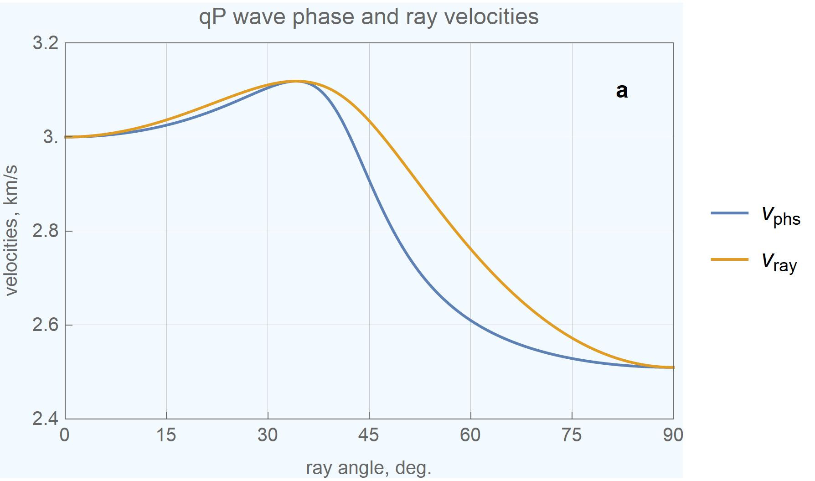
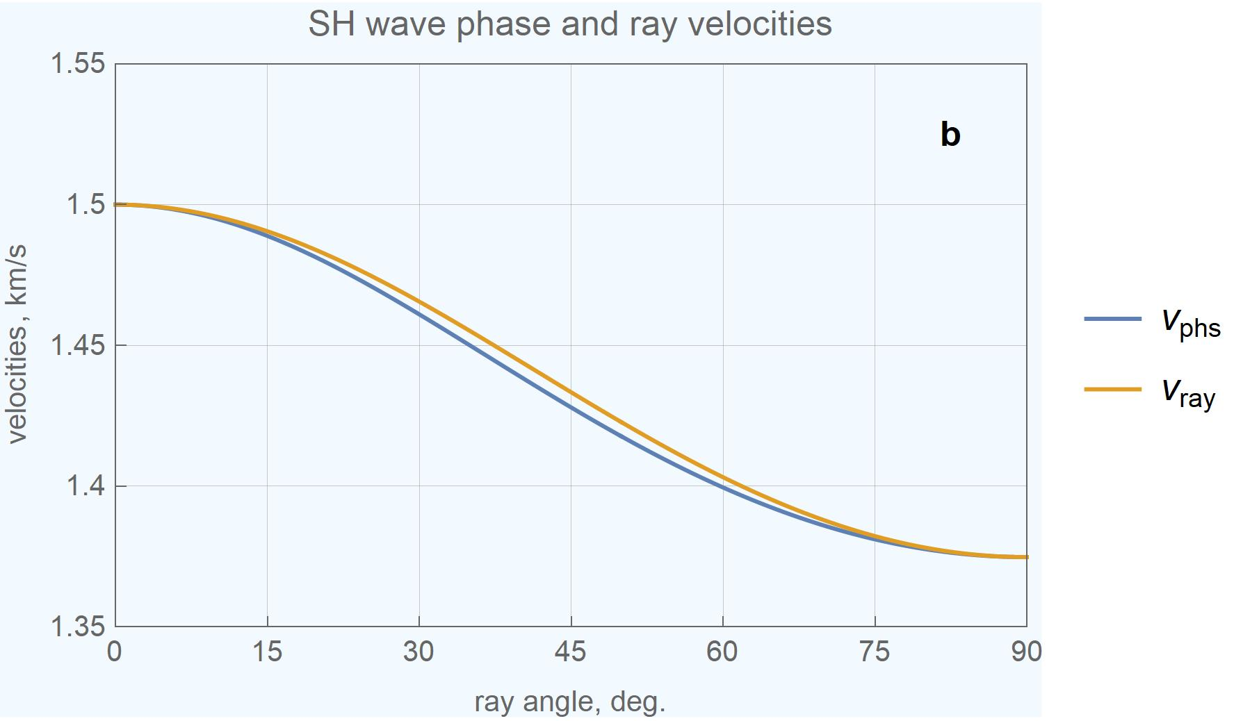
Phase and Ray Velocities of qP & SH Waves

Slide 34
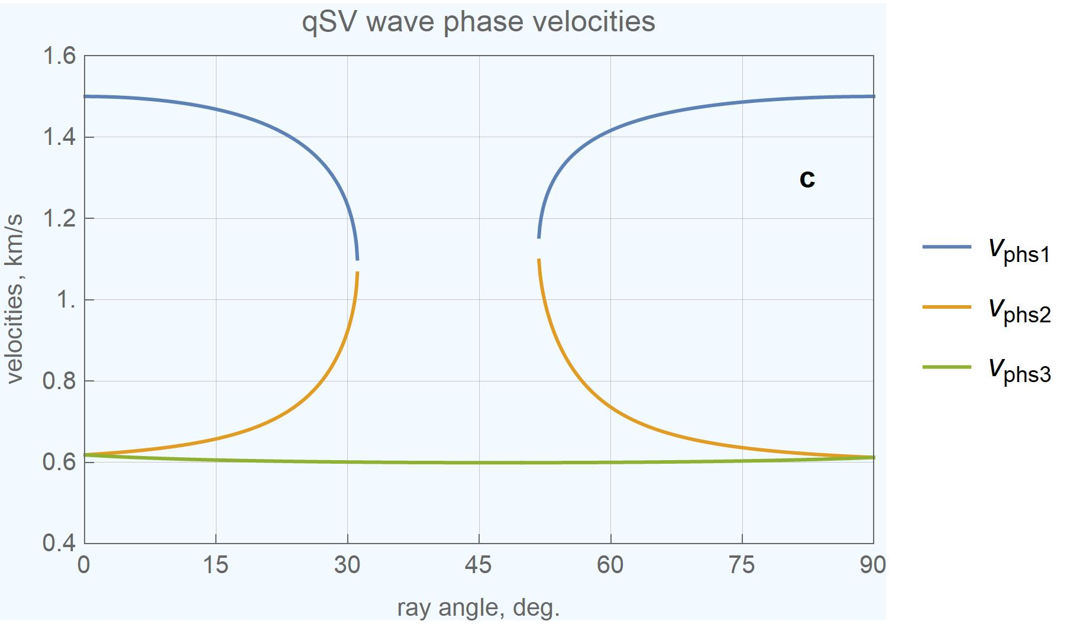
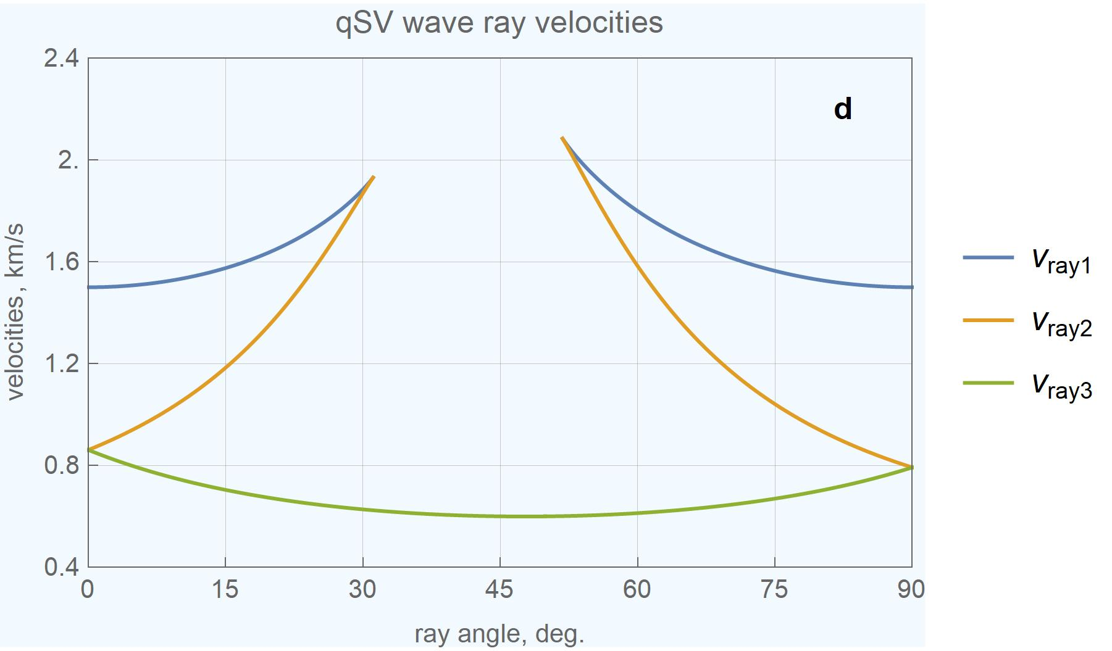
Phase and Ray Velocities of qSV Waves

Slide 35
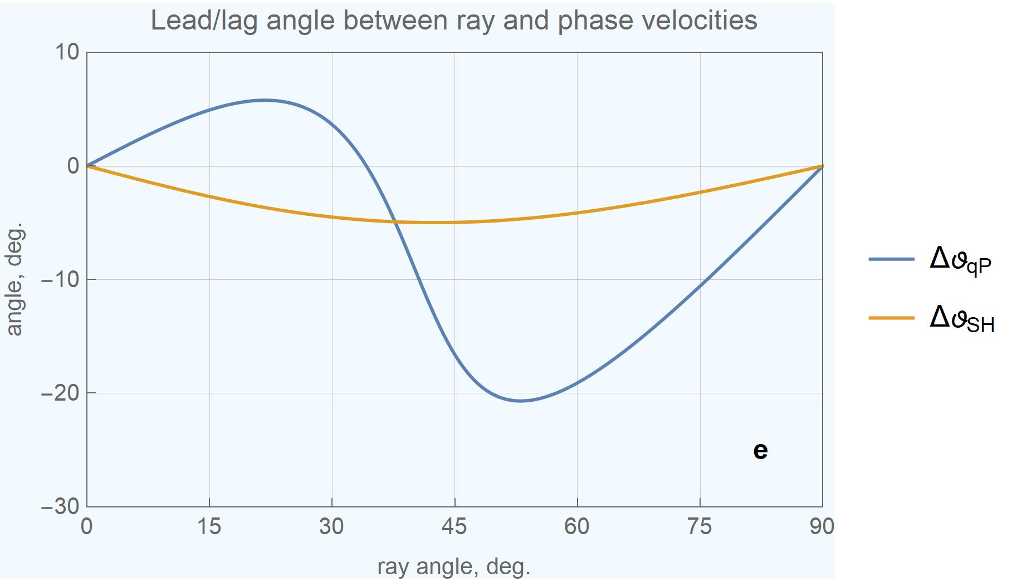
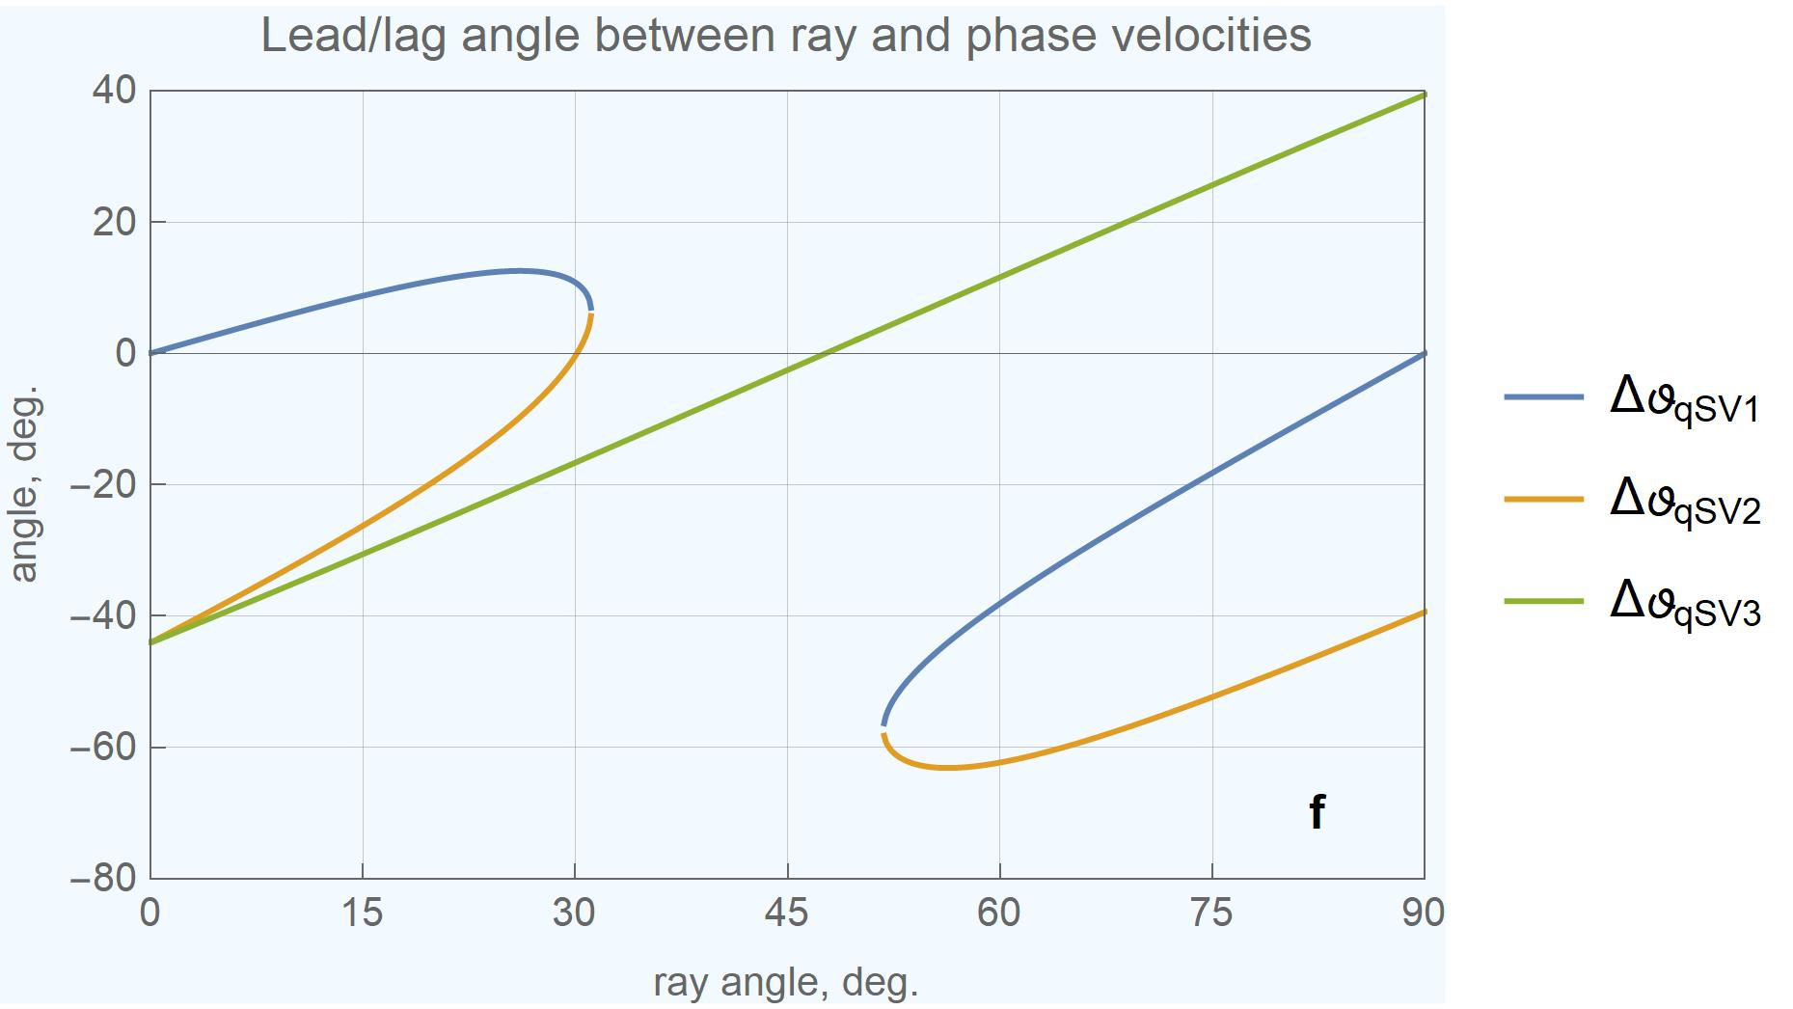
Lead/Lag Angle btw Ray and Phase Velocities
qP and SH Waves
qSV Waves

Slide 36
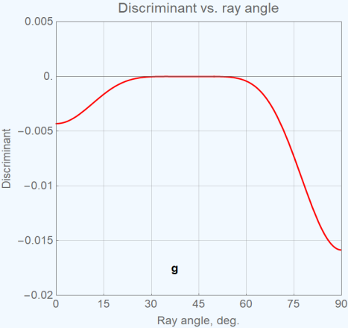
Discriminant of the Polynomial vs. Ray Angle

Slide 37
Conclusions
Considering elastic media characterized by polar anisotropy (TTI), we suggest a new efficient method to compute the slowness vector, given the medium properties, the axis of symmetry orientation, and the ray velocity direction.
Our method is based on the inherent geometric property of polar anisotropy, that the three vectors: the slowness, the ray velocity and the medium axis of symmetry, are coplanar.
Thus, the slowness vector can be presented as a linear combination of the ray direction and the symmetry axis direction, with two unknown scalar coefficients to be computed.
The main advantage of the proposed method is that it allows working with TTI media directly in the global frame without rotating the resolving equations to the “crystal” frame of the polar anisotropic media.

Slide 38
Conclusions (continued)
We apply the Hamiltonian approach, imposing the physical condition that the slowness-related gradient of the (vanishing) Hamiltonian is collinear with the ray direction.
For the coupled qP and qSV waves, this leads to a set of two polynomial equations of the third and fourth degrees, respectively. Such a system has up to twelve real and complex-conjugate solutions, which appear in pairs of the opposite slowness directions.
The common additional inequality constraint, that the angle between the slowness and ray directions does not exceed 90 degrees, cuts off one half of the solutions (to six roots).
We then rearrange the two polynomial equations in two variables and the inequality constraint into a single univariate polynomial equation of degree six for qP and qSV waves.

Slide 39
Conclusions (continued)
The coefficients of the polynomial depend on the medium properties and the ray angle, where the single unknown parameter is the phase angle.
The six roots include a unique solution for qP waves and one or three solutions for qSV waves (depending on the absence or presence of a triplication).
In addition, there are one or two pairs of complex-conjugate roots. One pair of complex-conjugate roots always exists and has a “cuspoidal” nature. The second pair exists only in the absence of a qSV triplication
A triplication exists if and only if the discriminant of the sixth-order polynomial equation is negative.

Slide 40
References
Bachrach, R., Dvorkin, J. & Nur, A., 2000. Seismic velocities and Poisson’s ratio of shallow unconsolidated sands, Geophysics 65, no. 2, 559-564.
Crampin, S., 1981, A review of wave motion in anisotropic and cracked elastic-media, Wave Motion, 3, no. 4, 343-391.
Edelman, A. & Murakami, H., 1995. Polynomial roots from companion matrix eigenvalues, Mathematics of computation, 64, no. 210, 763-776.
Farra, V., 2004. Improved first-order approximation of group velocities in Fedorov, F., 1968. Theory of elastic waves in crystals, New York, Plenum Press, ISBN 978-1475712773.
Grechka, V., 2013. Ray-direction velocities in VTI media, Geophysics, 78, no. 1, F1-F5.
Grechka, V., 2017. Algebraic degree of a general group-velocity surface, Geophysics, 82, no. 4, WA45-WA53.
Helbig, K., 1994. Foundations of anisotropy for exploration seismics, Pergamon, ISBN 978-0080372242.
Johnson, L. & Riess, R., 1982. Numerical Analysis, Addison-Wesley Publishing Company, ISBN 978-0201103922.
Koren, Z. & Ravve, I., 2021, Eigenrays in 3D heterogeneous anisotropic media: Part I – Kinematics, Geophysical Prospecting, 69, 3-27.

Slide 41
References (continued)
Musgrave, M., 1954a. On the propagation of elastic waves in aeolotropic media: I – General principles, Proceedings of the Royal Society of London, Series A: Mathematical and Physical Sciences, 226, no. 1166, 339–355, doi: 10.1098/rspa.1954.0258.
Musgrave, M., 1954b. On the propagation of elastic waves in aeolotropic media: II – Media of Hexagonal Symmetry, Proceedings of the Royal Society of London, Series A: Mathematical and Physical Sciences, 226, no. 1166, 356–366, doi: 10.1098/rspa.1954.0259.
Musgrave, M., 1970. Crystal acoustics, Holden-Day, Second Edition: Acoustical Society of America, ISBN 978-0816262021.
Press, W., Teukolsky, S., Vetterling, V. & Flannery, B., 2002. Numerical Recipes in C: The Art of Scientific Computing, Second Edition, Cambridge University Press, ISBN 978-0521431088.
Slawinski, M., 2015, Waves and rays in elastic continua, World Scientific Publishing, ISBN 978-981-4641-75-3.
Tsvankin, I., 2012, Seismic signatures and analysis of reflection data in anisotropic media: Society of Exploration Geophysicists, Third edition, ISBN 978-1560802990.
Zhang, L., and B. Zhou, 2018. Calculation of slowness vectors from ray directions for qP-, qSV-, and qSH-waves in tilted transversely isotropic media, Geophysics, 83, no. 4, C153-C160.

