Slide 1
Combined effects of seismic directivity and attenuation: an example from surface microseismic monitoring
M. Wcislo (IRSM CAS, Charles University)
F. Staněk (Colorado School of Mines)
F. Gallovic (Charles University)
I. Pšenčík (IG CAS, Charles University)
S. Wu (IG Chinese Academy of Sciences)
APSLIM II &19th IWSA
Želiv, Czech Republic, 2022

Slide 2
Outline
Motivation
Seismic directivity
Seismic attenuation and peak frequencies
Microseismic data
Combined effects of directivity and attenuation
Improvements in source mechanism inversion and interpretation

Slide 3
Motivation
Cooperation with the Institute of Geology and Geophysics of the Chinese Academy of Sciences who shared a commercial field data acquired during hydraulic fracturing of shale in North China
Star-like surface array consists of 12 arms with 1780 1C geophones (vertical component) with recorded event availible
This type of data is not easy to aquire

Slide 4
Motivation
Recordings of the obtained dataset included direct P-waves arrivals with high signal-to-noise ratio. They allowed us to investigate:
source mechanism of the event
frequency content (peak frequencies) of P-wave arrivals in relations to attenuation in the region and properties of the source.

Slide 5
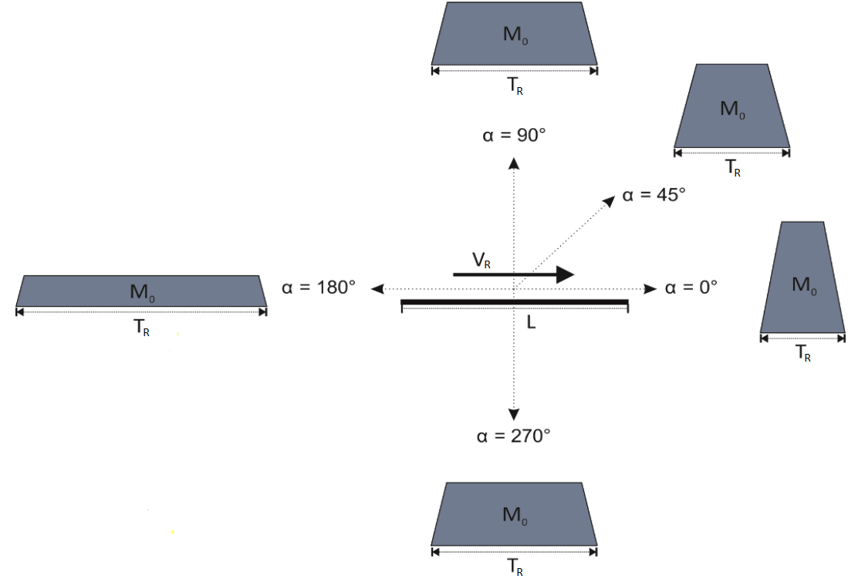

Rupture directivity of a seismic source
$$\left.T_{AR}=L(\frac{1}{V_{R}}+\frac{\cos{α}}{V_{ }})\right)$$
T_{AR} - apparent rupture time
L – rupture lenght
α - an angle between the rupture direction and the direction to observer
V_{R} – rupture velocity
V – seismic wave velocity (P or S)
M₀ – seismic moment
T_{AR} can be also expressed through:
$$T_{AR}=T_{R}\left(1−b cos\text{α}\right)$$
T_{R} – rupture time

Slide 6
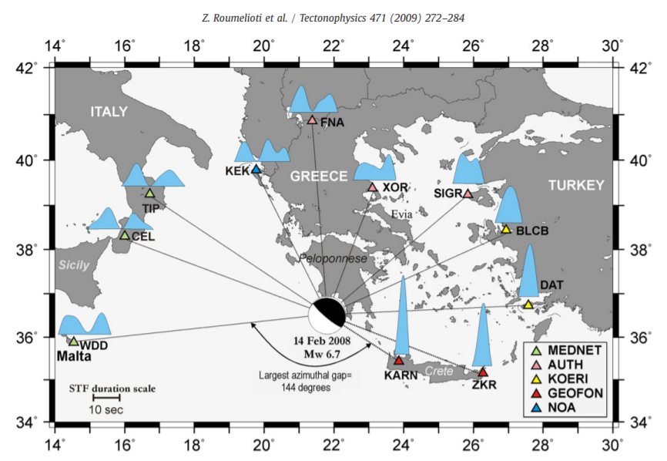
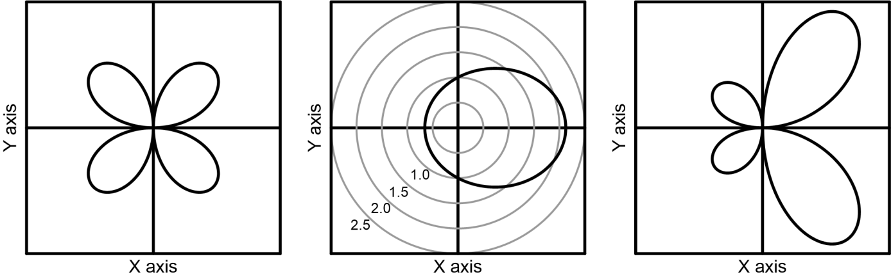
Seismic directivity
Approximate effect of directivity on amplitudes in comparison to S-wave
point source double couple radiation:
V_{P}/V_{S} ratio equal 1.7
V_{R}=0.9V_{S}
Point source
radiation pattern
Directivity effect on amplitudes
Radiation pattern with directivity effects

Slide 7
Seismic directivity
Strong earthquakes – rupturę directivity has a significant effect on the directional distribution of seimic intensity
Small earthquakes (e.g., Pakor et al., 2016, Yoshida, 2019)
Microseismicity (Kane et al., 2013)
Acoustic emissions/Lab experiments (Kolář et al., 2020)
Directivity of microeartquakes may not be recorded due to the accumulated effect of attenuation on waveforms

Slide 8
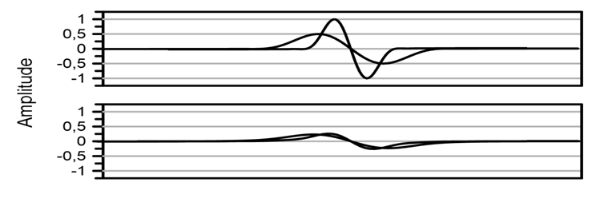
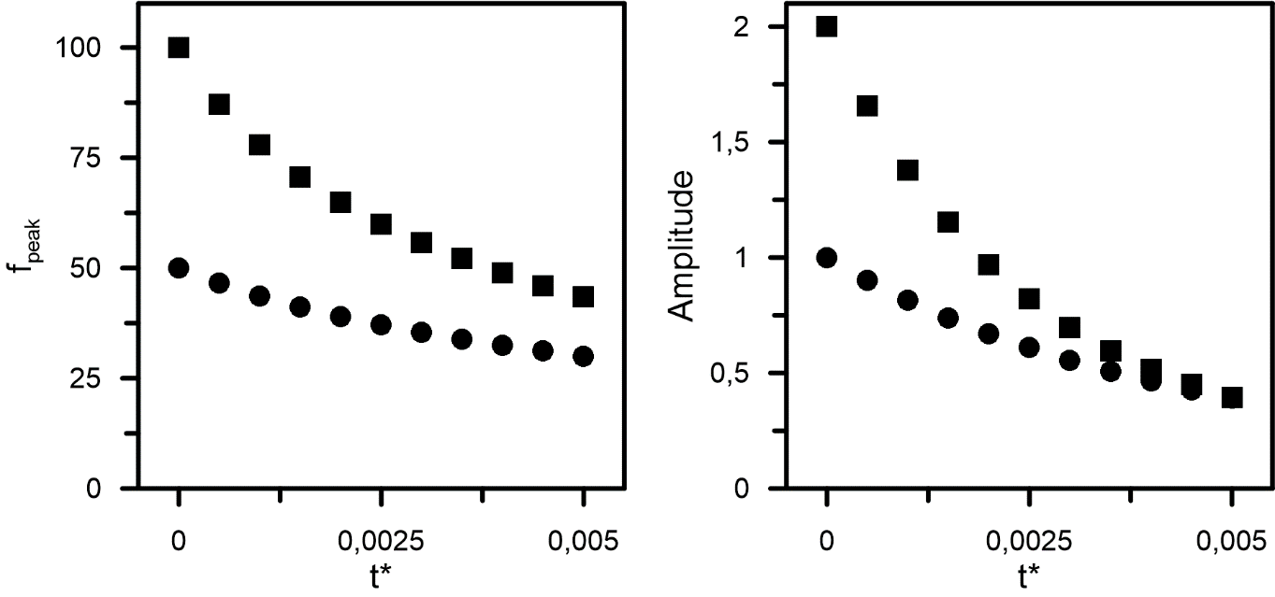
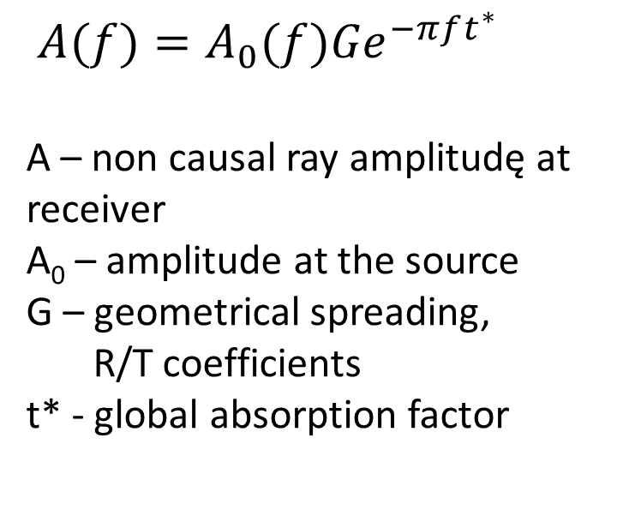
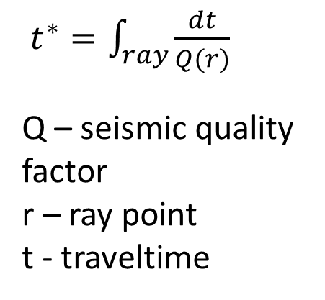
Seismic directivity & attenuation
Waveforms close to the source
Waveforms after propagation through attenuative medium
$A(f)=A_{0}(f){Ge}^{−πft^{∗}}$
A – non causal ray amplitudę at receiver
A₀ – amplitude at the source
G – geometrical spreading, zxwR/T coefficients
t* - global absorption factor
$t^{∗}=\int_{ray}^{ }{\frac{dt}{Q(r)}}$
Q – seismic quality
factor
r – ray point
t - traveltime

Slide 9
Seismic attenuation & peak frequency of the signal
Flat displacement spectrum used in seismology corresponding to rectangular source time function. Corner frequency f_{C} corresponds to the rupture duration
f_{C}

Slide 10

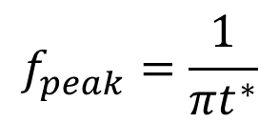

${ A}_{v}(f)=A_{D}\left(f\right)f$ $e^{−πft^{∗}}$
To find peak frequency we seek the maximum of the function:
$${fe}^{−πft^{∗}}$$
The maximum of the function for f<f_{c} :
$$f_{peak}^{ }=\frac{1}{πt^{∗}}$$

Slide 11
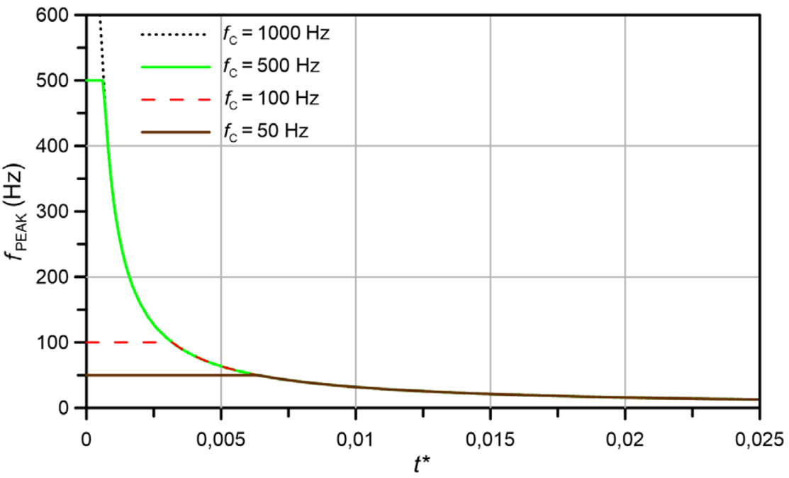
Seismic attenuation & peak frequency of the signal

Slide 12
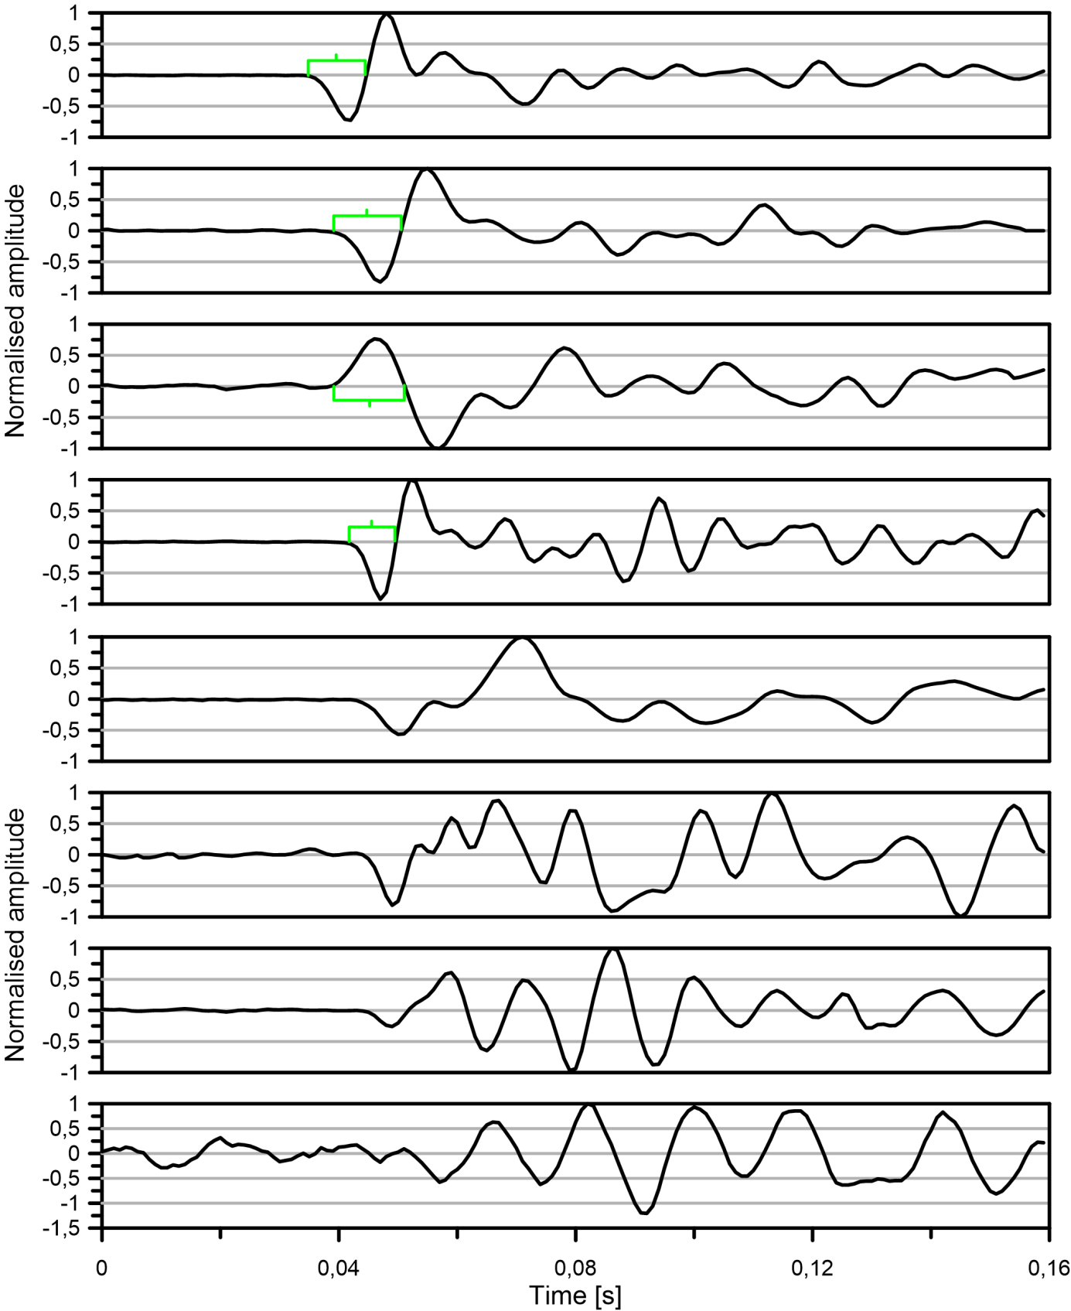
Measurement of peak frequencies
Examples of arrivals recorded by the array in China
Green brackets indicate the first half periods of the traces with clear arrivals

Slide 13
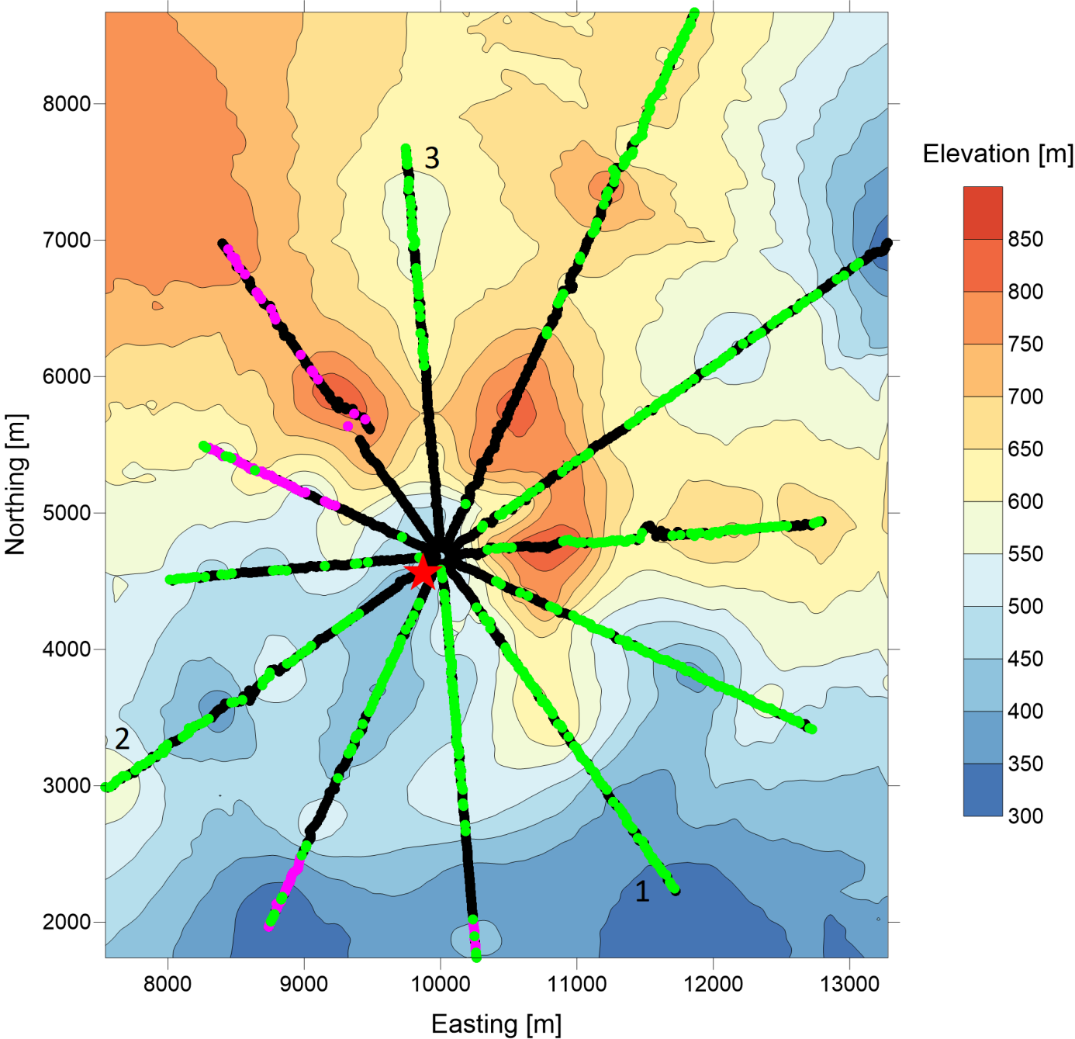
Dataset
- geometry
629 geophones provided clear, single direct arrivals (green dots)
Additional measurements of amplitudes for the mechanism computation (magenta dots)

Slide 14
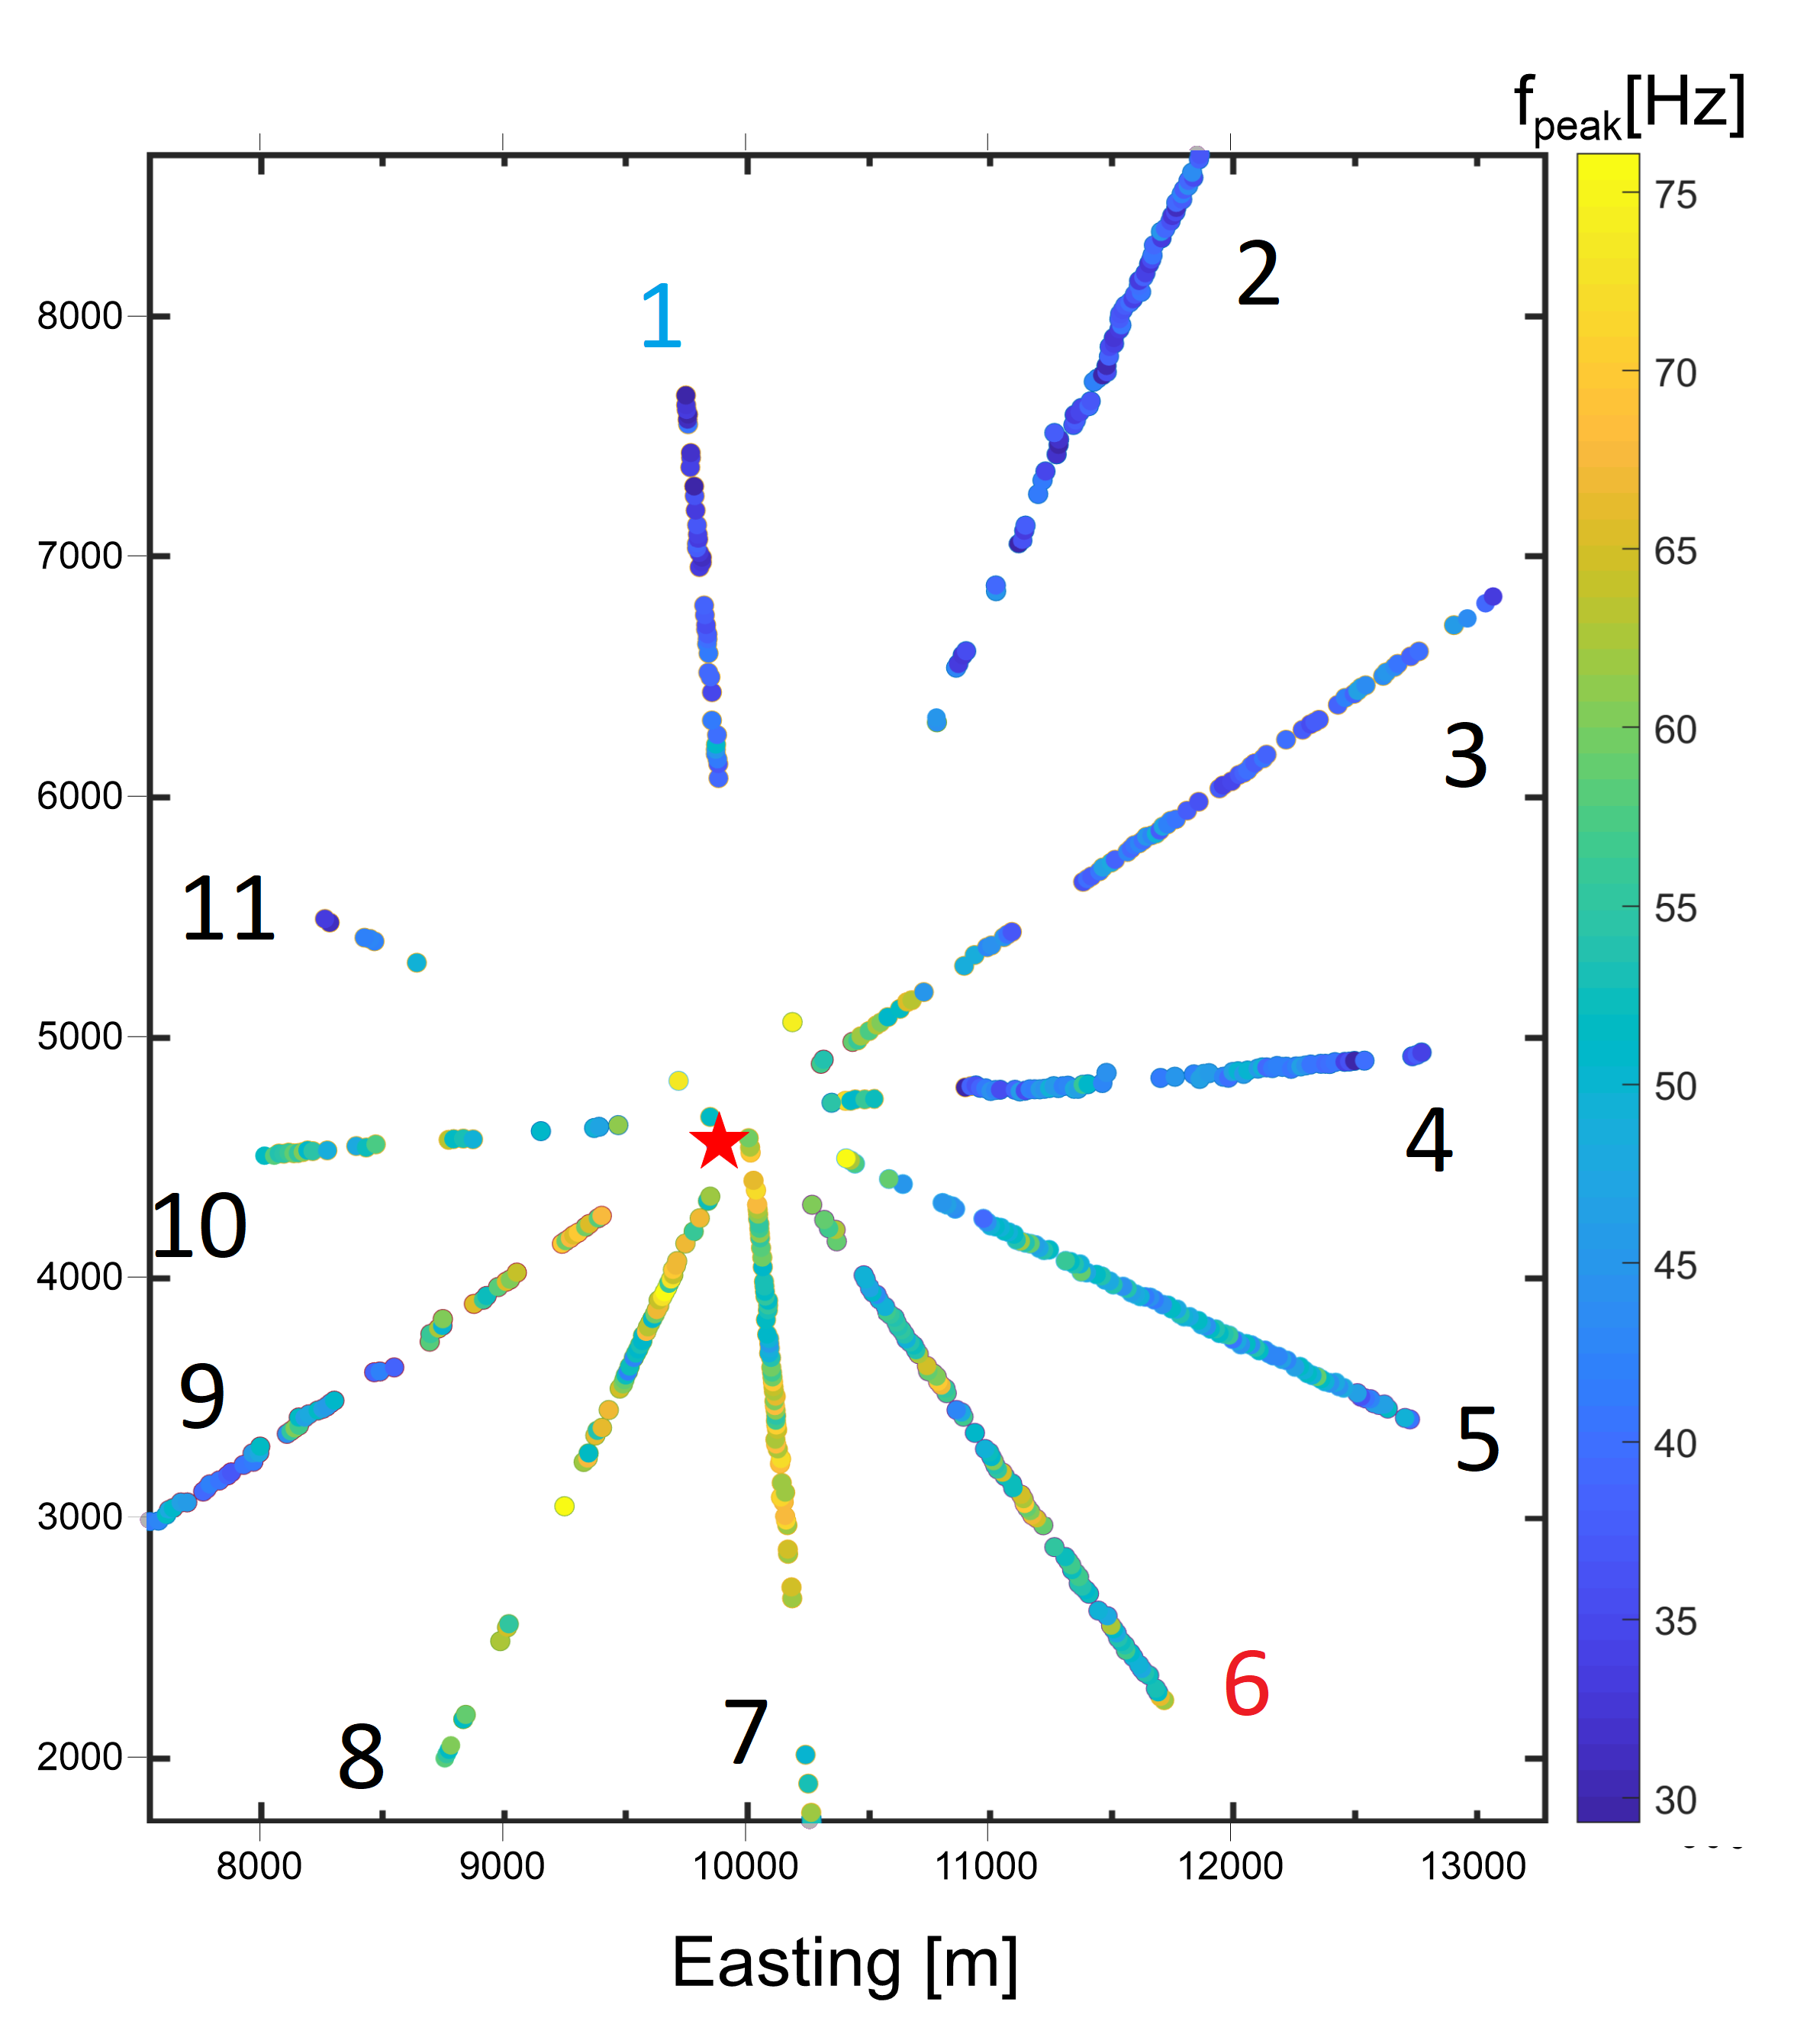
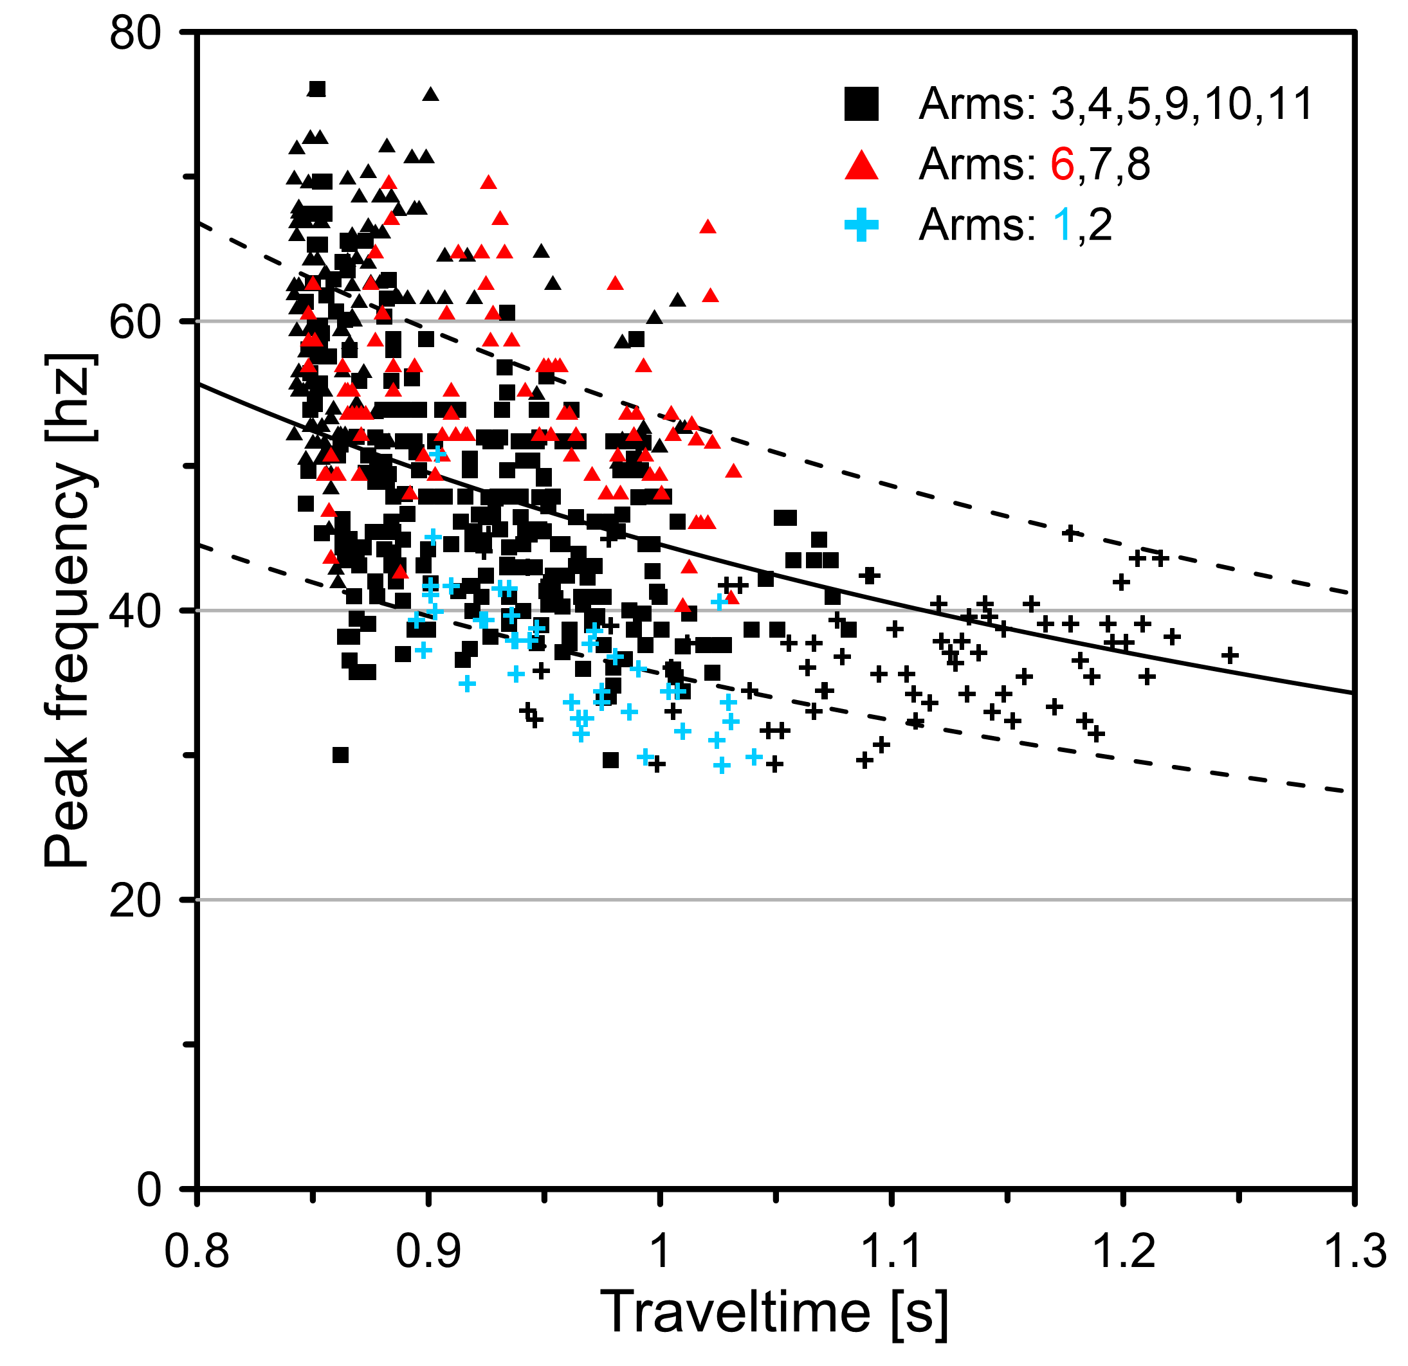

Results of peak frequency measurements

Slide 15
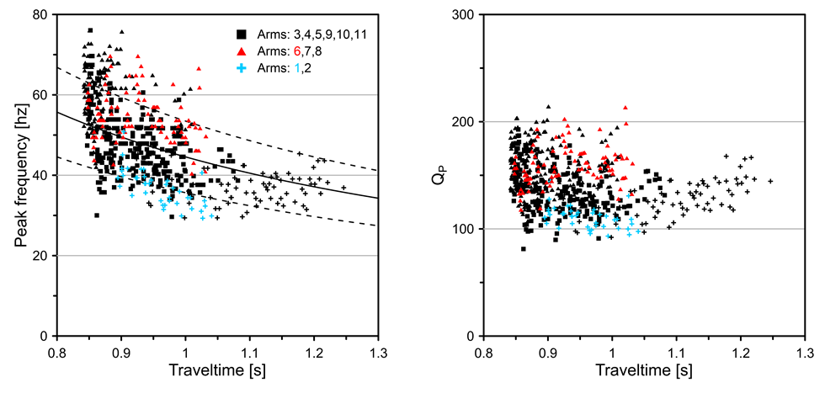
Results of peak frequency measurements

Slide 16
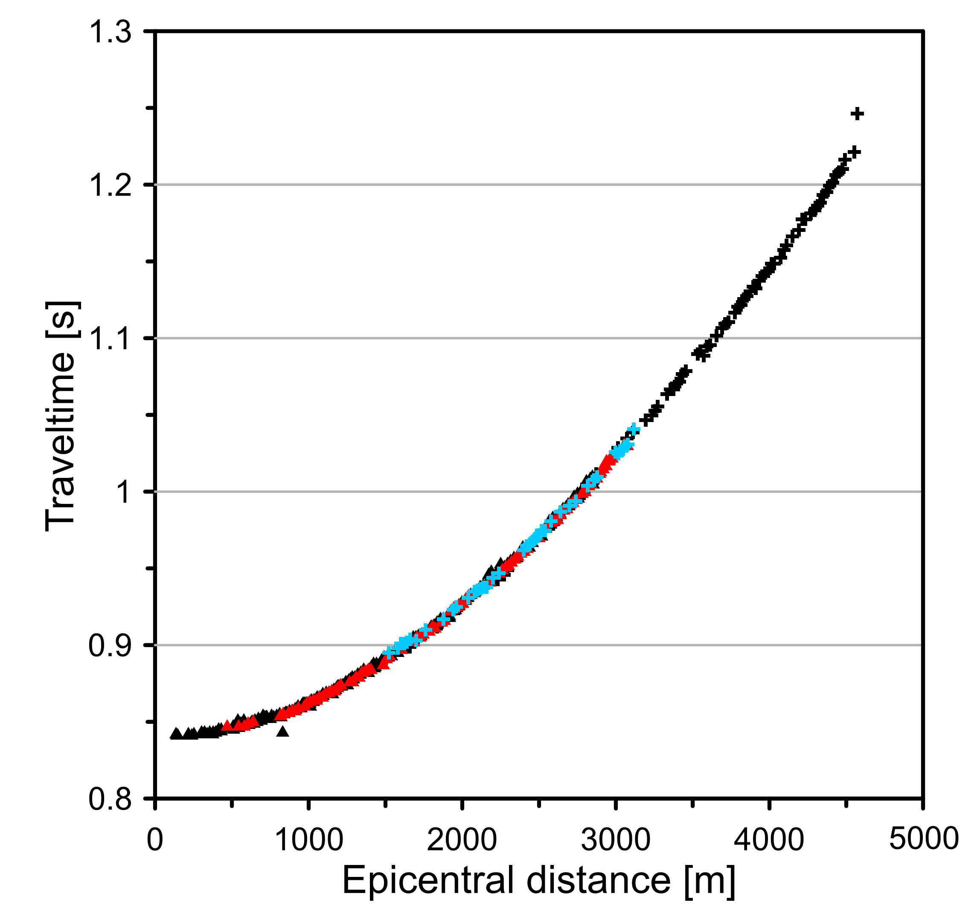
Differences in Q values – complexity of the medium?
no significant differences in traveltimes between arms
as example: red – arm 6, blue - arm 1

Slide 17
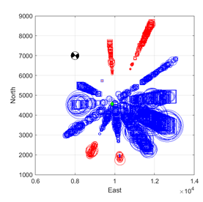
Rupture directivity as an explanation of the peak frequency pattern?
Solution | Strike [deg] | Dip [deg] | Rake [deg]
Plane 1 | 326 | 85 | -180
Plane 2 | 236 | 90 | -5
Decomposition results | DC [%] | CLVD [%] | VOL [%]
 | 66 | 17 | 18
Full moment tensor inversion using ray amplitudes
and point source approximation
Map of recorded (circles) and modeled (squares) first amplitudes (blue negative, red positive)

Slide 18
Seismic directivity combined with attenuation
To evaluate if combination of attenuation and directivity of the source may explain measured peak frequencies we performed synthetic modeling
Case 1: the peak frequencies are affected by neither attenuation nor the source directivity (best fit assumes a constant peak frequency).
Case 2: the attenuation is added to modeling (corner frequency of Brune spectra is limited up to 200Hz; a higher corner frequency is highly unlikely for M_{W} ~1.0 event, Eisner et al. 2013).
Case 3: the effects of directivity calculated for the fixed V_{R}/V_{S} value of 0.9 are added.
Case 4: modeling with permitted supershear rupture propagation.

Slide 19
Seismic directivity combined with attenuation
 |  |  | T_{r} | Q | Misfit | Misfit improvement | min / max modeled f_{peak} (logarithm)
No attenuation | No directivity | Vr/Vs=0 (fixed) | Not considered | Not considered | 36.6 | 1 | 48 (3,87) / 48 (3,87)
Attenuation |  | Vr/Vs=0 (fixed) | 1/200 s (fixed) | 150 | 18.1 | 2 | 37 (3,61) / 53 (3,95)
 | Directivity | Vr/Vs=0.9 (fixed) | 1/56 s | 220 | 13.7 | 2.7 | 35 (3,55) / 54 (3,98)
 |  | Vr/Vs=1.3 | 1/36 s | 200 | 11.8 | 3.1 | 31 (3,43) / 58 (4,06)
Measured: 29 (3.37) / 76 (4,33)
Measured (5% cut off): 33 (3.51) / 67 (4.20)

Slide 20
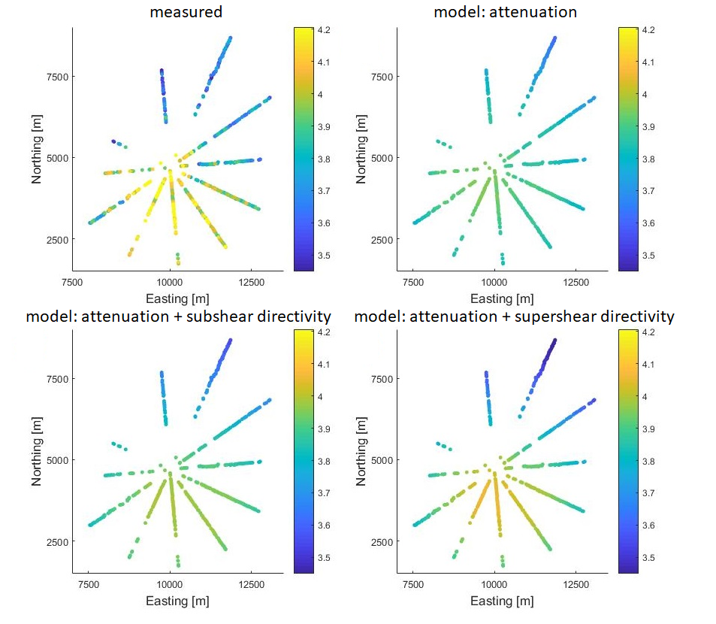
Effect of seismic attenuation and rupture directivity

Slide 21
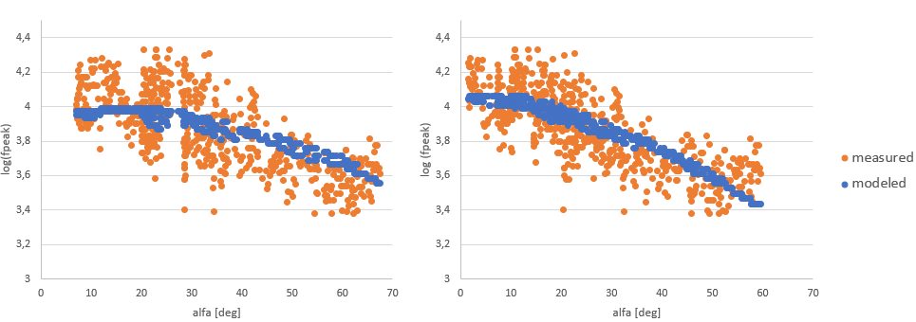
Best fit subshear vs supershear
Search best fit: Vr/Vs=0.9 (fixed)
Global search best fit: Vr/Vs=1.3

Slide 22
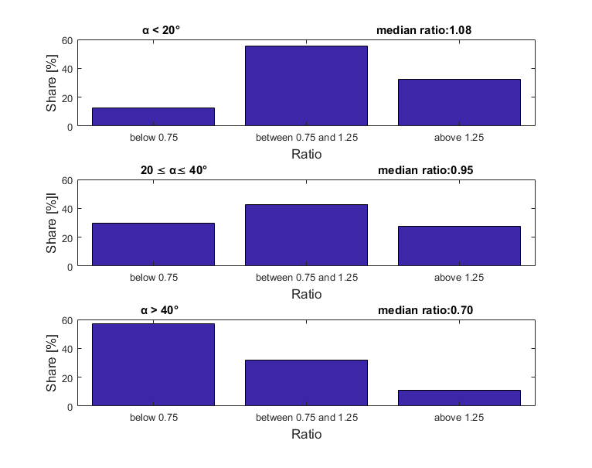
Directivity & source inversion
Distribution of ratios of real and modeled amplitudes reveal presence of the rupture directivity effects.
Linear fit of function of ratios of real and modeled amplitudes vs alfa angle is used to correct amplitudes for the rupture directivity effects

Slide 23
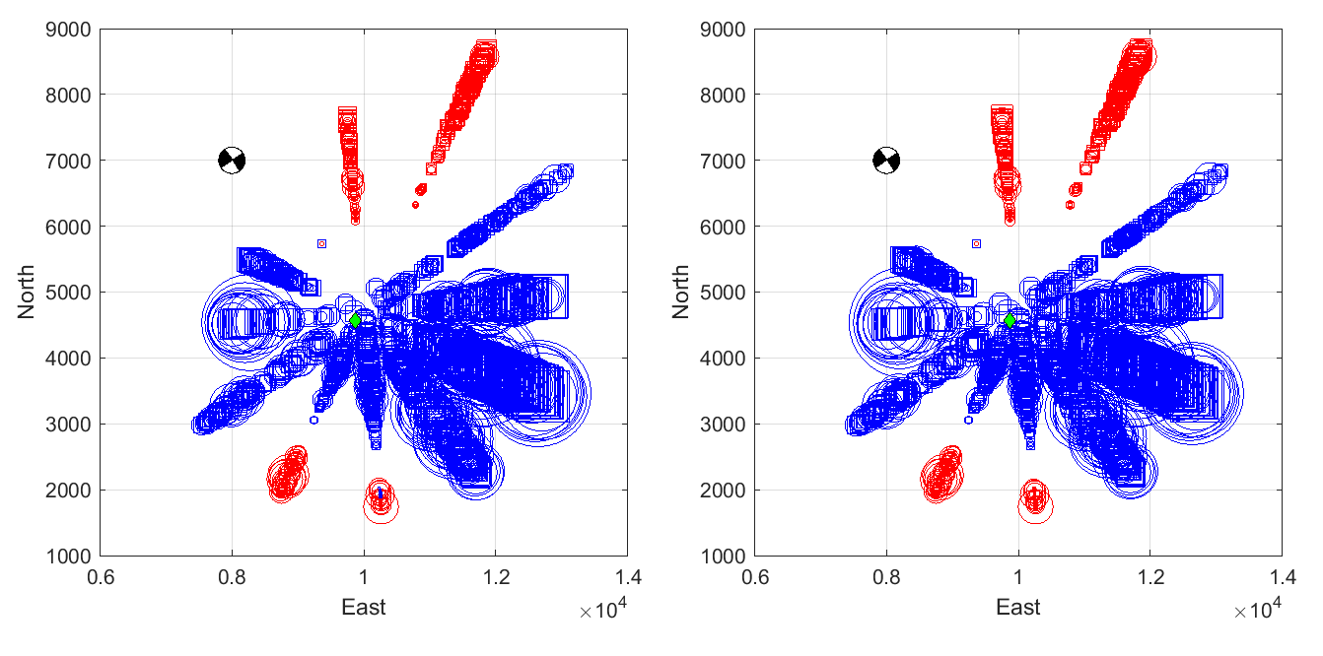
Source inversion results – initial vs after correction
Solution1/Solution2 | Strike [deg] | Dip [deg] | Rake [deg]
Plane 1 | 326/324 | 85/86 | -180/-178
Decomposition results | DC [%] | CLVD [%] | VOL [%]
 | 66/75 | 17/11 | 18/14
Maps of recorded (circles) and modeled (squares) first amplitudes (blue negative, red positive)
Original/Corrected
Original Corrected

Slide 24
Conclusions
Recorded peak frequencies can be explained by effects of rupture directivity and seismic attenuation
Rupture directivity allows determination of the true fault plane from the source mechanism solution
Star-like arrays provide good geometry for the stable source mechanism inversion

Slide 25
Thank you for attention

