Slide 1
Comparison of ray and full-wave synthetic seismograms of reflected SH waves in attenuating media
APSLIM II &19th IWSA
Želiv, Czech Republic, 2022
M. Wcisło (IRSM CAS, Charles University)
I. Pšenčík (IG CAS, Charles University)
J. Carcione (OGS)

Slide 2
Presentation Outline
Introduction
Weak Attenuation Concept (WAC)
SH- wave reflection/transmission in WAC
Comparison of results of the ray method and pseudospectral method (PS)
Comparison of results for the ray method with frequency-fixed and frequency-dependent reflection coefficients.

Slide 3
SH-wave in WAC
By applying correspondence principle (CP), SH-wave velocity is considered complex-valued:
β - SH-wave velocity
Q - quality factor (Q>>1)
f - frequency
In frequent case, when β^{I} << β^{R}, it is possible to treat the imaginary part of SH-wave velocity as a perturbation of its real part – therefore, anelasticity is treated as a perturbation of elasticity. For weakly attenuating madia it allows to avoid complicated complex ray tracing.

Slide 4
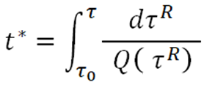
Weak attenuation in smooth media
Amplitude A at given frequency f in WAC calculated along the ray in the reference elastic medium. For model with constant Q (non-causal attenuation):
where: A_{el} - ray amplitude along the ray in the reference elastic medium
t* - global absorption factor
τ^{R} - traveltime along the ray
in the reference elastic medium

Slide 5
SH – wave reflection and transmission coefficients – elastic case
p /p^{(t)} - slowness vector of incident/transmitted wave
β - SH-wave velocity
ρ – density
N - unit normal to the interface – positive upwards

Slide 6
Reflection/Transmission – elastic case
Reflection coefficient:
Transmission coefficient:
ρ - density
β – SH-wave velocity
i – angle of incident
6

Slide 7
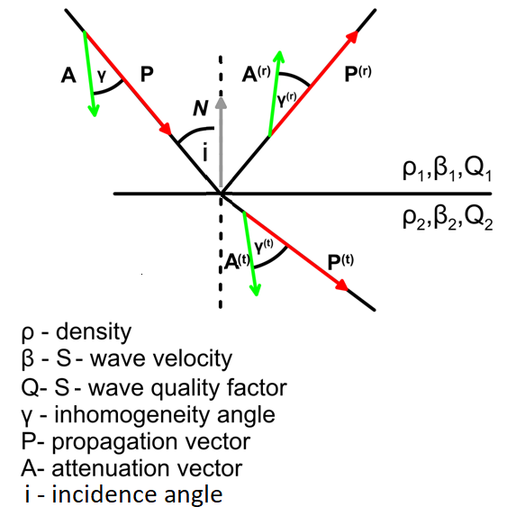
Reflection/Transmission – anelastic case
Reflection coefficient:
Transmission coefficient:
ρ - density
β – SH-wave velocity
Q – SH-wave quality factor
γ – inhomogeneity angle
P – propagation vector
A – attenuation vector
i – angle of incident
In anelastic case:

Slide 8
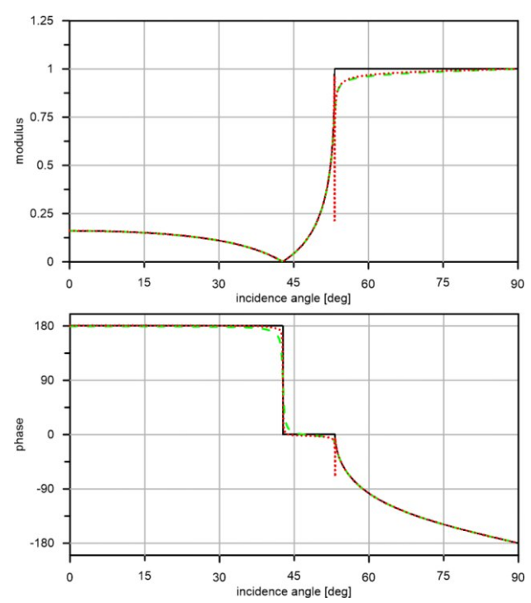
β₁ = 3.698km/s
β₂ = 4.618km/s
ρ₁ = 2.98kg/m³
ρ₂ = 3.3kg/m³
Q₁ = 50
Q₂ = 75
Elastic reference (solid black)
Daley and Krebes (2015) (dashed green)
WAC (dotted red)
Daley PF, Krebes ES (2015) Anelastic (poroviscoelastic)medium—the SH -wave problem. J Seism Explor 24:103–120

Slide 9
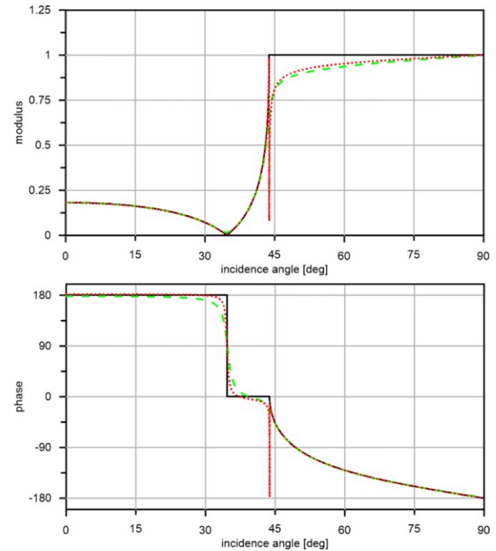
β₁ = 1.44km/s
β₂ = 2.08km/s
ρ₁ = 2.0kg/m³
ρ₂ = 2.0kg/m³
Q₁ = 15
Q₂ = 22
Elastic reference (solid black)
Daley and Krebes (2015) (dashed green)
WAC (dotted red)
Daley PF, Krebes ES (2015) Anelastic (poroviscoelastic)medium—the SH -wave problem. J Seism Explor 24:103–120

Slide 10
Configuration

Slide 11
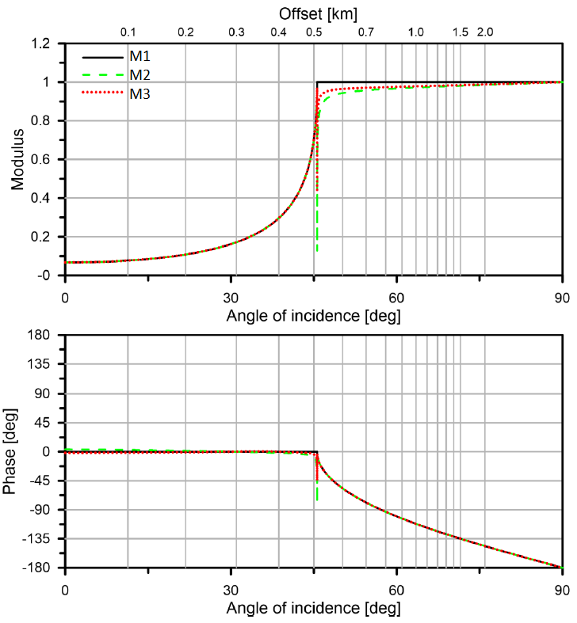
Reflection coefficients

Slide 12
Wavelet
Ricker wavelet with dominant frequency of 60 Hz is used in comparison of seismograms. In 2D models, Ricker signal loses its symmetry as a result of being convolved with 2 dimensional Green function. Adjustment of the wavelet in ray calculations is required.
Direct wave computed by PS modeling (red) overlaid by the ray counterpart used in the modified SEIS programme package (black).

Slide 13
Seismograms: model M1 (elastic/elastic)
PS method
Ray method

Slide 14
Seismograms: model M2 (elastic/anelastic)
Effect of attenuation at the reflection point only
PS method
Ray method

Slide 15
Seismograms: model M3 (anelastic/anelastic)
Effect of attenuation inside the layer and at the reflection point
PS method
Ray method

Slide 16
Maximum spectral amplitudes: model M1 (elastic/elastic)
effect of head wave in PS method calculations
numerical errors in PS calculations

Slide 17
Maximum spectral amplitudes: model M2 (elastic/anelastic)

Slide 18
Maximum spectral amplitudes: model M3 (anelastic/anelastic)
Note the reduced amplitude scale.

Slide 19
Different causal dispersion models
Complex velocities:
Maxwell model
$v\left(ω\right)=v\left(ω_{r}\right)\sqrt{\frac{Q(ω_{r})}{Q\left(ω_{r}\right)−i\frac{ω_{0}}{ω}}}$
Futterman model
$$v\left(ω\right)=v\left(ω_{r}\right)\left[1+\frac{1}{πQ\left(ω_{r}\right)}\log\left(\frac{ω}{ω_{0}}\right)+\frac{i}{2Q\left(ω_{r}\right)}\right]$$
Standard linear solid (SLS) model
$$v\left(ω\right)={[v}_{r}{(1−\frac{{(\frac{ω}{ω_{r}})}^{2}}{Q\left(ω_{r}\right)[1+{(\frac{ω}{ω_{r}})}^{2}]})}^{−1}]{[1+\frac{i}{2} (Q\left(ω_{r}\right)\frac{2\frac{ω}{ω_{r}}}{1+{\left(\frac{ω}{ω_{r}}\right)}^{2}})}^{−1}]$$
Maxwell : $v\left(ω_{r}\right)$=2.8 km/s and $Q\left(ω_{r}\right)$=60
Futterman : $v\left(ω_{r}\right)$=2.8 km/s and $Q\left(ω_{r}\right)$=60
SLS : relaxation time 1/60s, V_{r}=2.777km/s and $Q\left(ω_{r}\right)$=60

Slide 20
Maxwell model
layer 1: $v\left(ω_{r}\right)$=2.0 km/s and $Q\left(ω_{r}\right)$=40
layer 2: $v\left(ω_{r}\right)$=2.8 km/s and $Q\left(ω_{r}\right)$=60

Slide 21
Futterman model
layer 1: $v\left(ω_{r}\right)$=2.0 km/s and $Q\left(ω_{r}\right)$=40
layer 2: $v\left(ω_{r}\right)$=2.8 km/s and $Q\left(ω_{r}\right)$=60

Slide 22
SLS model
layer 1: V_{r}=1.975km/s and $Q\left(ω_{r}\right)$=40
layer 2: V_{r}=2.777km/s and $Q\left(ω_{r}\right)$=60
The above values of the V_{r} result in $v\left(ω_{r}\right)$ equal 2.8 km/s for layer 1
and 2.0 km/s for layer 2

Slide 23
Maxwell model
Red – frequency dependent reflection coefficients
layer 1: $v\left(ω_{r}\right)$=2.0 km/s and $Q\left(ω_{r}\right)$=40
layer 2: $v\left(ω_{r}\right)$=2.8 km/s and $Q\left(ω_{r}\right)$=60
Black – frequency independent reflection coefficients
layer 1: $v$=2.0km/s and $Q$=40
layer 2: $v$=2.8km/s and $Q$=60

Slide 24
Futterman model
Red – frequency dependent reflection coefficients
layer 1: $v\left(ω_{r}\right)$=2.0 km/s and $Q\left(ω_{r}\right)$=40
layer 2: $v\left(ω_{r}\right)$=2.8 km/s and $Q\left(ω_{r}\right)$=60
Black – frequency independent reflection coefficients
layer 1: $v$=2.0km/s and $Q$=40
layer 2: $v$=2.8km/s and $Q$=60

Slide 25
SLS model
Red – frequency dependent reflection coefficients
layer 1: V_{r}=1.975km/s and $Q\left(ω_{r}\right)$=40
layer 2: V_{r}=2.777km/s and $Q\left(ω_{r}\right)$=60
Black – frequency independent reflection coefficients
layer 1: $v$=2.0km/s and $Q$=40
layer 2: $v$=2.8km/s and $Q$=60

Slide 26
Maxwell model
Red – frequency dependent reflection coefficients
layer 1: $v\left(ω_{r}\right)$=2.0 km/s and $Q\left(ω_{r}\right)$=40
layer 2: $v\left(ω_{r}\right)$=2.8 km/s and $Q\left(ω_{r}\right)$=60
Black – frequency independent reflection coefficients
layer 1: $v$=2.0km/s and $Q$=40
layer 2: $v$=2.8km/s and $Q$=60

Slide 27
Futterman model
Red – frequency dependent reflection coefficients
layer 1: $v\left(ω_{r}\right)$=2.0 km/s and $Q\left(ω_{r}\right)$=40
layer 2: $v\left(ω_{r}\right)$=2.8 km/s and $Q\left(ω_{r}\right)$=60
Black – frequency independent reflection coefficients
layer 1: $v$=2.0km/s and $Q$=40
layer 2: $v$=2.8km/s and $Q$=60

Slide 28
SLS model
Red – frequency dependent reflection coefficients
layer 1: $v\left(ω_{r}\right)$=2.0 km/s and $Q\left(ω_{r}\right)$=40
layer 2: $v\left(ω_{r}\right)$=2.8 km/s and $Q\left(ω_{r}\right)$=60
Black – frequency independent reflection coefficients
layer 1: $v$=2.0km/s and $Q$=40
layer 2: $v$=2.8km/s and $Q$=60

Slide 29
Conclusions
Outside critical region the ray results fit well the PS results for elastic models and models with effects of attenaution included
Effects of attenuation at the interface are small in comparison to effects caused by wave propagation within attenuative layers
Calculating the reflection coefficient at a single frequency does not influence the results significantly

