Slide 1
An example of multi parameter finite frequency tomography
Ed Wright* (Shell Global Solution International, B.V.), Chris Haneveld (Former Shell Global Solution International, B.V.) and René-Édouard Plessix (Shell Global Solutions International, B.V.)

Slide 2
Introduction
In recent years seismic wave propagation algorithms used in the industry have moved beyond the high frequency approximation used for ray-tracing. Examples being:
Reverse time migration
Full waveform inversion (and all the flavors)
Driven mainly by:
The data available:
Broad-band seismic acquisition is common, so finite frequency modelling software is more suited for this data
Resources:
Compute is cheaper and faster, so finite frequency algorithms, such as finite difference, are becoming more practical on industry scale seismic problems (migration / inversion)

Slide 3
Introduction
Ray tracing is still an industry standard for both seismic migration and inversion problems, due to:
Computational efficiency (compared to FD methods)
Ease of using picked residuals for tomography (data and migration domain).
However, high frequency approximations start to break down when velocity heterogeneities are on the scale length of the dominate Fresnel zone [1].
A well-known hybrid method exists, [2,3,4,5], where finite frequency physics can be introduced via a single scattering approximation.
[1] Spetzler, J, The effect of small-scale heterogeneity on the arrival time of waves, Geophys. J. Int. (2001) 145, 786-796
[2] Dahlen, F, Frechet kernels for finite-frequency traveltimes –I. Theory, Geophys. J. Int. (2000) 141, 157-174
[3] Dahlen, F, Frechet kernels for finite-frequency traveltimes –II. Examples Geophys. J. Int. (2000) 141, 175-203
[4] Montelli, R, Global P and PP traveltime tomography: rays versus waves, Geophys. J. Int. (2004) 158, 637-654
[5] Cerveny, V, Fresnel volume ray tracing, Geophysics, (1992) 57, 902-915

Slide 4
Introduction
We present a form of multi-parameter finite frequency tomography, based on [2,3], where:
3D Fréchet kernels can be calculated via the paraxial approximation along a central ray connecting shot to receiver.
Model sensitivities are based on a non-tilted orthorhombic Eikonal under the weak anisotropy condition, similar to [6,7].
Two synthetic examples are given, showing:
Finite frequency effects due to a velocity heterogeneity of the same scale as the dominate Fresnel zone
A tomography example, recovering an anisotropic anomaly given picked travel times.
[2] Dahlen, F, Frechet kernels for finite-frequency traveltimes –I. Theory, Geophys. J. Int. (2000) 141, 157-174
[3] Dahlen, F, Frechet kernels for finite-frequency traveltimes –II. Examples Geophys. J. Int. (2000) 141, 175-203
[6] Tsvankin, I, Anisotropic parameters and P-wave velocity for orthorhombic media, Geophysics, (1997) 62, 1292-1309
[7] Pšenčìk, I, First-order ray tracing for qP waves in inhomogeneous weakly anisotropic media, Geophysics, (2005) 70, D65-D75

Slide 5
Theory
The full derivation for the travel time shift is given by [2], and is given here, as:
$$δT=\iiint{\left[\sum_{i}{K_{i}\left(δm_{i}\frac{∂G}{∂m_{i}}\right)}\right]}ⅆxdydz$$
Where:
$δT$ – Travel time shift
$K_{i}$ – The paraxial 3D Fréchet kernel for model parameter, $i$
$m_{i}$ – model parameter $(V_{n},δ,δ_{D},η,η_{D},η_{3},χ)$
$G$ – Eikonal equation describing slowness surface.
The volume integral is over all space, but, computationally, over the dominate Fresnel zone
[2] Dahlen, F, Frechet kernels for finite-frequency traveltimes –I. Theory, Geophys. J. Int. (2000) 141, 157-174

Slide 6
Theory
The paraxial kernel, $K_{i}$, is given as:
$$K_{i}=−\frac{1}{2π}\left(δm_{i}\frac{∂G}{∂m_{i}}\right)\sqrt{\left|\det\left(M^{′}+M^{′′}\right)\right|}\frac{\int_{0}^{∞}{ω^{3}{\left|\dot{p}(ω)\right|}^{2}\sin{φ}}dω}{\int_{0}^{∞}{ω^{2}}{\left|\dot{p}(ω)\right|}^{2}dω}$$
Where:
$M^{′},M′′$ – Are the forward and backwards travel time Hessians along the central ray respectively
$p(ω)$ – Is the Fourier transform of an assumed source time function, $p(t)$
$ω$ – Angular frequency
$φ$ – Is the phase factor, taking into account caustics along the central ray via Maslov indices, given by
$$φ=\frac{1}{2}ω{dt}_{0}−\left[sig\left(M^{′}+M^{′′}\right)−2\right]\frac{π}{4}$$
${dt}_{0}$ – is the travel time difference from the central ray, due to scatterers within the volume integral.

Slide 7
Theory
The source time function, can be approximated as a Gaussian distribution [3,8], giving an associated power spectrum of
$${\left|\dot{p}(ω)\right|}^{2}=\frac{ω^{2}τ^{2}}{4π}e^{−\frac{ω^{2}τ^{2}}{8π^{2}}}$$
Where:
$τ$ – is the characteristic period of the pulse.
Following this assumption, the integrals can be simplified to [8]:
$$\frac{\int_{0}^{∞}{ω^{3}{\left|\dot{p}(ω)\right|}^{2}\sin{φ}}dω}{\int_{0}^{∞}{ω^{2}}{\left|\dot{p}(ω)\right|}^{2}dω}=8{dt}_{0}e^{{−\left(\frac{{dt}_{0}π}{τ}\right)}^{2}}{\left(\frac{π}{3τ}\right)}^{6}\left({dt}_{0}^{4}−5{\left(\frac{{dt}_{0}τ}{π}\right)}^{2}+\frac{15}{4π^{4}}{dt}_{0}^{4}\right)$$
[3] Dahlen, F, Frechet kernels for finite-frequency traveltimes –II. Examples Geophys. J. Int. (2000) 141, 175-203
[8] Favier, N, Sensitivity kernels for shear wave splitting in transverse isotropic media Geophys. J. Int, (2003) 153, 213-228

Slide 8
Theory
The source time function, can be approximated as a Gaussian distribution [3,8], giving an associated power spectrum of
$${\left|\dot{p}(ω)\right|}^{2}=\frac{ω^{2}τ^{2}}{4π}e^{−\frac{ω^{2}τ^{2}}{8π^{2}}}$$
Where:
$τ$ – is the characteristic period of the pulse.
Following this assumption, the integrals can be simplified to [8]:
$$\frac{\int_{0}^{∞}{ω^{3}{\left|\dot{p}(ω)\right|}^{2}\sin{φ}}dω}{\int_{0}^{∞}{ω^{2}}{\left|\dot{p}(ω)\right|}^{2}dω}=8{dt}_{0}e^{{−\left(\frac{{dt}_{0}π}{τ}\right)}^{2}}{\left(\frac{π}{3τ}\right)}^{6}\left({dt}_{0}^{4}−5{\left(\frac{{dt}_{0}τ}{π}\right)}^{2}+\frac{15}{4π^{4}}{dt}_{0}^{4}\right)$$
[3] Dahlen, F, Frechet kernels for finite-frequency traveltimes –II. Examples Geophys. J. Int. (2000) 141, 175-203
[8] Favier, N, Sensitivity kernels for shear wave splitting in transverse isotropic media Geophys. J. Int, (2003) 153, 213-228

Slide 9
Thin ray to kernel
Thin ray
Kernel

Slide 10
Theory
The Eikonal equation, $G$, is derived in a similar way as [6,7]:
$$G(\underline{x}, \underline{p})≐\frac{V_{N}^{2}}{1+2δ}\left[{\left\|\underline{p}\right\|}^{2}+2A\left(δ+η+η\left(δ+δ_{D}\right)\right)+η_{D}\left(δ+δ_{D}\right)+η\left(δ−δ_{D}\right)−η_{D}(δ−δ_{D})\right]$$
$$+\frac{V_{N}^{2}}{1+2δ}\left[2B\left(δ_{D}+η_{D}+η\left(δ+δ_{D}\right)\right)+η_{D}\left(δ+δ_{D}\right)−η\left(δ−δ_{D}\right)+η_{D}(δ−δ_{D})\right]$$
$$−\frac{V_{N}^{2}}{(1+2δ){\left\|\underline{p}\right\|}^{2}}\left[2Aηp_{z}^{2}+2Bη_{D}p_{z}^{2}+\frac{1}{2}Cη_{3}\right]$$
Where:
${V_{N}=V}_{P0}\sqrt{1+2δ}$, $δ=\frac{1}{2}\left(δ_{1}+δ_{2}\right)$, $δ_{D}=\frac{1}{2}\left(δ_{1}−δ_{2}\right)$, $η=\frac{1}{2}\left(η_{1}+η_{2}\right)$, $η_{D}=\frac{1}{2}\left(η_{1}−η_{2}\right)$, $η_{3}$ are anisotropy parameters based on [6,9,10].
${\underline{p}=(p}_{x},p_{y},p_{z})$ – Slowness vector
$A=\left(p_{y}^{2}+p_{y}^{2}\right)$, $B=\left(p_{y}^{2}−p_{x}^{2}\right)\cos{2χ+}2p_{x}p_{y}\sin{2χ}$, $C=\left(p_{x}^{2}−p_{y}^{2}\right)\sin{2χ+}2p_{x}p_{y}\cos{2χ}$
$χ$ – is the angle determining the principal axes of azimuthal dependence.
[6] Tsvankin, I, Anisotropic parameters and P-wave velocity for orthorhombic media, Geophysics, (1997) 62, 1292-1309
[7] Pšenčìk, I, First-order ray tracing for qP waves in inhomogeneous weakly anisotropic media, Geophysics, (2005) 70, D65-D75
[9] Alkhalifah, T., Velocity analysis for transversely isotropic media, Geophysics, (1995) 60, 1550-1566
[10] L. Thomsen, Weak elastic anisotropy, Geophysics, (1986) 51, 1954-1966

Slide 11
Finite frequency experiment 1.
Aim:
To test the validity of the approach by reproducing a published result in [3]. A similar result is published in [11].
[3] Dahlen, F, Frechet kernels for finite-frequency traveltimes –II. Examples Geophys. J. Int. (2000) 141, 175-203
[11] Spetzler, J, Tutorial the Fresnel volume and transmitted waves, Geophysics, (2004) 69, 653-663

Slide 12
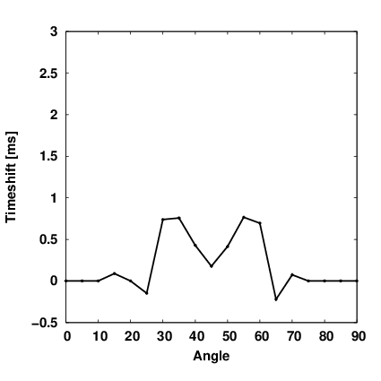
Finite frequency experiment 1.
Method:
Generate “real” data by finite difference exploding a source and measuring at the curved surface. The width of the velocity anomaly is $a=250m$, and the characteristic wavelength of the propagated source is, $λ=v_{0}τ$, such that $a/λ=1.5$

Slide 13
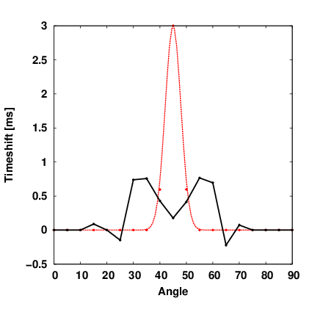
Finite frequency experiment 1.
Method:
Calculate straight rays between the source point and receivers and integrate these rays in the model containing the scatterer.

Slide 14
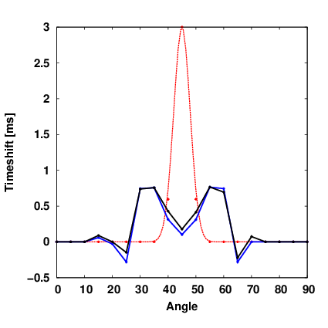
Finite frequency experiment 1.
Method:
Calculate straight rays between the source point and receivers and dynamically integrate these in the model containing the scatterer, calculating the travel time by integrating the 3D Fréchet volume kernels.

Slide 15
Finite frequency experiment 2.
Aim:
Compare results between “thin ray” tomography and “finite frequency tomography” in the recovery of an $η$ anomaly, using either transmission/ reflection or both branches.

Slide 16
Finite frequency experiment 2.
Method:
Generate $8[km]$offset reflection and transmission travel time data between a single shot and receiver in a $v=2000\left[ms^{−1}\right]+0.8z$ velocity model, containing an $η$ anomaly. The characteristic wavelength, $λ=vτ$ of the modelled data, at the depth of the anomaly [2.5km] is ~400m. The vertical size of the anomaly is 700m. The reflection takes place at a depth of 3.5[km].
$$0$$
$$η$$
$$0.2$$
$$0$$
$$η$$
$$0.2$$
$$0$$
$$1$$
$$z[km]$$
$$ξ$$
3.5
$$0$$
$$1$$
$$x[km]$$
$$9$$
$$1$$
$$x[km]$$
$$9$$

Slide 17
Finite frequency experiment 2.
Method:
Remove the $η$ anomaly and regenerate the data, picking the travel time residual for both the reflection and transmission branches. The picked residuals were found to be:
$${dt}_{transmission}=−122.35ms$$
$${dt}_{reflection}=−46.1ms$$

Slide 18
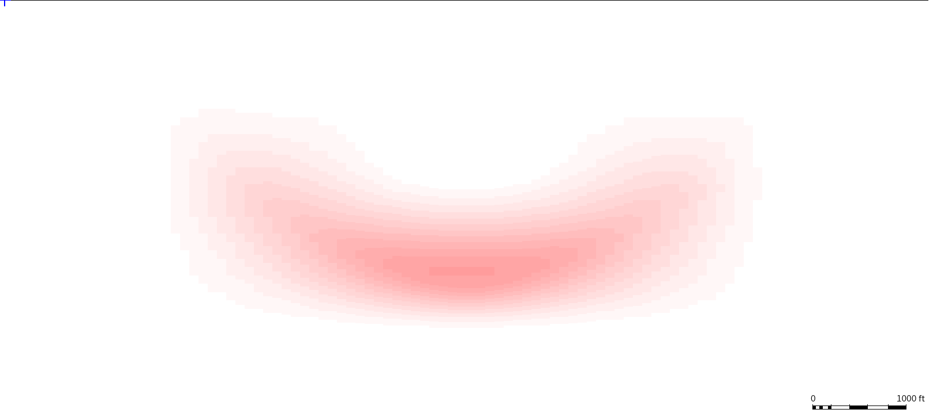
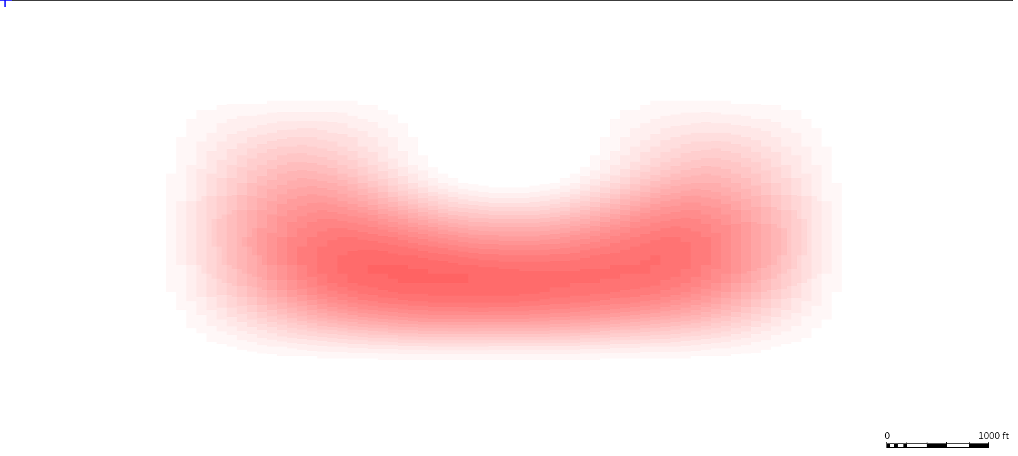
Finite frequency experiment 2.
Method:
Find a solution update, $δη,$ to the inverse tomography problem, $dt=Aδη$, where, $A,$is the Jacobian of sensitivities calculated via the high frequency ray approximation (Ray), or via the 3D volume Fréchet kernels (FFTomo), using the $η$ derivative of the Eikonal equation. Apply the update, and recalculate, $dt$.
$$0$$
$$η$$
$$0.2$$
$$0$$
$$η$$
$$0.2$$
$$0$$
$$1$$
Ray – reflection branch only. $dt$ reduced from $−46.1\left[ms^{−1}\right]$ to $−7.41\left[ms^{−1}\right]$
Residual improvmet: $83.9\%$
FFTomo – reflection branch only. $dt$ reduced from $−46.1\left[ms^{−1}\right]$ to $7.68\left[ms^{−1}\right]$
Residual improvmet: $116.7\%$
$$z[km]$$
$$ξ$$
3.5
$$0$$
$$1$$
$$x[km]$$
$$9$$
$$1$$
$$x[km]$$
$$9$$

Slide 19
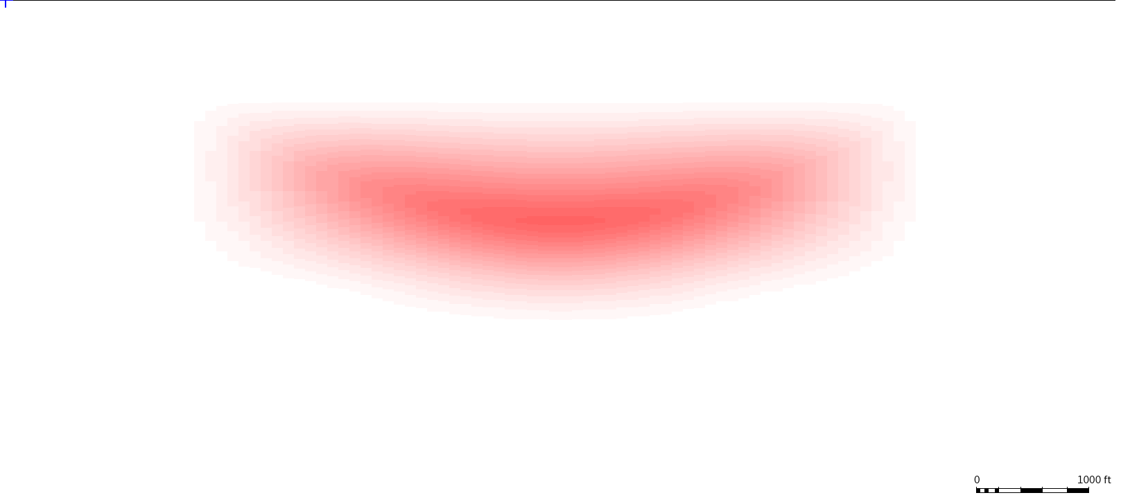
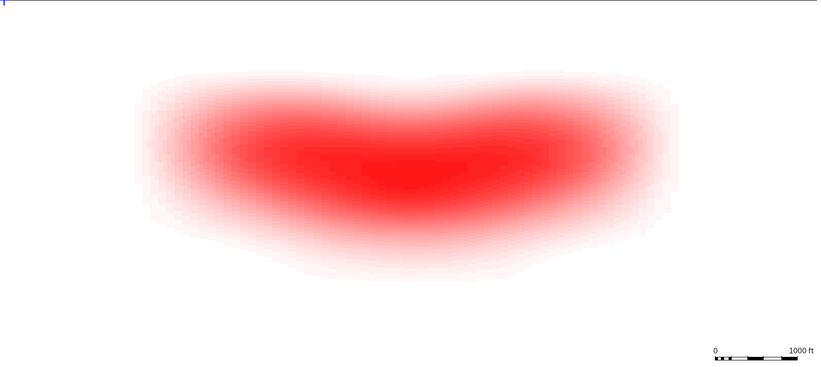
Finite frequency experiment 2.
Method:
Find a solution update, $δη,$ to the inverse tomography problem, $dt=Aδη$, where, $A,$is the Jacobian of sensitivities calculated via the high frequency ray approximation (Ray), or via the 3D volume Fréchet kernels (FFTomo), using the $η$ derivative of the Eikonal equation. Apply the update, and recalculate, $dt$.
$$0$$
$$η$$
$$0.2$$
$$0$$
$$η$$
$$0.2$$
$$0$$
$$1$$
Ray – transmission branch only. $dt$ reduced from $−122.35\left[ms^{−1}\right]$ to $−29.47\left[ms^{−1}\right]$
Residual improvmet: $75.9\%$
FFTomo – transmission branch only. $dt$ reduced from $−122.35\left[ms^{−1}\right]$ to $−2.87\left[ms^{−1}\right]$
Residual improvmet: $97.6\%$
$$z[km]$$
$$ξ$$
3.5
$$0$$
$$1$$
$$x[km]$$
$$9$$
$$1$$
$$x[km]$$
$$9$$

Slide 20
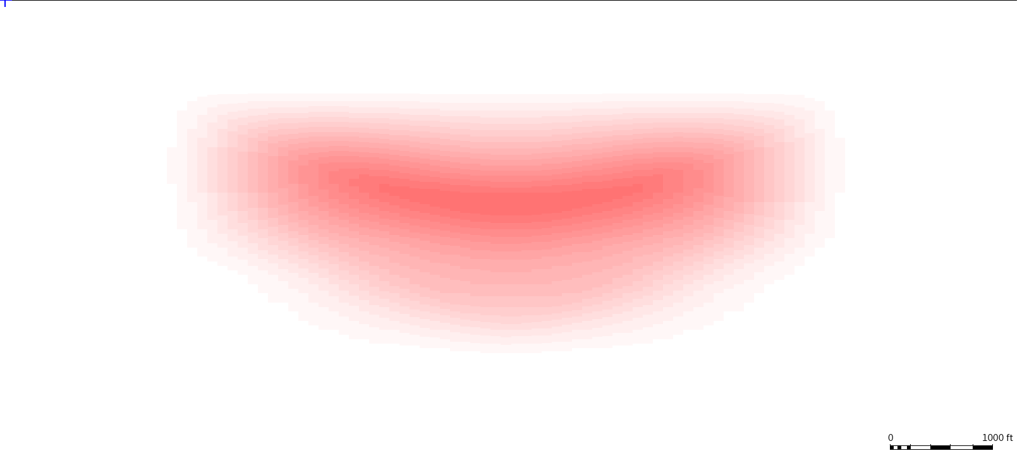
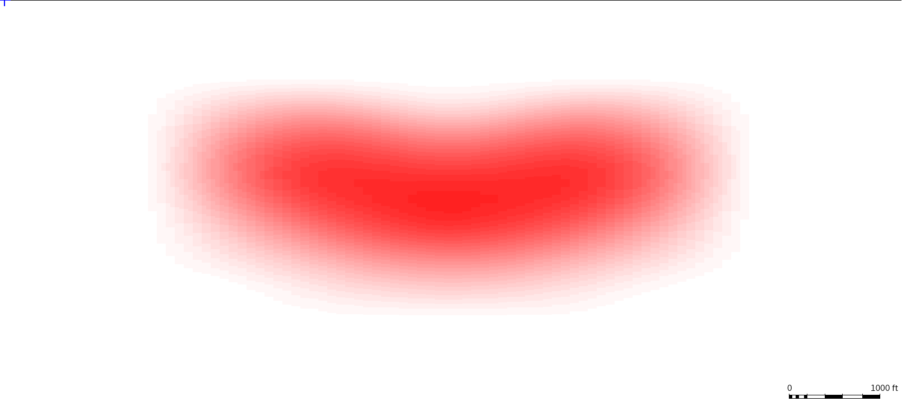
Finite frequency experiment 2.
Method:
Find a solution update, $δη,$ to the inverse tomography problem, $dt=Aδη$, where, $A,$is the Jacobian of sensitivities calculated via the high frequency ray approximation (Ray), or via the 3D volume Fréchet kernels (FFTomo), using the $η$ derivative of the Eikonal equation. Apply the update, and recalculate, $dt$.
$$0$$
$$η$$
$$0.2$$
$$0$$
$$η$$
$$0.2$$
$$0$$
$$1$$
Ray – both branches. $dt$ reduced from $−84.22\left[ms^{−1}\right]$ to $−18.97\left[ms^{−1}\right]$
Residual improvmet: $77.47\%$
FFTomo – both branches. $dt$ reduced from $−84.22\left[ms^{−1}\right]$ to $−1.78\left[ms^{−1}\right]$
Residual improvmet: $97.9\%$
$$z[km]$$
$$ξ$$
3.5
$$0$$
$$1$$
$$x[km]$$
$$9$$
$$1$$
$$x[km]$$
$$9$$

Slide 21
Conclusions for experiment 2.
Due to the horizontal propagation of the central ray, the diving wave is most sensitive to the changes in $η$and this is seen in both the updates for ray and FFTomo.
However, due to the extra infill of the Jacobian from the 3D volume Frechet integration, FFTomo shows both a significant decrease in the residual compared to ray only and better recovers the shape and magnitude of the $η$, anomaly.
The smoothing parameters have been balanced to ensure the same smoothing is applied between a ray inversion, and an FFTomo inversion.

Slide 22
General conclusions
An extension has been made to the ray-based method to include a single scattering approximation allowing for finite frequency tomography with 3D Fréchet kernel sensitivities to orthorhombic parameters.
FFTomo offers an efficient and robust way to introduce finite frequency physics into the ray-based work-flow, while maintaining all the benefits of ray tracing.
Future work will focus on combining FFTomo with finite difference techniques and exploring frequency continuation work-flows.

Slide 23
Reference papers
[1] Spetzler, J, The effect of small-scale heterogeneity on the arrival time of waves, Geophys. J. Int. (2001) 145, 786-796
[2] Dahlen, F, Frechet kernels for finite-frequency traveltimes –I. Theory, Geophys. J. Int. (2000) 141, 157-174
[3] Dahlen, F, Frechet kernels for finite-frequency traveltimes –II. Examples Geophys. J. Int. (2000) 141, 175-203
[4] Montelli, R, Global P and PP traveltime tomography: rays versus waves, Geophys. J. Int. (2004) 158, 637-654
[5] Cerveny, V, Fresnel volume ray tracing, Geophysics, (1992) 57, 902-915
[6] Tsvankin, I, Anisotropic parameters and P-wave velocity for orthorhombic media, Geophysics, (1997) 62, 1292-1309
[7] Pšenčìk, I, First-order ray tracing for qP waves in inhomogeneous weakly anisotropic media, Geophysics, (2005) 70, D65-D75
[8] Favier, N, Sensitivity kernels for shear wave splitting in transverse isotropic media Geophys. J. Int, (2003) 153, 213-228
[9] Alkhalifah, T., Velocity analysis for transversely isotropic media, Geophysics, (1995) 60, 1550-1566
[10] L. Thomsen, Weak elastic anisotropy, Geophysics, (1986) 51, 1954-1966
[11] Spetzler, J, Tutorial the Fresnel volume and transmitted waves, Geophysics, (2004) 69, 653-663

Slide 26
Transmission kernel example (with vel anomaly, not shown)

Slide 27
Standard ray based travel time tomography
Frist order travel time shift predicted by geometrical ray-tracing (isotropic velocity)
$$δ\left(∆T\right)=−\int_{s}^{r}{c^{−2}δcdl}$$
Here:
$δ\left(∆T\right)=δ(T_{B}−T_{A})$ – variation of differential travel time (measured residual in your data, could be RMO)
$c$ – phase velocity
$r,s$ – receiver and shot
$l$ – path length along ray
Computational procedure:
Trace geometrical ray
Compute integral along the ray
[1] F.A. Dahlen, S.-H. Hung and Guust Nolet, Frechet kernels for finite-frequency traveltimes – I. Theory, Geophys. J. Int. 141, 157-174 (2000)

Slide 28
Finite Frequency Tomography using rays
Quick derivation:
Consider an isotropic elastic earth model occupying a volume $⨁$, with boundary $Σ$. Let $G_{rs}\left(t\right)$ be the time-domain Green tensor. The impulse response is given by solving
$LG_{rs}=0$ in $⨁$
$\left[BG_{rs}\right]=0$ on $Σ$
Where L and B are the standard isotropic elastic operators, containing earth parameters $c,β,ρ$, (compressional wave speed, shear wave speed and density respectively).
[1] F.A. Dahlen, S.-H. Hung and Guust Nolet, Frechet kernels for finite-frequency traveltimes – I. Theory, Geophys. J. Int. 141, 157-174 (2000)

Slide 29
Finite Frequency Tomography using rays
We invoke the approximate JWKB solution.
The impulse response is expressed as a sum over all of the body waves that propagate from s to r.
The amplitude is assumed to be slowly varying, but the phase can be rapidly varying (in x and t).
The greens tensor is then given by
$$G_{rs}\left(t\right)=\frac{1}{4π}\sum_{rays}{{\hat{p}}_{r}{\hat{p}}_{s}{\left(ρ_{r}ρ_{s}c_{r}c_{s}^{3}\right)}^{−\frac{1}{2}}}Π_{rs}ℛ_{rs}^{−1}δ_{H}^{(M_{rs})}\left(t−T_{rs}\right)$$
Where:
${\hat{p}}_{r},{\hat{p}}_{s}$ - are unit polarization vectors
$ρ_{r},ρ_{s}$ - are densities along shot a receiver rays
$c_{r},c_{s}$ - are phase velocities along shot and receiver rays
$Π_{rs}$ - production of any reflection / transmission coefficients
$ℛ_{rs}$ - is the geometrical spreading coefficient.
$δ_{H}^{(M_{rs})}$- accounts for the $\frac{π}{2}$ phase shifts due to the passage of the wave through caustics ($M_{rs}$is the Masloz index)
$T_{rs}$ - is the travel-time between shot and receiver.

Slide 30
Finite Frequency Tomography using rays
Perturbation of the greens function under JWKB approximation leads to (Fourier domain):
$$δG_{rs}\left(ω\right)=ω^{2}\iiint_{⊕}{\left[G_{rx}\left(ω\right)⋅\left(ρS\right)⋅G_{xs}\left(ω\right)\right]}d^{3}x$$
Where:
$ω$ – angular frequency
$x$ – scattering location
$S$ – second order scattering tensor

Slide 31
Finite Frequency Tomography using rays
Now we have the perturbed greens tensor, we wish to understand how a variation in the observed differential travel time, $δ\left(∆T\right)$, is dependent on the response of a temporal point source. (long derivation leads to…), our sensitivity kernel within the JWKB approximation (for a single phase):
$$δ\left(∆T\right)=\iiint_{⊕}{\left[K_{c}\left(\frac{δc}{c}\right)+K_{β}\left(\frac{δβ}{β}\right)+K_{ρ}\left(\frac{δρ}{ρ}\right)\right]}$$
$$K_{c,β,ρ}=−\frac{1}{2π}\sum_{{rays}^{′}}{\sum_{{rays}^{′′}}{NΩ_{c,β,ρ}\left(\frac{1}{\sqrt{c^{′}c^{′′}}}\right)\left(\frac{ℛ}{c_{r}ℛ^{′}ℛ^{′′}}\right)\frac{\int_{0}^{∞}{ω^{3}{\left|\dot{m}(ω)\right|}^{2}\sin\left[{ω(T}^{′}+T^{′′}−T)−(M^{′}+M^{′′}−M)π/2\right]}dω}{\int_{0}^{∞}{ω^{2}}{\left|\dot{m}(ω)\right|}^{2}dω}}}$$
Where, ‘ and ‘’ indicate forward and backward rays and:
$N$ – dimensionless term containing reflection/transmission/and other terms for forward and backward rays
$Ω$ – Scattering coefficient, related to the second order scattering tensor
$m\left(ω\right)$ - moment tensor for the point source

Slide 32
Finite Frequency Tomography using rays
Computational procedure:
Trace the geometrical ray corresponding to the phase of interest
Compute $T^{′},T^{′′},M^{′},M^{′′},ℛ^{′},ℛ^{′′},Π^{′},Π^{′′}$and all other factors for this central ray
Trace all possible forward rays from the source and backward rays from the receiver to every scattering point, $x$, in the volume $⊕$.
Compute all quantities as done in 2.), for all these rays
Evaluate the double sum.
Due to the need to trace ALL rays, this procedure can be very computationally expensive.
Instead we look for a paraxial approximation.

Slide 33
Finite Frequency Tomography using rays – Paraxial approximation
Approximations (Forward scattering):
We assume all source to scatter to receiver paths to be of the same ‘type’. So far we assume them to only be P-wave types.
We assume ingoing and outgoing vectors at the scatterer to be identical.
These two assumption reduce:
$$N=1$$
$$Ω_{c,β,ρ}=Ω_{c}=1$$

Slide 34
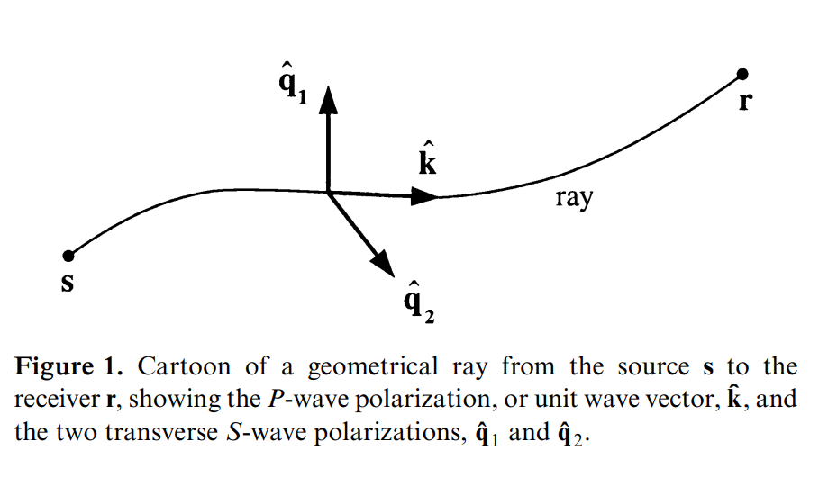
Finite Frequency Tomography using rays – Paraxial approximation
Approximations (Ray centered coordinates):
Express every scatterer in the form $x= ξ+q$, $q= q_{1}{\hat{q}}_{1}+q_{2}{\hat{q}}_{2}$, where, $ξ$, is the nearest point on the central ray.
We assume that the geometrical spreading factor is calculated only on the central ray:
$$\frac{ℛ(r,s)}{c_{r}{ℛ(x,s)}^{′}{ℛ(x,r)}^{′′}}=\frac{ℛ(r,s)}{c_{r}{ℛ(ξ,s)}^{′}{ℛ(ξ,r)}^{′′}}$$

Slide 35
Finite Frequency Tomography using rays – Paraxial approximation
Approximations (Travel time difference):
We assume all the Maslov indices are the same as for the central ray
We only account for the difference in travel time:
$$dt\left(q_{1},q_{2}\right)=T_{xs}+T_{xr}−T_{rs}=\frac{1}{2}q^{T}∙(M_{ξs}+M_{ξr})∙q$$
Where:
$M_{ξs}$,$M_{ξr}$ - are the second partial derivatives of the travel time field at scatterer, $x$, and are 2x2 Hessian matrices

Slide 36
Finite Frequency Tomography using rays – Paraxial approximation
Approximations (Use of the Hessian):
The eigenvalues of the Hessian matrices, ${cM}_{ξs}$,${cM}_{ξr}$ - are the principal curvatures of the forward and backward propagating waves from source and receiver.
It can be shown (not here) that the geometrical spreading factor can be given by (reverting back to ‘, ‘’ notation):
$$\frac{ℛ(r,s)}{c_{r}{ℛ(ξ,s)}^{′}{ℛ(ξ,r)}^{′′}}=\sqrt{\left|\det\left(M^{′}+M^{′′}\right)\right|}$$

Slide 37
Finite Frequency Tomography using rays – Paraxial approximation
Approximations (Approximate the moment tensor):
Instead of integrating over some normalized source time function, $\dot{m}(t)$, we approximate this integral as the derivative of a Gaussian function, which is dependent on frequency, $ω$:
$$\frac{\int_{0}^{∞}{ω^{3}{\left|\dot{m}(ω)\right|}^{2}\sin{φ}}dω}{\int_{0}^{∞}{ω^{2}}{\left|\dot{m}(ω)\right|}^{2}dω}=W(q_{1},q_{2},ω)$$
Where
$$W\left(q_{1},q_{2},ω\right)=8dt\left(q_{1},q_{2}\right)e^{{−\left(\frac{dt(q_{1},q_{2})π}{τ}\right)}^{2}}{\left(\frac{π}{3τ}\right)}^{6}\left({dt(q_{1},q_{2})}^{4}−5{\left(\frac{dt\left(q_{1},q_{2}\right)τ}{π}\right)}^{2}+\frac{15}{4π^{4}}{dt\left(q_{1},q_{2}\right)}^{4}\right)$$
$$φ=ωdt(q_{1},q_{2})$$
$$τ=\frac{4π}{ω}$$

Slide 38
W

Slide 39
Finite Frequency Tomography using rays – Paraxial approximation
Putting all this together, we get the paraxial kernel in ray centered coordinates (for isotropic wave speed, at a certain phase):
$$δ\left(∆T\right)=−\frac{1}{2π}\int_{0}^{L}{dl\iint_{−∞}^{∞}{ⅆq_{1}dq_{2}\frac{δc}{c}\left(1+\frac{q_{1}}{c}\frac{∂c}{∂q_{1}}+\frac{q_{2}}{c}\frac{∂c}{∂q_{2}}\right)}}\sqrt{\left|\det\left(M^{′}+M^{′′}\right)\right|}W(q_{1},q_{2},ω)$$
Computational procedure:
Dynamically trace the central ray from shot to receiver and save in the ray buffer.
For each segment along the ray calculate the geometric spreading factor taking advantage of the simplectic properties of the propagator matrix.
Integrate over the kernel volume. Integration over $q_{1},q_{2}$ is until the integration sum goes to zero.
[1] F.A. Dahlen, S.-H. Hung and Guust Nolet, Frechet kernels for finite-frequency traveltimes – I. Theory, Geophys. J. Int. 141, 157-174 (2000)

Slide 40
Extension to anisotropy (Paraxial approximation)
Paraxial kernel in ray centered coordinates:
$$δ\left(∆T\right)=−\frac{1}{2π}\int_{0}^{L}{dl\iint_{−∞}^{∞}{δm\frac{∂G}{∂m}}}F(Γ,q_{2},q_{1},ω)ⅆq_{1}dq_{2}$$
Where:
$ΔT$ – Residual measurement
$L$ – Length of ray
$F(Γ,q_{2},q_{1},ω)$ – Frequency ($ω$) term containing the 2nd order travel time hessians
$Γ$ – 6x6 Christoffel matrix containing stiffnesses
$m$ – model parameter
$G$ – Eikonal equation describing slowness surface.
[1] F.A. Dahlen, S.-H. Hung and Guust Nolet, Frechet kernels for finite-frequency traveltimes – I. Theory, Geophys. J. Int. 141, 157-174 (2000)

Slide 41
Extension to anisotropy (Paraxial approximation)
For orthorhombic media:
$$G(\underline{x}, \underline{p})≐V_{P0}^{2}\left\{{\left\|\underline{p}\right\|}^{2}+(ε_{1}+ε_{2})(p_{x}^{2}+p_{y}^{2})+\left(ε_{1}−ε_{2}\right)\left[\left(p_{y}^{2}−p_{x}^{2}\right)\cos{2χ}+2p_{x}p_{y}\sin{2χ}\right] \right\}$$
$$−\frac{V_{P0}^{2}}{{\left\|\underline{p}\right\|}^{2}}\left[ (η_{1}+η_{2})(p_{x}^{2}+p_{y}^{2})p_{z}^{2}+\left(η_{1}−η_{2}\right)\left[\left(p_{y}^{2}−p_{x}^{2}\right)\cos{2χ}+2p_{x}p_{y}\sin{2χ}\right]p_{z}^{2}\right]$$
$$−\frac{V_{P0}^{2}}{{2\left\|\underline{p}\right\|}^{2}}η_{3}{\left(2p_{x}p_{y}\cos{2χ}−\left(p_{y}^{2}−p_{x}^{2}\right)\sin{2χ}\right)}^{2}$$
Where:
$V_{P0},ε_{1},ε_{2},η_{1},η_{2},η_{3},χ$ – Anisotropy parameters in their respective planes of symmetry.
$p_{x},p_{y},p_{z}$ – Slowness vector
[2] E.Wright, P. Bakker, Travel time inversion within tri-elliptic and orthorhombic media: theory, implementation, and examples. SR.15.11797 (2015)

Slide 42
Thin rays
Back ground model
Back ground model + velocity anomaly
Ray tracer does not “see” the
velocity anomaly at non zero
offset
Therefore Jacobians along the
ray are also insensitive to the
anomaly

Slide 43
Kernels
Back ground model
Back ground model + velocity anomaly
Ray tracer does not “see” the
velocity anomaly at non zero
offset.
Volume integral of kernel does
”see” the anomaly. Therefore
Jacobians are sensitive to the
anomaly.

Slide 44
Kernel update compared with conventional ray update
Eastern Flank Synthetic

Slide 45
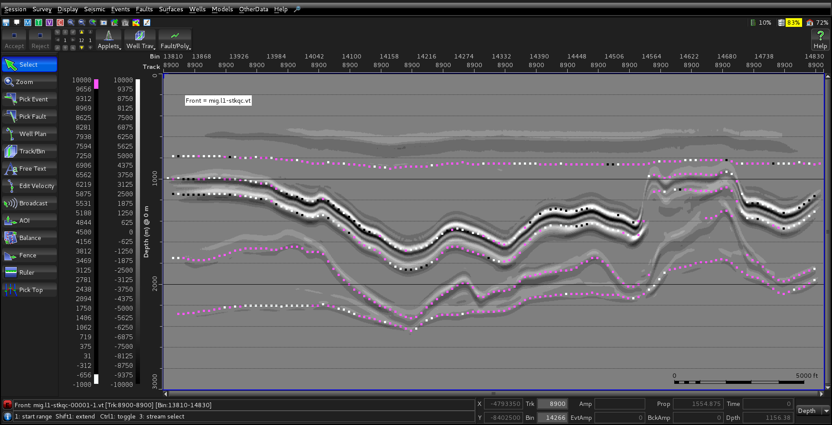
Stack
Stack using true model, with velocity
Stack using migration model, with picks
NOTE: Sign (color) of picks indicates
what sign (color) the velocity update
should be – outliers only

Slide 46
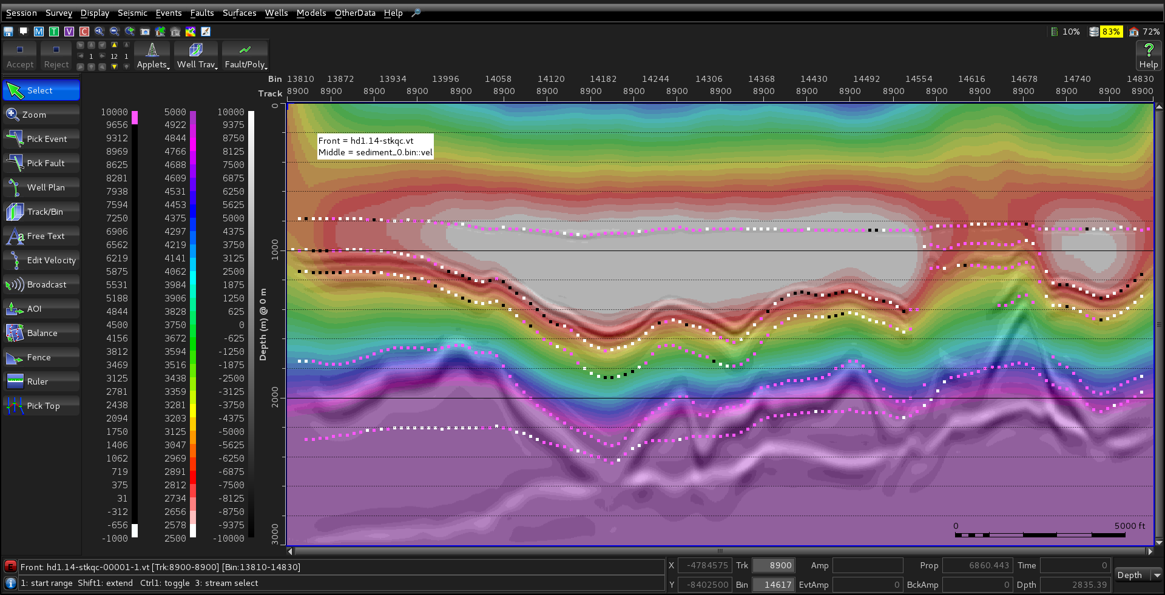
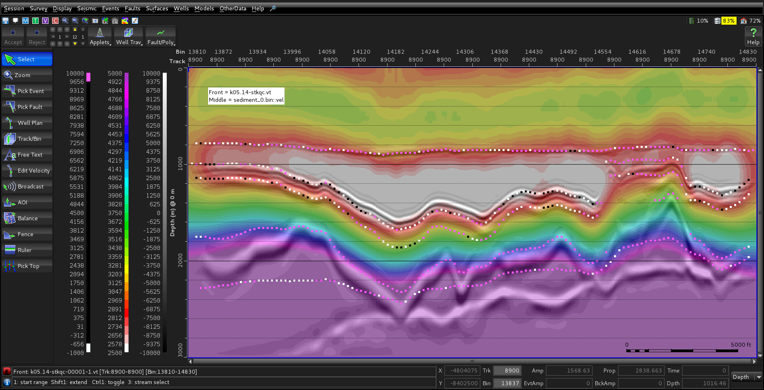
Velocity update (over stack)
Ray
Kernel 5Hz

Slide 47
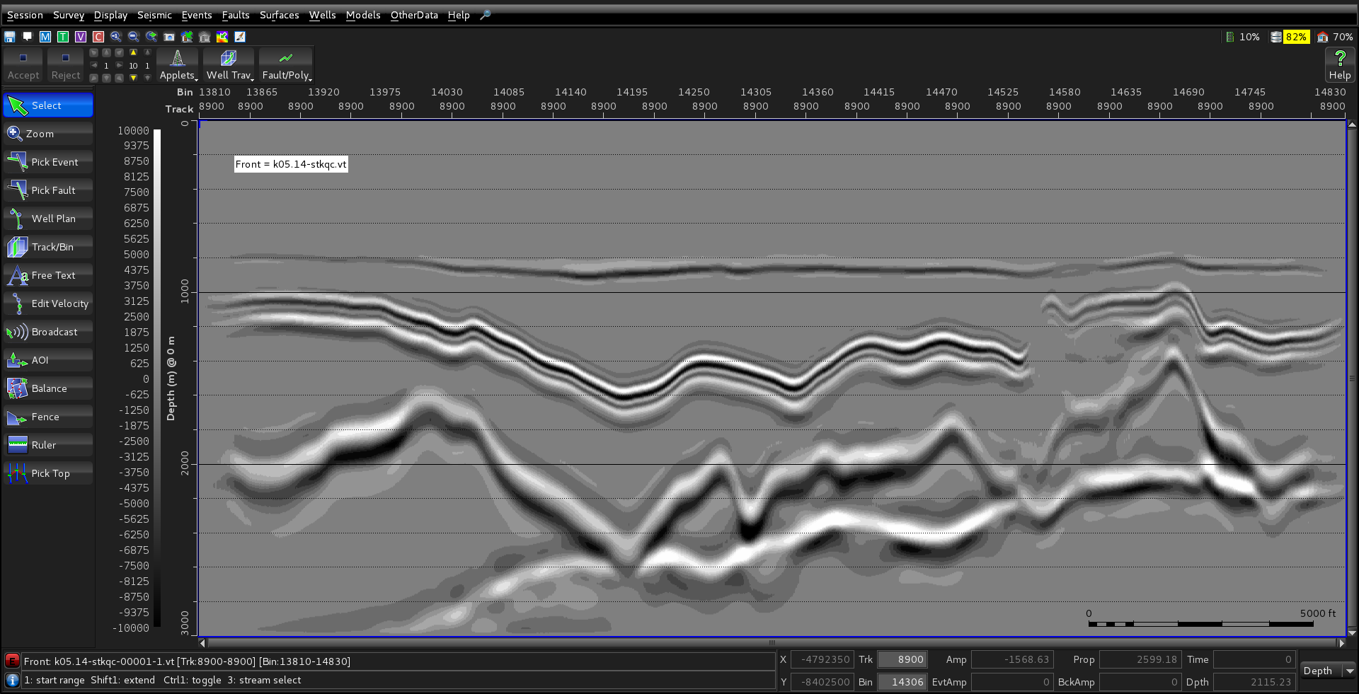
Stack comparison
Ray
Kernel 5Hz

Slide 48
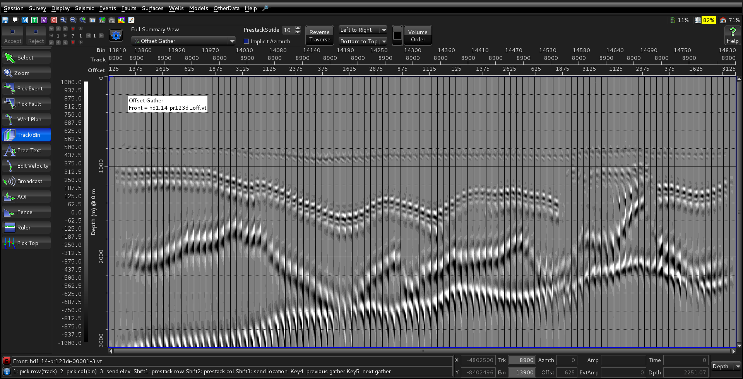
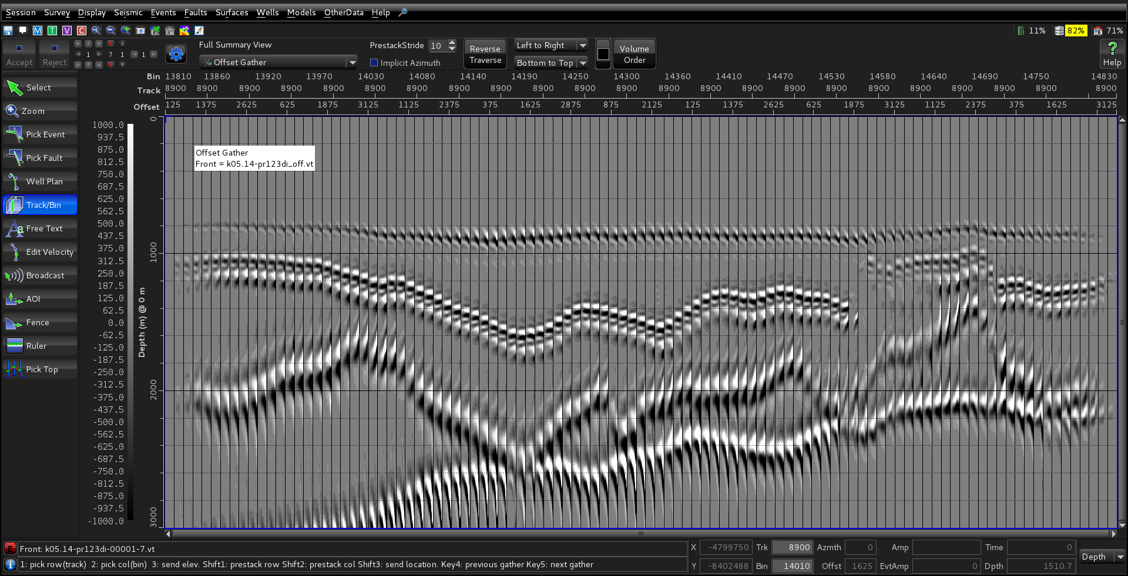
Gathers comparison
Ray
Kernel 5Hz

